Slide 1

8
Integration Techniques and Improper Integrals
P
Copyright © Cengage Learning. All rights reserved.

Slide 2

8.6
Numerical Integration
Copyright © Cengage Learning. All rights reserved.

Slide 3
Objectives
Approximate a definite integral using the Trapezoidal Rule.
Approximate a definite integral using Simpson’s Rule.
Analyze the approximate errors in the Trapezoidal Rule and Simpson’s Rule.

Slide 4
The Trapezoidal Rule

Slide 5

The Trapezoidal Rule
Some elementary functions simply do not have antiderivatives that are elementary functions. For example, there is no elementary function that has any of the following functions as its derivative.
If you need to evaluate a definite integral involving a function whose antiderivative cannot be found, then while the Fundamental Theorem of Calculus is still true, it cannot be easily applied. In this case, it is easier to resort to an approximation technique.

Slide 6
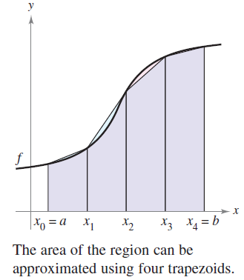

The Trapezoidal Rule
One way to approximate a definite integral is to use n trapezoids, as shown in Figure 8.14.
In the development of this method,
assume that f is continuous and positive on the interval [a, b]. So, the definite integral
represents the area of the region bounded by the graph of f and the x-axis, from x = a to x = b.
Figure 8.14

Slide 7
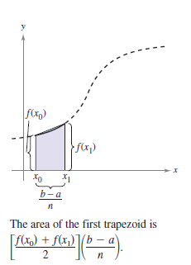

The Trapezoidal Rule
First, partition the interval [a, b] into n subintervals, each of width Δx = (b − a)/n, such that
Then form a trapezoid for each subinterval (see Figure 8.15). The area of the ith trapezoid is
Figure 8.15

Slide 8
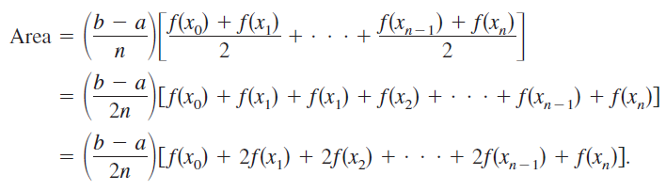
The Trapezoidal Rule
This implies that the sum of the areas of the n trapezoids is

Slide 9
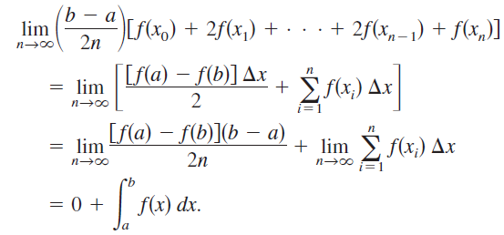
The Trapezoidal Rule
Letting Δx = (b − a)/n, you can take the limit as to obtain
The result is summarized in the next theorem.

Slide 10
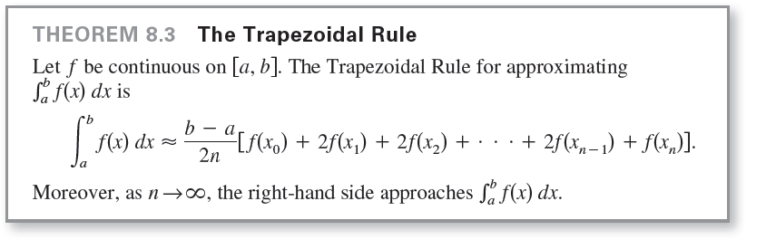
The Trapezoidal Rule

Slide 11

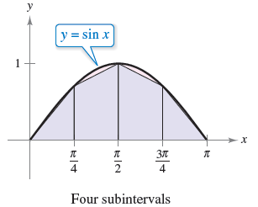
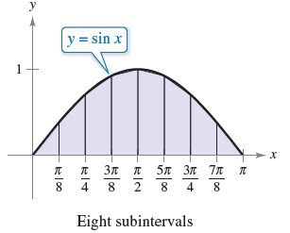
Example 1 – Approximation with the Trapezoidal Rule
Use the Trapezoidal Rule to approximate
Compare the results for n = 4 and n = 8, as shown in Figure 8.16.
Figure 8.16

Slide 12





Example 1 – Solution
When n = 4, , and you obtain

Slide 13




Example 1 – Solution
cont’d
When n = 8, , and you obtain
For this particular integral, you could have found an antiderivative and determined that the exact area of the region is 2.

Slide 14
Simpson’s Rule

Slide 15
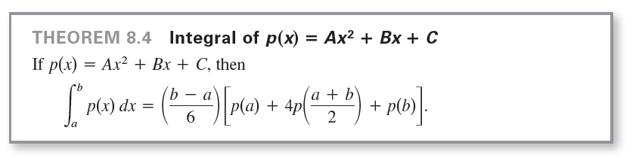
Simpson’s Rule
One way to view the trapezoidal approximation of a definite integral is to say that on each subinterval, you approximate f by a first-degree polynomial. In Simpson’s Rule, you take this procedure one step further and approximate f by second-degree polynomials.
Before presenting Simpson’s Rule, consider the following theorem for evaluating integrals of polynomials of degree 2 (or less).

Slide 16
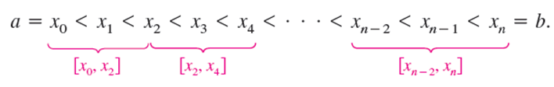

Simpson’s Rule
To develop Simpson’s Rule for approximating a definite integral, you again partition the interval [a, b] into n subintervals, each of width . This time, however, n is required to be even, and the subintervals are grouped in pairs such that
On each (double) subinterval you can approximate f by a polynomial p of degree less than or equal to 2.

Slide 17




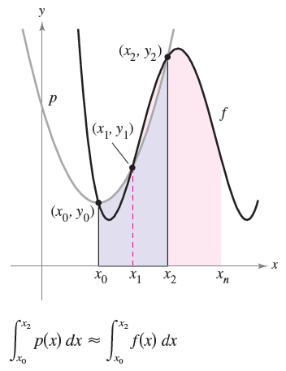
Simpson’s Rule
For example, on the subinterval choose the polynomial of least degree passing through the points and as shown in Figure 8.17.
Figure 8.17

Slide 18
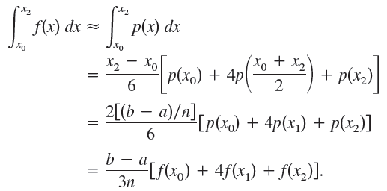
Simpson’s Rule
Now, using p as an approximation of f on this subinterval, you have, by Theorem 8.4,
Repeating this procedure on the entire interval [a, b] produces the next theorem.

Slide 19
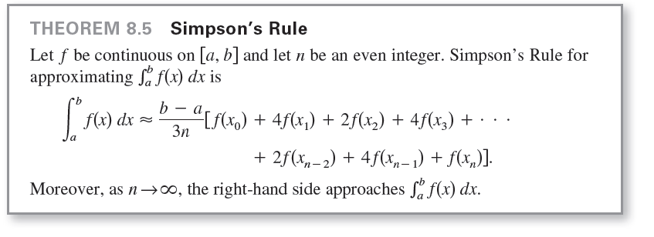
Simpson’s Rule

Slide 20

Example 2 – Approximation with Simpson’s Rule
Use Simpson’s Rule to approximate
Compare the results for n = 4 and n = 8.
Solution:
When n = 4, you have
When n = 8, you have

Slide 21
Error Analysis

Slide 22
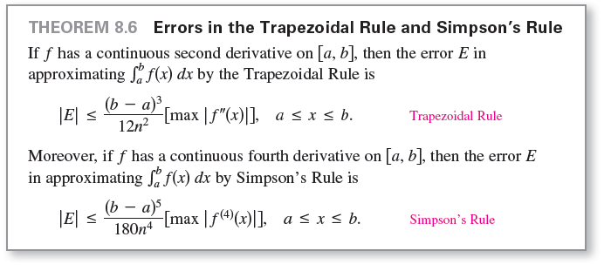
Error Analysis
When you use an approximation technique, it is important to know how accurate you can expect the approximation to be. The following theorem, gives the formulas for estimating the errors involved in the use of Simpson’s Rule and the Trapezoidal Rule.

Slide 23



Error Analysis
In general, when using an approximation, you can think of the error E as the difference between and the approximation.
Theorem 8.6 states that the errors generated by the Trapezoidal Rule and Simpson’s Rule have upper bounds dependent on the extreme values of and in the interval [a, b]. Furthermore, these errors can be made arbitrarily small by increasing n, provided that and are continuous and therefore bounded in [a, b].

Slide 24




Example 3 –The Approximate Error in the Trapezoidal Rule
Determine a value of n such that the Trapezoidal Rule will approximate the value of
with an error that is less than or equal to 0.01.
Solution:
Begin by letting and finding the second derivative of f.
and
The maximum value of on the interval [0, 1] is

Slide 25


Example 3 – Solution
cont’d
So, by Theorem 8.6, you can write
To obtain an error E that is less than or equal to 0.01, you must choose n such that

Slide 26
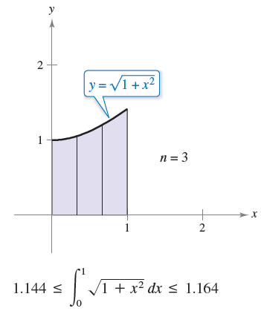


Example 3 – Solution
cont’d
So, you can choose n = 3 (because n must be greater than or equal to 2.89) and apply the Trapezoidal Rule, as shown in Figure 8.18,
to obtain
Figure 8.18

Slide 27

Example 3 – Solution
cont’d
So, by adding and subtracting the error from this estimate, you know that,

