Slide 1

8
Integration Techniques and Improper Integrals
P
Copyright © Cengage Learning. All rights reserved.

Slide 2

8.3
Trigonometric Integrals
Copyright © Cengage Learning. All rights reserved.

Slide 3
Objectives
Solve trigonometric integrals involving powers of sine and cosine.
Solve trigonometric integrals involving powers of secant and tangent.
Solve trigonometric integrals involving sine-cosine products.

Slide 4
Integrals Involving Powers of Sine and Cosine

Slide 5
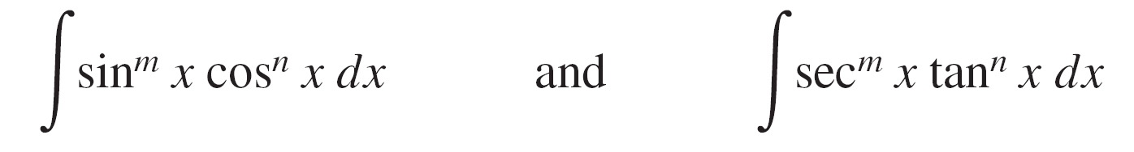
Integrals Involving Powers of Sine and Cosine
In this section, you will study techniques for evaluating integrals of the form
where either m or n is a positive integer.
To find antiderivatives for these forms, try to break them into combinations of trigonometric integrals to which you can apply the Power Rule.

Slide 6
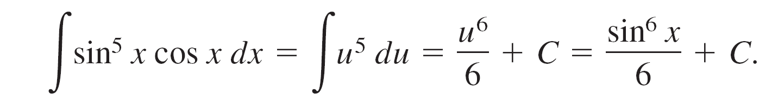
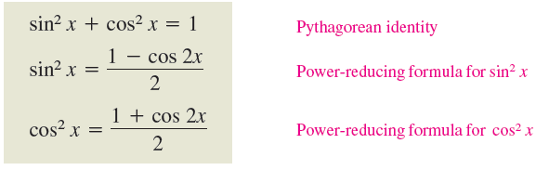
Integrals Involving Powers of Sine and Cosine
For instance, you can find ∫ sin⁵ x cos x dx with the Power Rule by letting u = sin x. Then, du = cos x dx and you have
To break up ∫ sin^{m} x cos^{n} x dx into forms to which you can apply the Power Rule, use the following relationships.

Slide 7
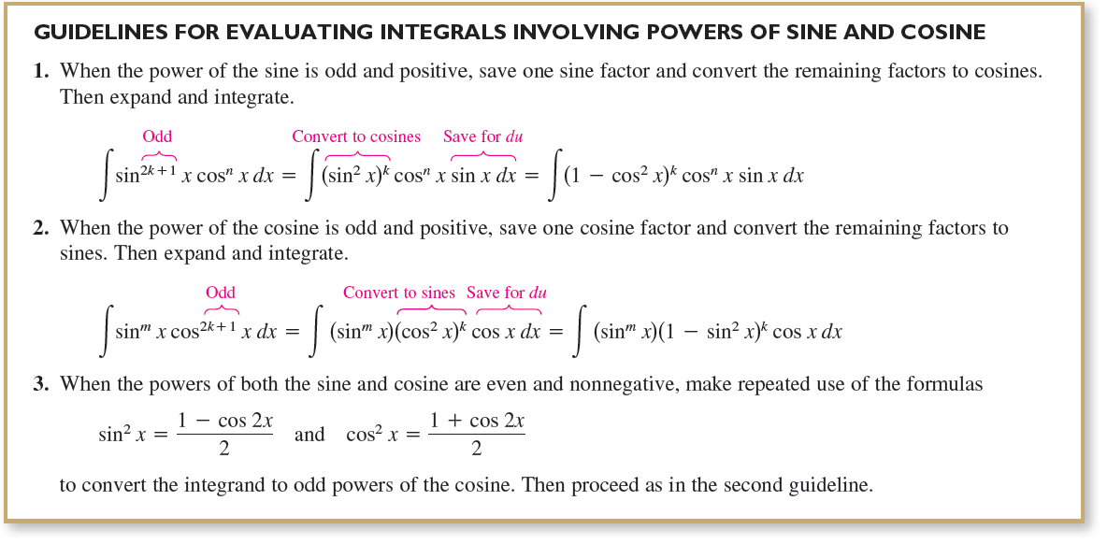
Integrals Involving Powers of Sine and Cosine

Slide 8
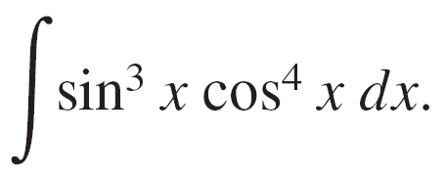
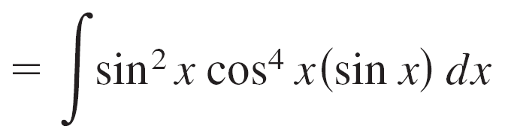
Example 1 – Power of Sine Is Odd and Positive
Find
Solution:
Because you expect to use the Power Rule with u = cos x, save one sine factor to form du and convert the remaining sine factors to cosines.

Slide 9
Example 1 – Solution
cont’d

Slide 10
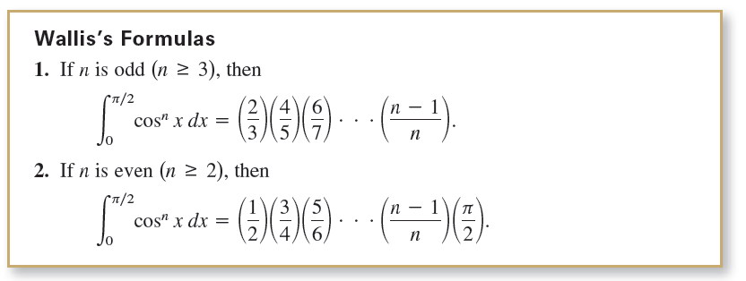
Integrals Involving Powers of Sine and Cosine
These formulas are also valid when cos^{n} x is replaced by sin^{n} x.

Slide 11
Integrals Involving Powers of Secant and Tangent

Slide 12

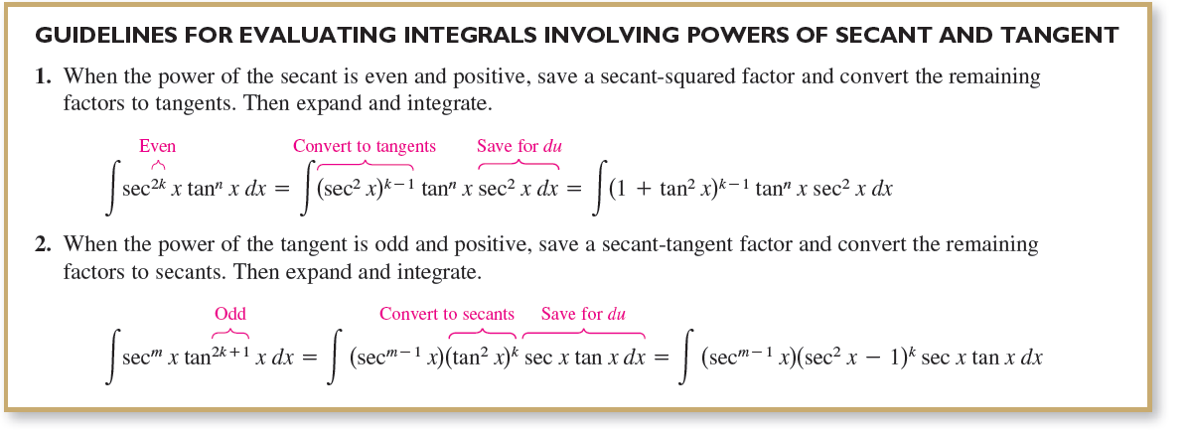
Integrals Involving Powers of Secant and Tangent
The guidelines below can help you find integrals of the form

Slide 13
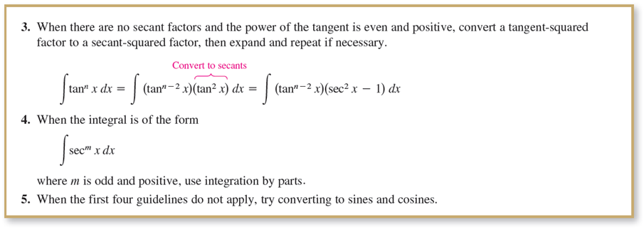
Integrals Involving Powers of Secant and Tangent
cont’d

Slide 14
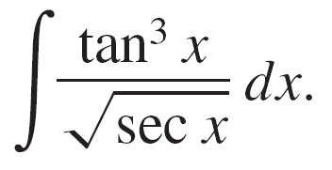




Example 4 – Power of Tangent Is Odd and Positive
Find
Solution:
Because you expect to use the Power Rule with u = sec x, save a factor of (sec x tan x) to form du and convert the remaining tangent factors to secants.

Slide 15




Example 4 – Solution
cont’d

Slide 16
Integrals Involving Sine-Cosine Products

Slide 17
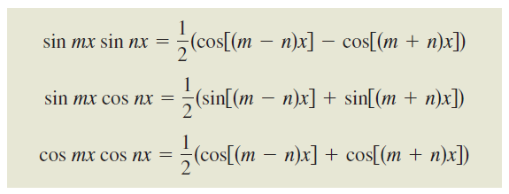
Integrals Involving Sine-Cosine Products
Integrals involving the products of sines and cosines of two angles occur in many applications.
In such instances, you can use the following product-to-sum formulas.

Slide 18
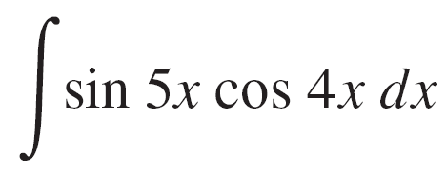
Example 8 – Using a Product-to-Sum Formula
Find
Solution:
Considering the second product-to-sum formula, you can write

