Slide 1

8
Integration Techniques and Improper Integrals
P
Copyright © Cengage Learning. All rights reserved.

Slide 2

8.1
Basic Integration Rules
Copyright © Cengage Learning. All rights reserved.

Slide 3
Objective
Review procedures for fitting an integrand to one of the basic integration rules.

Slide 4
Fitting Integrands to Basic Integration Rules

Slide 5
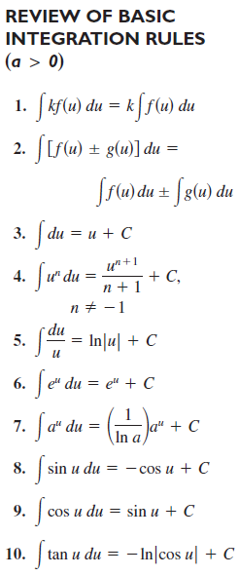
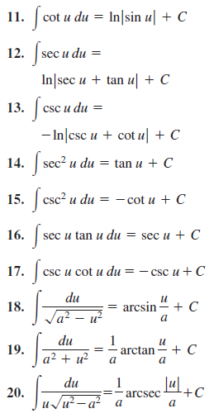
Fitting Integrands to Basic Integration Rules

Slide 6



Example 1 – A Comparison of Three Similar Integrals
Find each integral.

Slide 7



Example 1(a) – Solution
Use the Arctangent Rule and let u = x and a = 3.

Slide 8

Example 1(b) – Solution
cont’d
The Arctangent Rule does not apply because the numerator contains a factor of x.
Consider the Log Rule and let u = x² + 9. Then du = 2x dx, and you have

Slide 9



Example 1(c) – Solution
cont’d
Because the degree of the numerator is equal to the degree of the denominator, you should first use division to rewrite the improper rational function as the sum of a polynomial and a proper rational function.

Slide 10
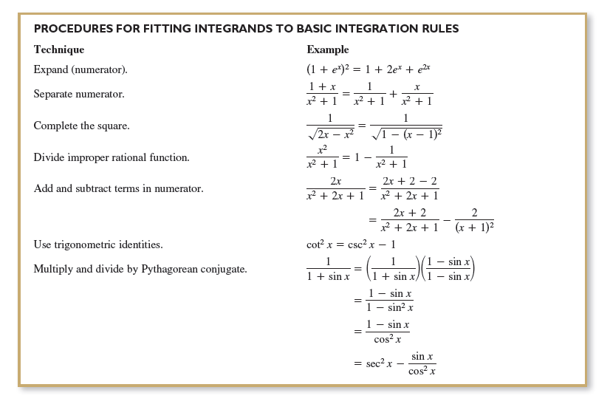
Fitting Integrands to Basic Integration Rules

