Slide 1
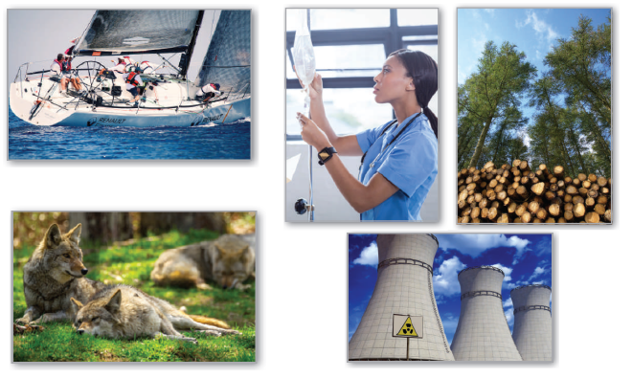
6
P
Differential Equations
Copyright © Cengage Learning. All rights reserved.

Slide 2

First-Order Linear Differential Equations
6.4
Copyright © Cengage Learning. All rights reserved.

Slide 3
Objective
Solve a first-order linear differential equation, and use linear differential equations to solve applied problems.

Slide 4
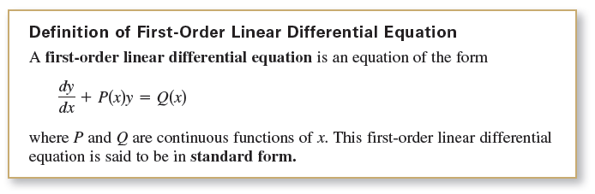
First-Order Linear Differential Equations
You will see how to solve a very important class of
first-order differential equations—first-order linear
differential equations.

Slide 5
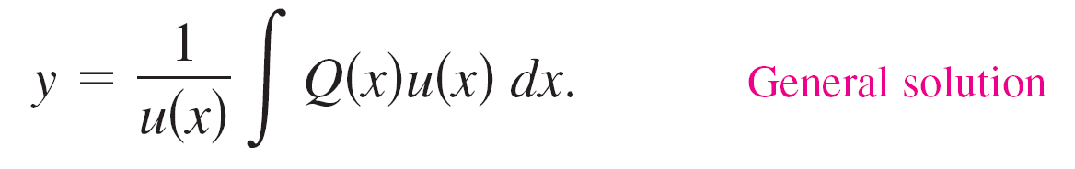
First-Order Linear Differential Equations
To solve a linear differential equation, write it in standard form to identify the functions P(x) and Q(x).
Then integrate P(x) and form the expression
which is called an integrating factor. The general solution of the equation is

Slide 6


First-Order Linear Differential Equations
It is instructive to see why the integrating factor helps solve a linear differential equation of the form y' = P(x)y = Q(x).
When both sides of the equation are multiplied by the integrating factor the left side becomes the derivative of a product.
Integrating both sides of this second equation and dividing by u(x) produce the general solution.

Slide 7

Example 1 – Solving a Linear Differential Equation
Find the general solution of
y' + y = e^{x}.
Solution:
For this equation, P(x) = 1 and Q(x) = e^{x}.
So, the integrating factor is

Slide 8
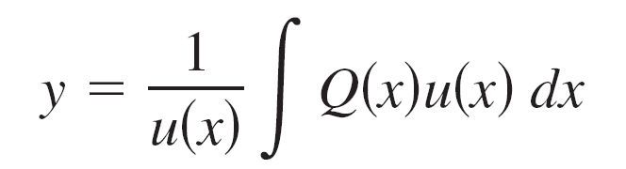
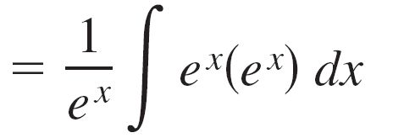
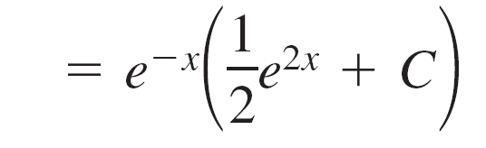

Example 1 – Solution
cont’d
This implies that the general solution is

Slide 9
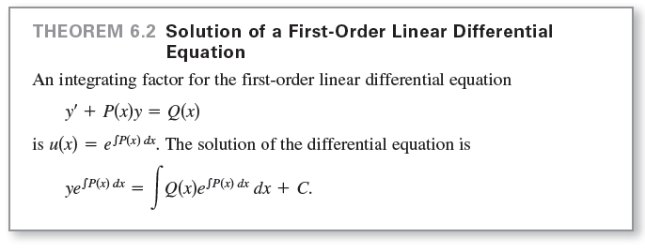
First-Order Linear Differential Equations

Slide 10


Example 2 – Solving a First-Order Linear Differential Equation
Find the general solution of xy' – 2y = x², x > 0.
Solution:
The standard form of the equation is
So, P(x) = –2/x, and you have

Slide 11

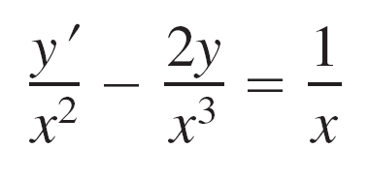
Example 2 – Solution
cont’d
which implies that the integrating factor is
So, multiplying each side of the standard form by 1/x² yields

Slide 12
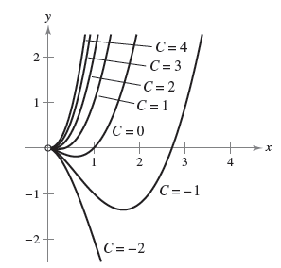
Example 2 – Solution
cont’d
Several solution curves
(for C = –2, –1, 0, 1, 2, 3, and 4)
are shown in Figure 6.18.
Figure 6.18

Slide 13

First-Order Linear Differential Equations
In most falling-body problems discussed so far, air resistance has been neglected. The next example includes this factor.
In the example, the air resistance on the falling object is assumed to be proportional to its velocity v. If g is the acceleration due to gravity, the downward force F on a falling object of mass m is given by – mg – kv. If a is the acceleration of the object, then by Newton’s Second Law of Motion,

Slide 14

First-Order Linear Differential Equations
which yields the following differential equation.

Slide 15

Example 3 – A Falling Object with Air Resistance
An object of mass m is dropped from a hovering helicopter. The air resistance is proportional to the velocity of the object. Find the velocity of the object as a function of time t.
Solution:
The velocity v satisfies the equation
Letting b = k /m, you can separate variables to obtain

Slide 16




Example 3 – Solution
cont’d
Because the object was dropped, v = 0 when t = 0;
so g = C, and it follows that

Slide 17
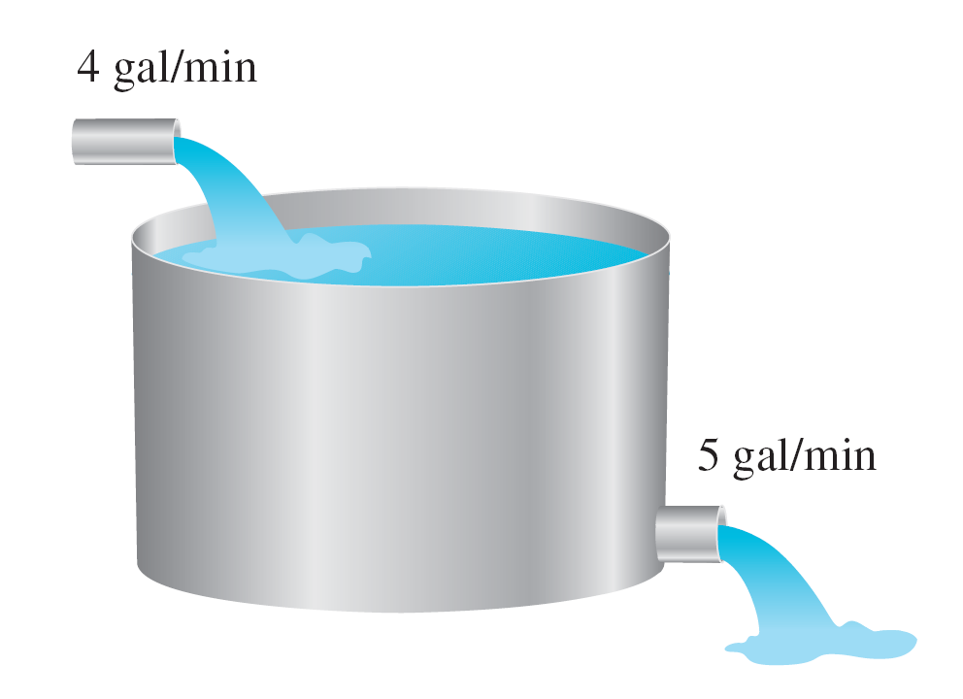
Example 5 – A Mixture Problem
A tank contains 50 gallons of a solution composed of 90% water and 10% alcohol. A second solution containing 50% water and 50% alcohol is added to the tank at the rate of 4 gallons per minute. As the second solution is being added, the tank is being drained at a rate of 5 gallons per minute, as shown in Figure 6.20. The solution in the tank is stirred constantly. How much alcohol is in the tank after 10 minutes?
Figure 6.20

Slide 18


Example 5 – Solution
Let y be the number of gallons of alcohol in the tank at any time t. You know that y = 5 when t = 0.
Because the number of gallons of solution in the tank at any time is 50 – t, and the tank loses 5 gallons of solution per minute, it must lose
gallons of alcohol per minute.
Furthermore, because the tank is gaining 2 gallons of alcohol per minute, the rate of change of alcohol in the tank is

Slide 19

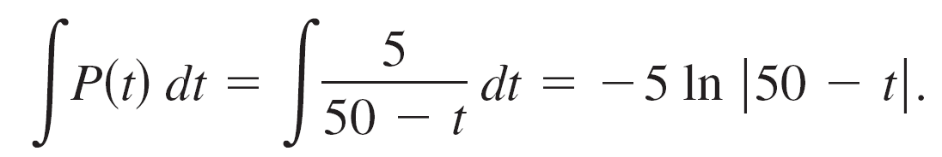

Example 5 – Solution
cont’d
To solve this linear differential equation, let
and obtain
Because t < 50, you can drop the absolute value signs and conclude that

Slide 20




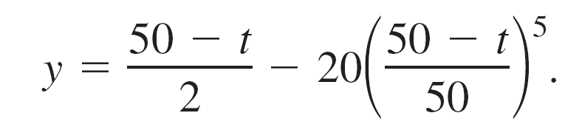
Example 5 – Solution
cont’d
So, the general solution is
Because y = 5 when t = 0, you have
which means that the particular solution is

Slide 21
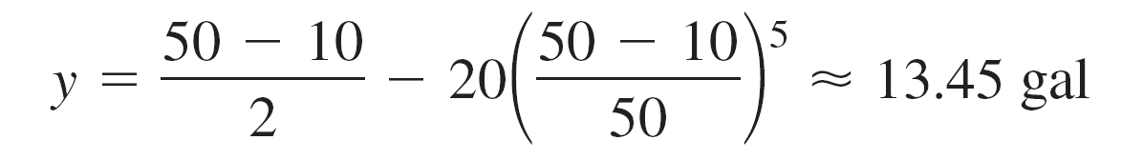
Example 5 – Solution
cont’d
Finally, when t = 10, the amount of alcohol in the tank is
which represents a solution containing 33.6% alcohol.

