Slide 1
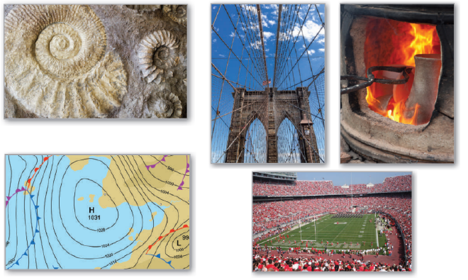
5
Logarithmic, Exponential, and Other Transcendental Functions
P
Copyright © Cengage Learning. All rights reserved.

Slide 2

Exponential Functions: Differentiation and Integration
5.4
Copyright © Cengage Learning. All rights reserved.

Slide 3
Objectives
Develop properties of the natural exponential function.
Differentiate natural exponential functions.
Integrate natural exponential functions.

Slide 4
The Natural Exponential Function

Slide 5
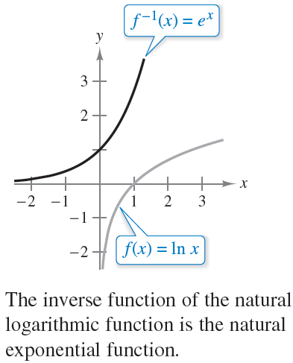
The Natural Exponential Function
The function f(x) = ln x is increasing on its entire domain, and therefore it has an inverse function f ^{–1}.
The domain of f ^{–1} is the set of all real numbers, and the range is the set of positive real numbers, as shown in Figure 5.18.
Figure 5.18

Slide 6
The Natural Exponential Function
So, for any real number x,
If x is rational, then
Because the natural logarithmic function is one-to-one, you can conclude that f ^{–1}(x) and e^{x} agree for rational values of x.

Slide 7
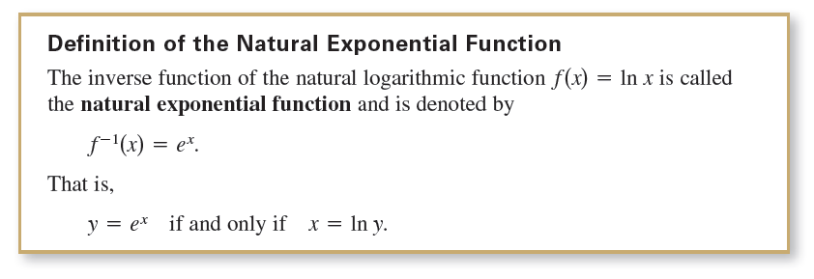

The Natural Exponential Function
The next definition extends the meaning of e^{x} to include all real values of x.
The inverse relationship between the natural logarithmic function and the natural exponential function can be summarized as follows.

Slide 8
Example 1 – Solving an Exponential Equation
Solve 7 = e^{x + 1}.
Solution:
You can convert from exponential form to logarithmic form by taking the natural logarithm of each side of the equation.
So, the solution is –1 + ln 7 ≈ 0.946.

Slide 9


Example 1 – Solution
cont’d
You can check the solution as shown.

Slide 10
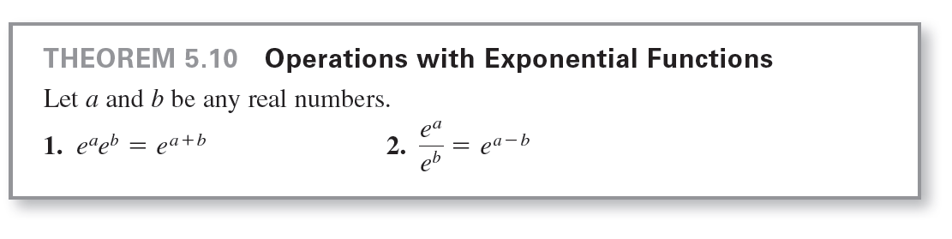
The Natural Exponential Function
The familiar rules for operating with rational exponents can be extended to the natural exponential function, as shown in the next theorem.

Slide 11
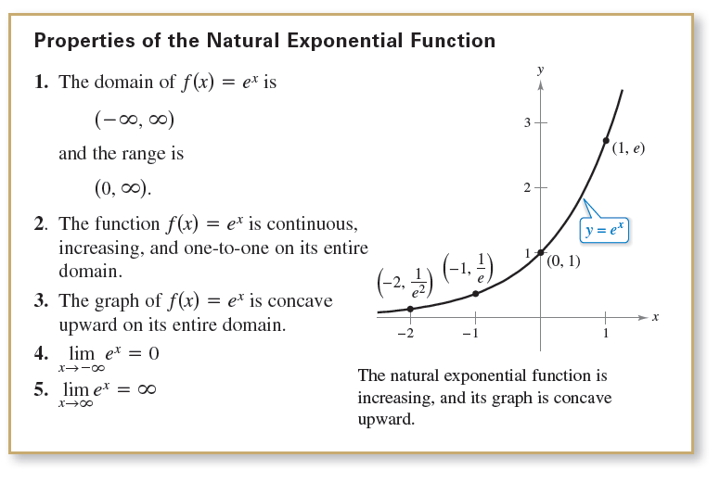
The Natural Exponential Function
An inverse function f ^{–1} shares many properties with f.
So, the natural exponential function inherits the properties listed below from the natural logarithmic function.

Slide 12
Derivatives of Exponential Functions

Slide 13
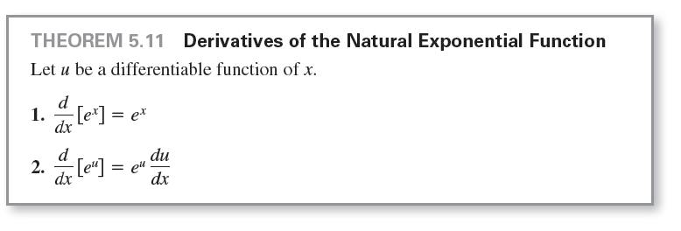
Derivatives of Exponential Functions
One of the most intriguing (and useful) characteristics of the natural exponential function is that it is its own derivative.
In other words, it is a solution to the differential equation y' = y. This result is stated in the next theorem.

Slide 14







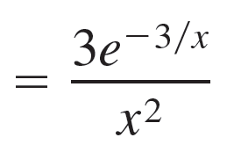








Example 3 – Differentiating Exponential Functions

Slide 15
Integrals of Exponential Functions

Slide 16
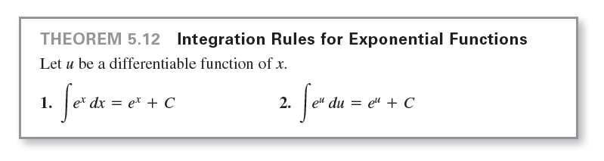
Integrals of Exponential Functions
Each differentiation formula in Theorem 5.11 has a corresponding integration formula.

Slide 17





Example 7 – Integrating Exponential Functions
Find the indefinite integral.
Solution:
If you let u = 3x + 1, then du = 3 dx.

