Slide 1

5
Logarithmic, Exponential, and Other Transcendental Functions
P
Copyright © Cengage Learning. All rights reserved.

Slide 2

The Natural Logarithmic Function: Integration
5.2
Copyright © Cengage Learning. All rights reserved.

Slide 3
Objectives
Use the Log Rule for Integration to integrate a rational function.
Integrate trigonometric functions.

Slide 4
Log Rule for Integration

Slide 5
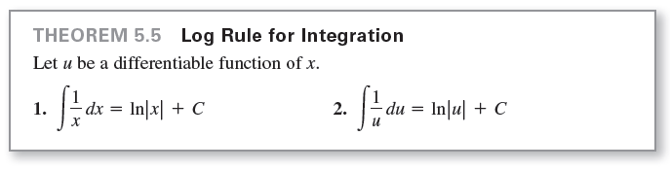
Log Rule for Integration
The differentiation rules
and
produce the following integration rule.

Slide 6


Log Rule for Integration
Because the second formula can also be written as

Slide 7
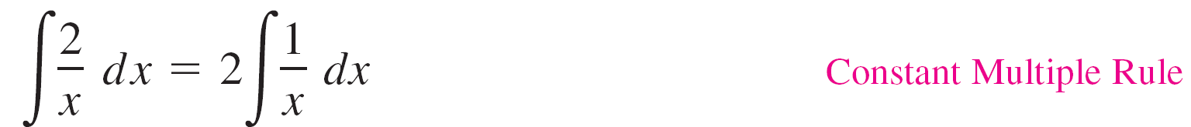
Example 1 – Using the Log Rule for Integration
Because x² cannot be negative, the absolute value notation is unnecessary in the final form of the antiderivative.

Slide 8
Log Rule for Integration
Integrals to which the Log Rule can be applied often appear in disguised form. For instance, when a rational function has a numerator of degree greater than or equal to that of the denominator, division may reveal a form to which you can apply the Log Rule.
This is shown in Example 5.

Slide 9
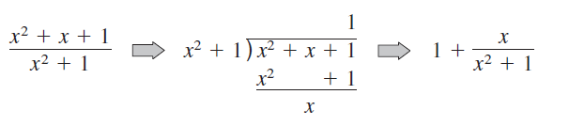
Example 5 – Using Long Division Before Integrating
Find the indefinite integral.
Solution:
Begin by using long division to rewrite the integrand.
Now, you can integrate to obtain

Slide 10
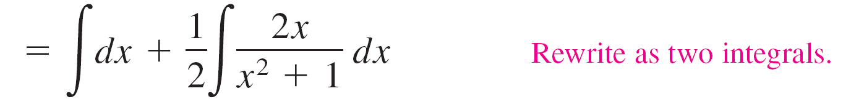
Example 5 – Solution
cont’d
Check this result by differentiating to obtain the original integrand.

Slide 11
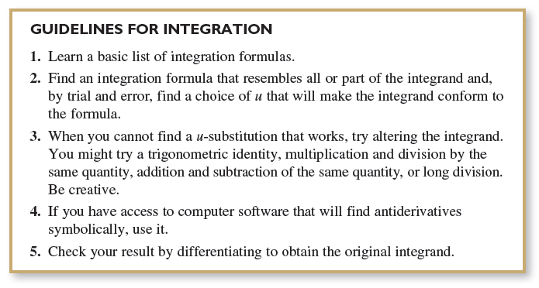
Log Rule for Integration
The following are guidelines you can use for integration.

Slide 12
Example 7 – u-Substitution and the Log Rule
Solve the differential equation
Solution:
The solution can be written as an indefinite integral.
Because the integrand is a quotient whose denominator is raised to the first power, you should try the Log Rule.

Slide 13

Example 7 – Solution
cont’d
There are three basic choices for u. The choices u = x and u = x ln x fail to fit the u'/u form of the Log Rule.
However, the third choice does fit. Letting u = ln x produces u' = 1/x, and you obtain the following.
So, the solution is

Slide 14
Integrals of Trigonometric Functions

Slide 15
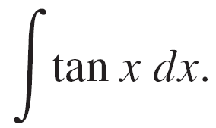

Example 8 – Using a Trigonometric Identity
Find
Solution:
This integral does not seem to fit any formulas on our basic list.
However, by using a trigonometric identity, you obtain
Knowing that D_{x}[cos x] = –sin x, you can let u = cos x and write

Slide 16
Example 8 – Solution
cont’d

Slide 17
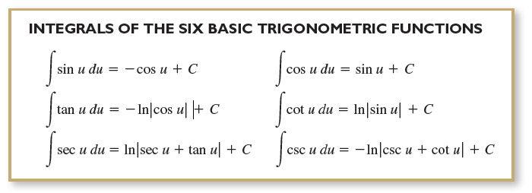
Integrals of Trigonometric Functions
The integrals of the six basic trigonometric functions are summarized below.

