Slide 1
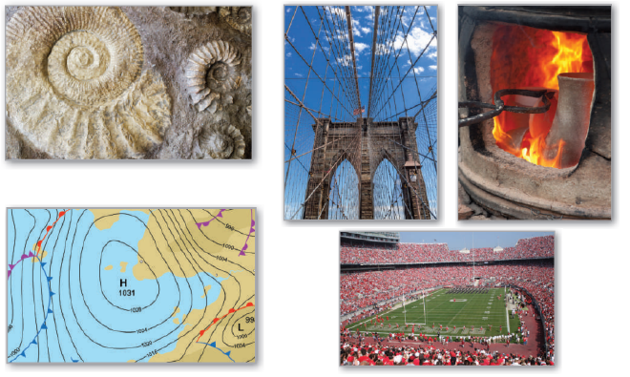
5
Logarithmic, Exponential, and Other Transcendental Functions
P
Copyright © Cengage Learning. All rights reserved.

Slide 2

The Natural Logarithmic Function: Differentiation
5.1
Copyright © Cengage Learning. All rights reserved.

Slide 3
Objectives
Develop and use properties of the natural logarithmic function.
Understand the definition of the number e.
Find derivatives of functions involving the natural logarithmic function.

Slide 4
The Natural Logarithmic Function

Slide 5

The Natural Logarithmic Function
The General Power Rule
has an important disclaimer—it does not apply when n = –1. Consequently, you have not yet found an antiderivative for the function f(x) = 1/x.
In this section, you will use the Second Fundamental Theorem of Calculus to define such a function.

Slide 6
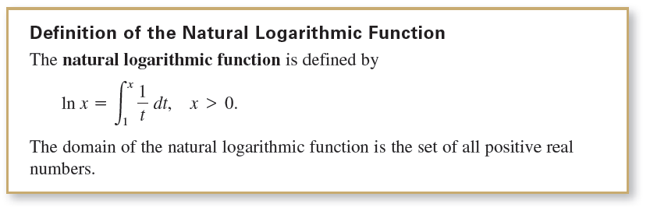
The Natural Logarithmic Function
It is neither algebraic nor trigonometric, but falls into a new class of functions called logarithmic functions. This particular function is the natural logarithmic function.

Slide 7
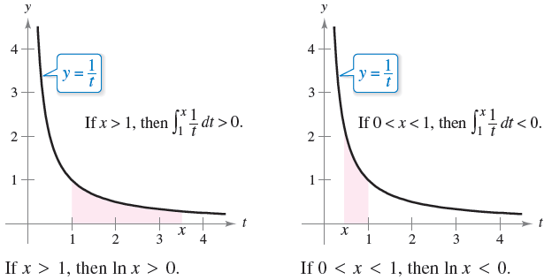
The Natural Logarithmic Function
From this definition, you can see that ln x is positive for
x > 1 and negative for 0 < x < 1, as shown in Figure 5.1.
Moreover, ln 1 = 0, because the upper and lower limits of
integration are equal when x = 1.
Figure 5.1

Slide 8
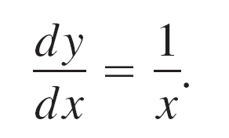
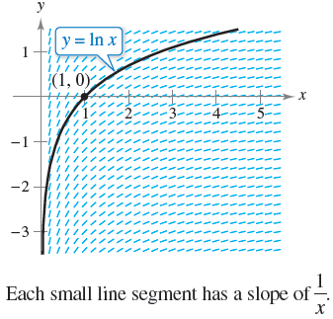
The Natural Logarithmic Function
To sketch the graph of y = ln x, you can think of the natural logarithmic function as an antiderivative given by the differential equation
Figure 5.2 is a computer-generated graph, called a slope field (or direction field), showing small line segments of slope 1/x.
The graph of y = ln x is the solution that passes through the point (1, 0).
Figure 5.2

Slide 9
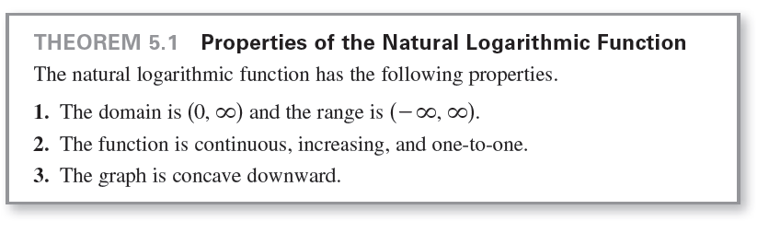
The Natural Logarithmic Function
The next theorem lists some basic properties of the natural logarithmic function.

Slide 10
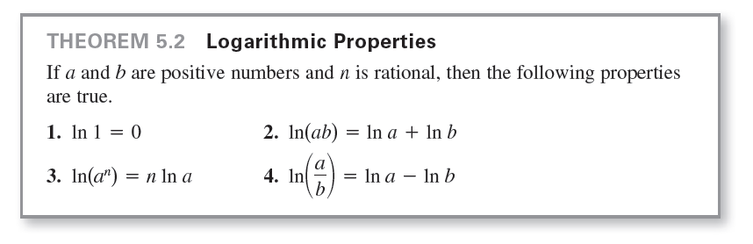
The Natural Logarithmic Function
Using the definition of the natural logarithmic function, you can prove several important properties involving operations with natural logarithms. If you are already familiar with logarithms, you will recognize that these properties listed below are characteristic of all logarithms.

Slide 11




Example 1 – Expanding Logarithmic Expressions

Slide 12
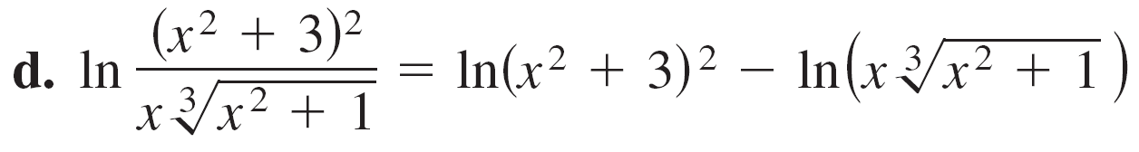
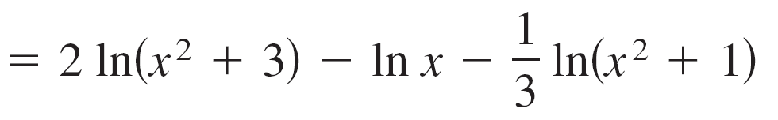
Example 1 – Expanding Logarithmic Expressions
cont’d

Slide 13
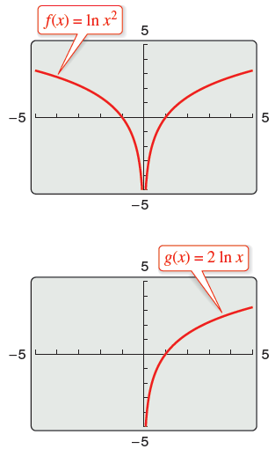
The Natural Logarithmic Function
When using the properties of logarithms to rewrite logarithmic functions, you must check to see whether the domain of the rewritten function is the same as the domain of the original.
For instance, the domain of f(x) = ln x² is all real numbers except x = 0, and the domain of g(x) = 2 ln x is all positive real numbers. (See Figure 5.4.)
Figure 5.4

Slide 14
The Number e

Slide 15

The Number e
It is likely that you have studied logarithms in an algebra course. There, without the benefit of calculus, logarithms would have been defined in terms of a base number.
For example, common logarithms have a base of 10 and therefore log₁₀10 = 1.
The base for the natural logarithm is defined using the fact that the natural logarithmic function is continuous, is one-to-one, and has a range of ( , ).

Slide 16
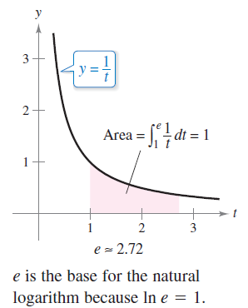

The Number e
So, there must be a unique
real number x such that ln x = 1,
as shown in Figure 5.5.
This number is denoted by the
letter e. It can be shown that e is
irrational and has the following
decimal approximation.
Figure 5.5

Slide 17
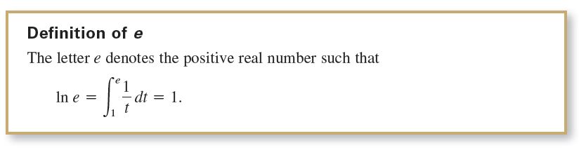
The Number e
Once you know that ln e = 1, you can use logarithmic properties to evaluate the natural logarithms of several other numbers.

Slide 18
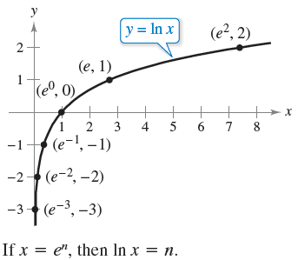
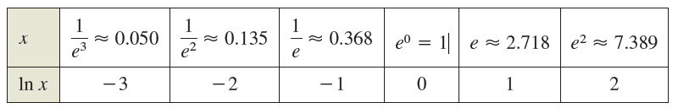
The Number e
For example, by using the property
ln(e^{n}) = n ln e
= n(1)
= n
you can evaluate ln(e^{n}) for various values of n, as shown
in the table and in Figure 5.6.
Figure 5.6

Slide 19
The Number e
The logarithms shown in the table are convenient because the x–values are integer powers of e. Most logarithmic expressions are, however, best evaluated with a calculator.

Slide 20



Example 2 – Evaluating Natural Logarithmic Expressions

Slide 21
The Derivative of the Natural Logarithmic Function

Slide 22
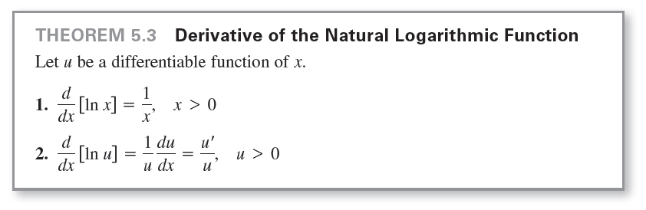
The Derivative of the Natural Logarithmic Function
The derivative of the natural logarithmic function is given in Theorem 5.3.
The first part of the theorem follows from the definition of the natural logarithmic function as an antiderivative. The second part of the theorem is simply the Chain Rule version of the first part.

Slide 23
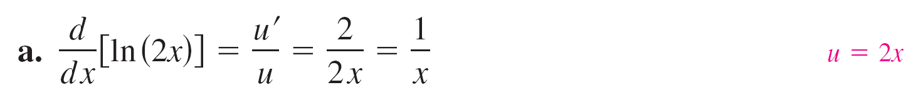



Example 3 – Differentiation of Logarithmic Functions

Slide 24



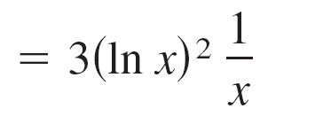
Example 3 – Differentiation of Logarithmic Functions
cont’d

Slide 25
The Derivative of the Natural Logarithmic Function
On occasion, it is convenient to use logarithms as aids in differentiating nonlogarithmic functions.
This procedure is called logarithmic differentiation.

Slide 26
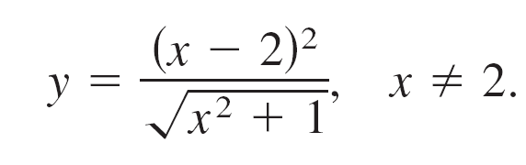
Example 6 – Logarithmic Differentiation
Find the derivative of
Solution:
Note that y > 0 for all x ≠ 2. So, ln y is defined.
Begin by taking the natural logarithm of each side of the equation.
Then apply logarithmic properties and differentiate implicitly. Finally, solve for y'.

Slide 27

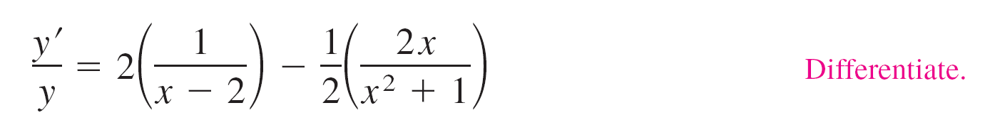
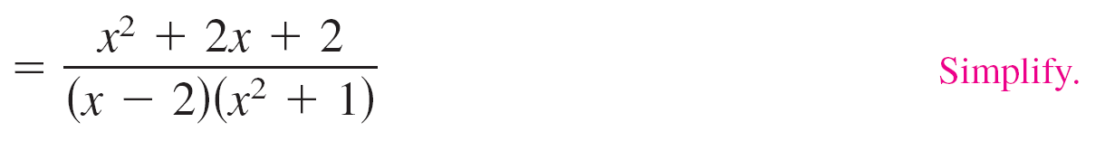
Example 6 – Solution
cont’d

Slide 28
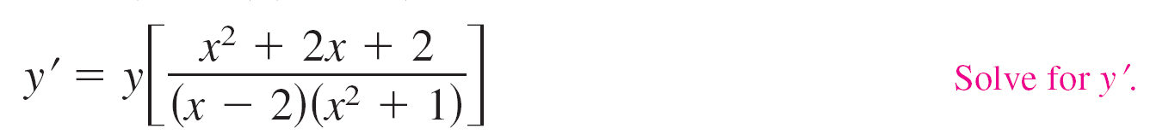
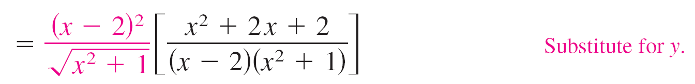
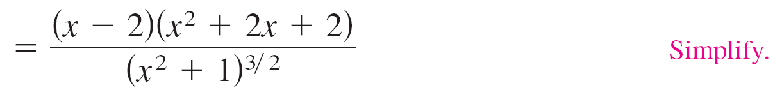
Example 6 – Solution
cont’d

Slide 29


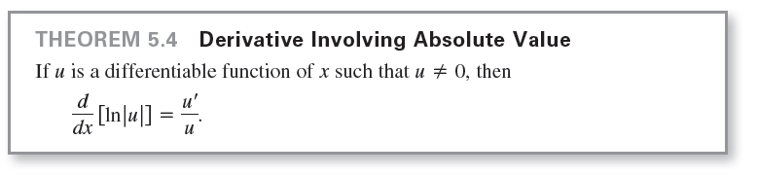
The Derivative of the Natural Logarithmic Function
Because the natural logarithm is undefined for negative numbers, you will often encounter expressions of the form
The next theorem states that you can differentiate functions of the form as though the absolute value notation was not present.

Slide 30
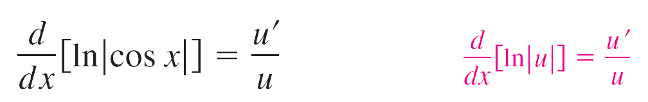
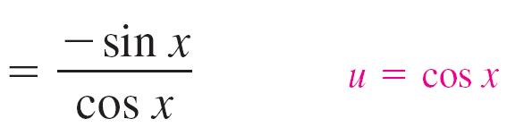

Example 7 – Derivative Involving Absolute Value
Find the derivative of
f(x) = ln | cos x |.
Solution:
Using Theorem 5.4, let u = cos x and write

