Slide 1

3
Applications of Differentiation
P
Copyright © Cengage Learning. All rights reserved.

Slide 2

3.7
Optimization Problems
Copyright © Cengage Learning. All rights reserved.

Slide 3
Objective
Solve applied minimum and maximum problems.

Slide 4
Applied Minimum and Maximum
Problems

Slide 5
Applied Minimum and Maximum Problems
One of the most common applications of calculus involves the determination of minimum and maximum values.

Slide 6
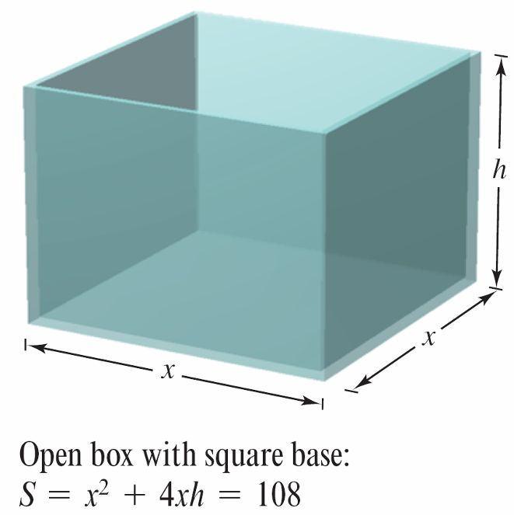
Example 1 – Finding Maximum Volume
A manufacturer wants to design an open box having a square base and a surface area of 108 square inches, as shown in Figure 3.53. What dimensions will produce a box with maximum volume?
Figure 3.53

Slide 7
Example 1 – Solution
Because the box has a square base, its volume is
V = x²h. Primary equation
This equation is called the primary equation because it gives a formula for the quantity to be optimized.
The surface area of the box is
S = (area of base) + (area of four sides)
108 = x² + 4xh. Secondary equation

Slide 8
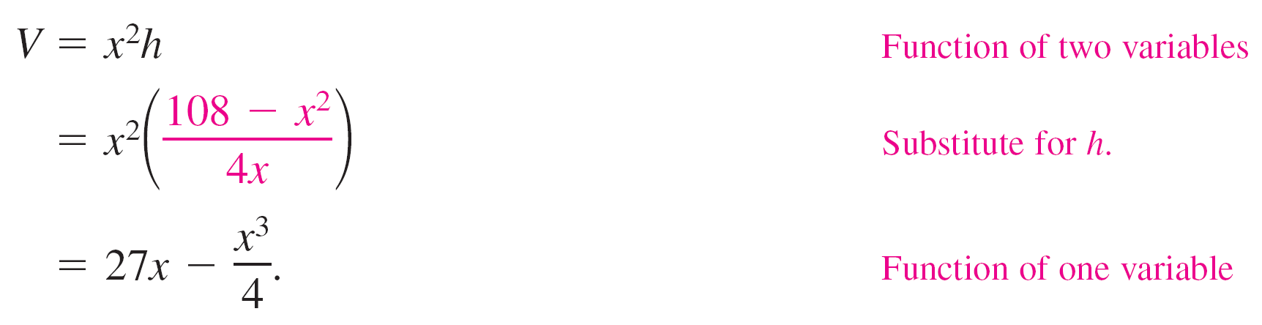
Example 1 – Solution
cont’d
Because V is to be maximized, you want to write V as a function of just one variable.
To do this, you can solve the equation x² + 4xh = 108 for h in terms of x to obtain h = (108 – x²)/(4x).
Substituting into the primary equation produces

Slide 9
Example 1 – Solution
cont’d
Before finding which x-value will yield a maximum value of V, you should determine the feasible domain.
That is, what values of x make sense in this problem?
You know that V ≥ 0. You also know that x must be nonnegative and that the area of the base (A = x²) is at most 108.
So, the feasible domain is

Slide 10

Example 1 – Solution
cont’d
To maximize V, find its critical numbers on the interval
So, the critical numbers are x = ±6.
You do not need to consider x = –6 because it is outside the
domain.

Slide 11
Example 1 – Solution
cont’d
Evaluating V at the critical number x = 6 and at the endpoints
of the domain produces V(0) = 0, V(6) = 108, and
So, V is maximum when x = 6, and the dimensions of the box
are 6 inches by 6 inches by 3 inches.

Slide 12
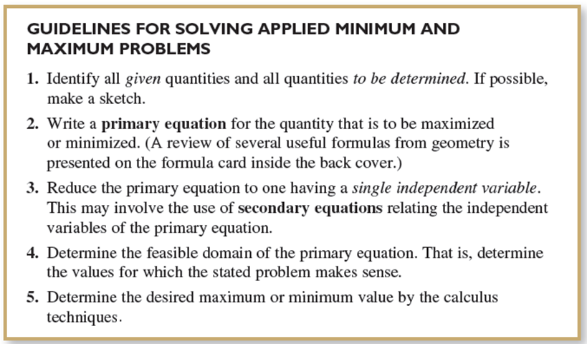
Applied Minimum and Maximum Problems

Slide 13
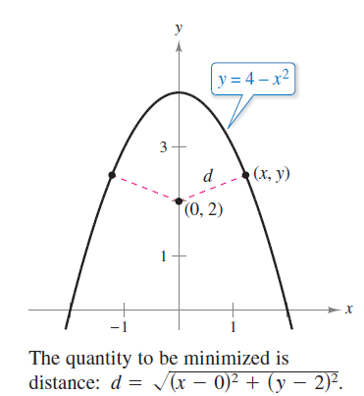
Example 2 – Finding Minimum Distance
Which points on the graph of y = 4 – x² are closest to the point (0, 2)?
Solution:
Figure 3.55 shows that there are two
points at a minimum distance from the
point (0, 2).
The distance between the point (0, 2) and
a point (x, y) on the graph of y = 4 – x² is
Figure 3.55

Slide 14
Example 2 – Solution
cont’d
Using the secondary equation y = 4 – x², you can rewrite the primary equation as
Because d is smallest when the expression inside the radical is smallest, you need only find the critical numbers of f(x) = x⁴ – 3x² + 4.
Note that the domain of f is the entire real number line. So, there are no endpoints of the domain to consider.

Slide 15




Example 2 – Solution
cont’d
Moreover, the derivative of f
is zero when
Testing these critical numbers using the First Derivative Test
verifies that x = 0 yields a relative maximum, whereas both
yield a minimum distance.
So, the closest points are

