Slide 1

3
Applications of Differentiation
P
Copyright © Cengage Learning. All rights reserved.

Slide 2

Concavity and the Second Derivative Test
3.4
Copyright © Cengage Learning. All rights reserved.

Slide 3
Objectives
Determine intervals on which a function is concave upward or concave downward.
Find any points of inflection of the graph of a function.
Apply the Second Derivative Test to find relative extrema of a function.

Slide 4
Concavity

Slide 5
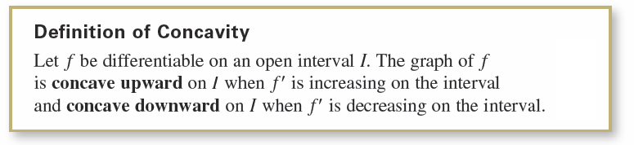
Concavity
You have seen that locating the intervals on which a function f increases or decreases helps to describe its graph. In this section, you will see how locating the intervals on which f' increases or decreases can be used to determine where the graph of f is curving upward or curving downward.

Slide 6
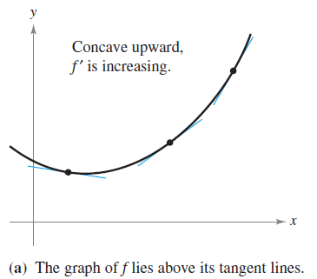
Concavity
The following graphical interpretation of concavity is useful.
Let f be differentiable on an open interval I. If the graph of f is concave upward on I, then the graph of f lies above all of its tangent lines on I. [See Figure 3.23(a).]
Figure 3.23

Slide 7
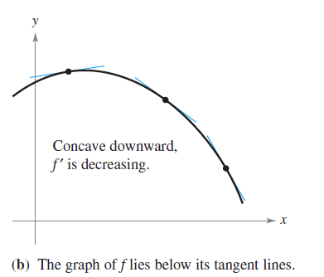
Concavity
Let f be differentiable on an open interval I. If the graph of f is concave downward on I, then the graph of f lies below all of its tangent lines on I. [See Figure 3.23(b).]
Figure 3.23

Slide 8
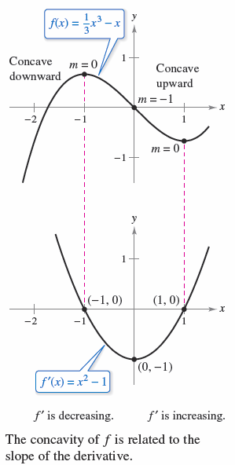



Concavity
To find the open intervals on which the
graph of a function f is concave upward
or concave downward, you need to find
the intervals on which f' is increasing or
decreasing.
For instance, the graph of
is concave downward on the open interval because
is decreasing there. (See Figure 3.24)
Figure 3.24

Slide 9
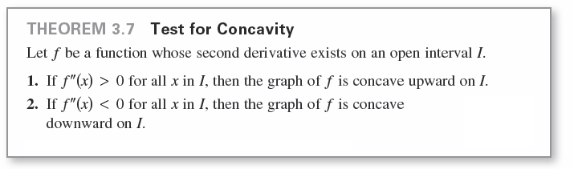
Concavity
Similarly, the graph of f is concave upward on the interval
because f' is increasing on .
The next theorem shows how to use the second derivative of a function f to determine intervals on which the graph of f is concave upward or concave downward.

Slide 10
Concavity
To apply Theorem 3.7, locate the x-values at which
f" (x) = 0 or f" (x) does not exist. Use these x-values to determine test intervals. Finally, test the sign of f" (x) in each of the test intervals.

Slide 11
Example 1 – Determining Concavity
Determine the open intervals on which the graph of
is concave upward or concave downward.
Solution:
Begin by observing that f is continuous on the entire real number line.
Next, find the second derivative of f.

Slide 12
Example 1 – Solution
cont’d
Because f ''(x) = 0 when x = ±1 and f'' is defined on the entire real number line, you should test f'' in the intervals , (–1, 1), and

Slide 13
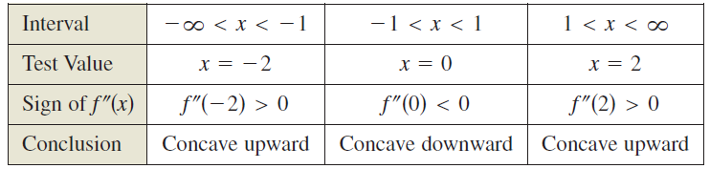
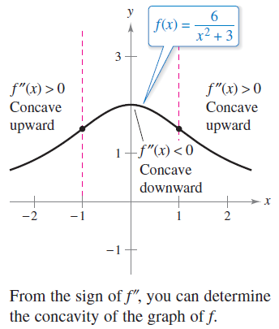
Example 1 – Solution
cont’d
The results are shown in the table and in Figure 3.25.
Figure 3.25

Slide 14
Concavity
cont’d
The function given in Example 1 is continuous on the entire real number line.
When there are x-values at which the function is not continuous, these values should be used, along with the points at which f"(x)= 0 or f"(x) does not exist, to form the test intervals.

Slide 15
Points of Inflection

Slide 16
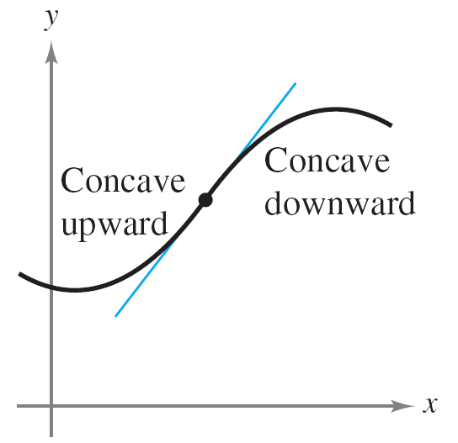
Points of Inflection
If the tangent line to the graph exists at such a point where the concavity changes, then that point is a point of inflection. Three types of points of inflection are shown in Figure 3.27.
The concavity of f changes at a point of inflection. Note that the graph crosses its tangent line at a point of inflection.
Figure 3.27

Slide 17
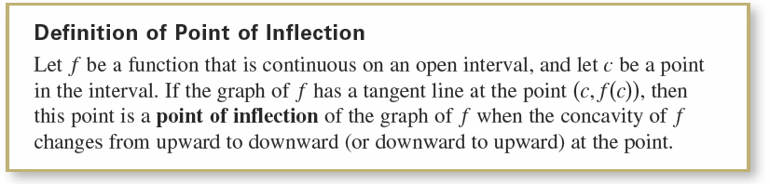
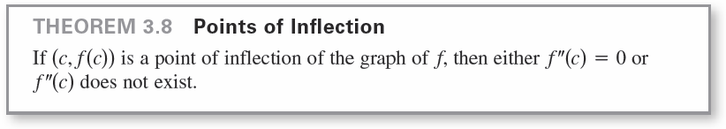
Points of Inflection
To locate possible points of inflection, you can determine the values of x for which f"(x)= 0 or f"(x) does not exist. This is similar to the procedure for locating relative extrema of f.

Slide 18


Example 3 – Finding Points of Inflection
Determine the points of inflection and discuss the concavity of the graph of
Solution:
Differentiating twice produces the following.

Slide 19
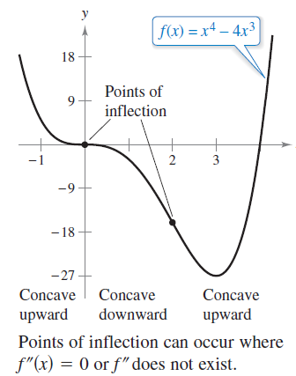
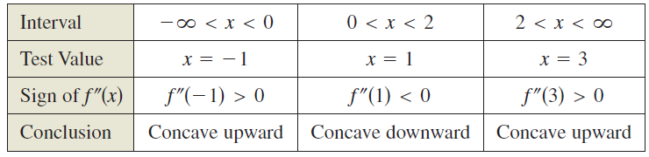
Example 3 – Solution
cont’d
Setting f"(x) = 0, you can determine that the possible points of inflection occur at x = 0 and x = 2.
By testing the intervals determined by these x-values, you can conclude that they both yield points of inflection.
A summary of this testing is shown in the table, and the graph of f is shown in Figure 3.28.
Figure 3.28

Slide 20
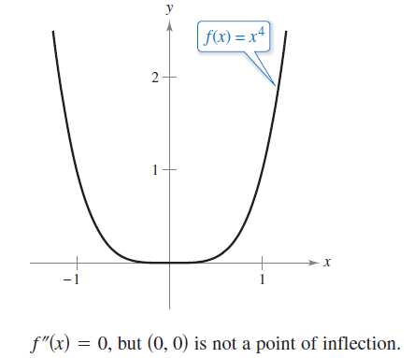
Points of Inflection
The converse of Theorem 3.8 is not generally true. That is, it is possible for the second derivative to be 0 at a point that is not a point of inflection.
For instance, the graph of f(x) = x⁴ is shown in Figure 3.29.
The second derivative is 0 when
x = 0, but the point (0,0) is not a
point of inflection because the
graph of f is concave upward on
the intervals
Figure 3.29

Slide 21
The Second Derivative Test

Slide 22
The Second Derivative Test
In addition to testing for concavity, the second derivative can be used to perform a simple test for relative maxima and minima.
The test is based on the fact that if the graph of a function f is concave upward on an open interval containing c, and f' (c) = 0, then f(c) must be a relative minimum of f.

Slide 23
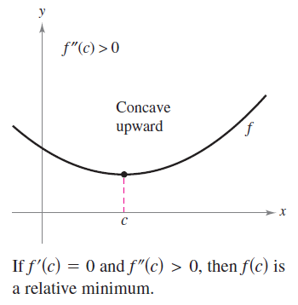
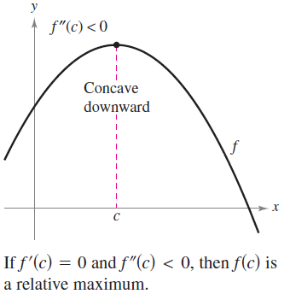
The Second Derivative Test
Similarly, if the graph of a function f is concave downward on an open interval containing c, and f' (c) = 0, then f(c) must be a relative maximum of f. (See Figure 3.30.)
Figure 3.30

Slide 24
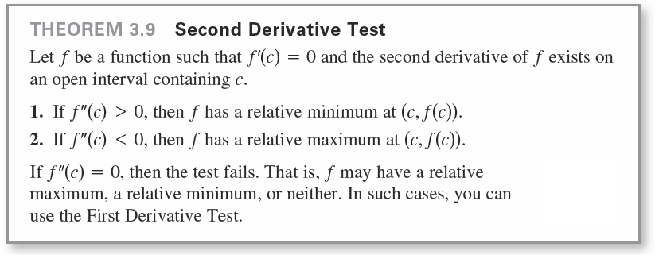
The Second Derivative Test

Slide 25

Example 4 – Using the Second Derivative Test
Find the relative extrema of f(x) = –3x⁵ + 5x³.
Solution:
Begin by finding the first derivative of f.
From this derivative, you can see that x = –1, 0, and 1 are the only critical numbers of f.
By finding the second derivative
you can apply the Second Derivative Test.

Slide 26
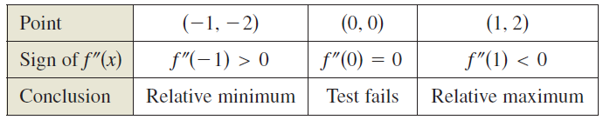
Example 4 – Solution
cont’d
Because the Second Derivative Test fails at (0, 0), you can use the First Derivative Test and observe that f increases to the left and right of x = 0.

Slide 27
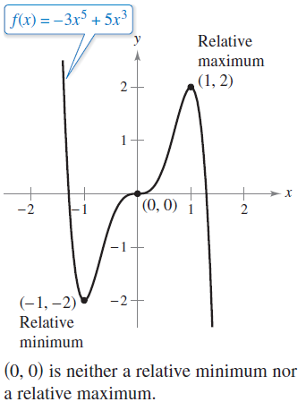
Example 4 – Solution
cont’d
So, (0, 0) is neither a relative minimum nor a relative maximum (even though the graph has a horizontal tangent line at this point). The graph of f is shown in Figure 3.31.
Figure 3.31

