Slide 1

3
Applications of Differentiation
P
Copyright © Cengage Learning. All rights reserved.

Slide 2

3.3
Increasing and Decreasing Functions and the First Derivative Test
Copyright © Cengage Learning. All rights reserved.

Slide 3
Objectives
Determine intervals on which a function is increasing or decreasing.
Apply the First Derivative Test to find relative extrema of a function.

Slide 4
Increasing and Decreasing Functions

Slide 5
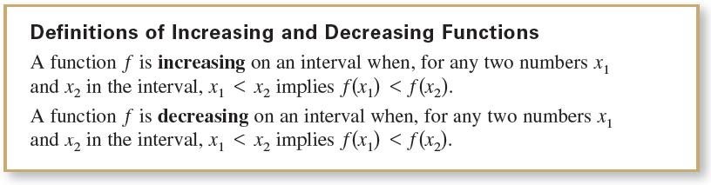
Increasing and Decreasing Functions
You will learn how derivatives can be used to classify relative extrema as either relative minima or relative maxima. First, it is important to define increasing and decreasing functions.

Slide 6

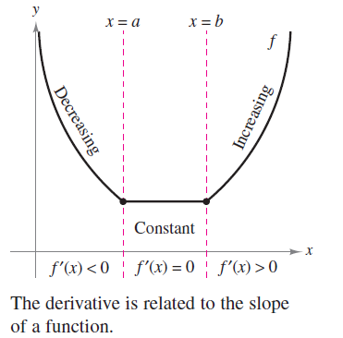
Increasing and Decreasing Functions
A function is increasing when, as x moves to the right, its graph moves up, and is decreasing when its graph moves down. For example, the function in Figure 3.15 is decreasing on the interval is constant on the interval (a, b), and is increasing on the interval
Figure 3.15

Slide 7
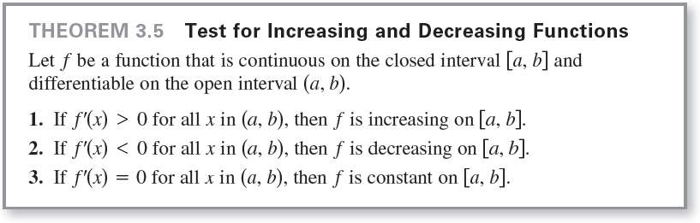
Increasing and Decreasing Functions
As shown in Theorem 3.5 below, a positive derivative implies that the function is increasing, a negative derivative implies that the function is decreasing, and a zero derivative on an entire interval implies that the function is constant on that interval.

Slide 8

Example 1 – Intervals on Which f Is Increasing or Decreasing
Find the open intervals on which is increasing or decreasing.
Solution:
Note that f is differentiable on the entire real number line and the derivative of f is

Slide 9


Example 1 – Solution
cont’d
To determine the critical numbers of f, set f'(x) equal to zero.

Slide 10
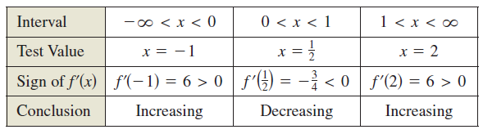
Example 1 – Solution
cont’d
Because there are no points for which f' does not exist, you can conclude that x = 0 and x = 1 are the only critical numbers.
The table summarizes the testing of the three intervals determined by these two critical numbers.

Slide 11

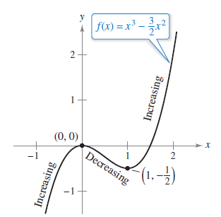
Example 1 – Solution
cont’d
By Theorem 3.5, f is increasing on the intervals and
and decreasing on the interval (0,1), as shown in Figure 3.16.
Figure 3.16

Slide 12
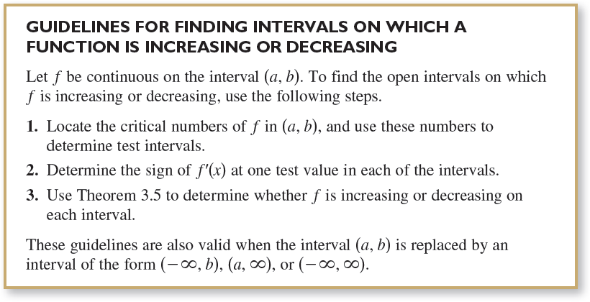
Increasing and Decreasing Functions
Example 1 gives you one instance of how to find intervals on which a function is increasing or decreasing. The guidelines below summarize the steps followed in that example.

Slide 13
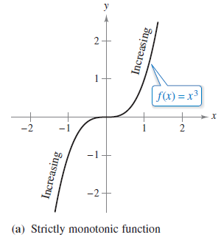
Increasing and Decreasing Functions
A function is strictly monotonic on an interval when it is either increasing on the entire interval or decreasing on the entire interval. For instance, the function f(x) = x³
is strictly monotonic on the entire real number line because it is increasing on the entire real number line, as shown in Figure 3.17(a).
Figure 3.17

Slide 14
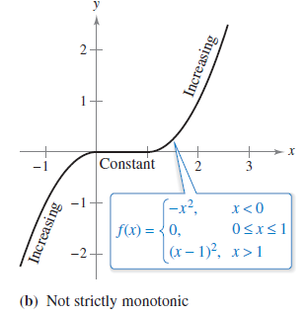
Increasing and Decreasing Functions
The function shown in Figure 3.17(b) is not strictly monotonic on the entire real number line because it is constant on the interval [0, 1].
Figure 3.17

Slide 15
The First Derivative Test

Slide 16
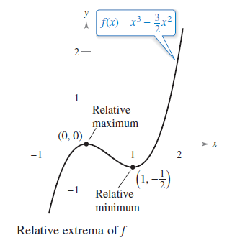
The First Derivative Test
After you have determined the intervals on which a function is increasing or decreasing, it is not difficult to locate the relative extrema of the function.
For instance, in Figure 3.18
(from Example 1), the function
has a relative maximum at the point
(0, 0) because f is increasing
immediately to the left of x = 0
and decreasing immediately to the
right of x = 0.
Figure 3.18

Slide 17

The First Derivative Test
Similarly, f has a relative minimum at the point
because f is decreasing immediately to the left of x = 1 and
increasing immediately to the right of x = 1. The next theorem makes this more explicit.

Slide 18
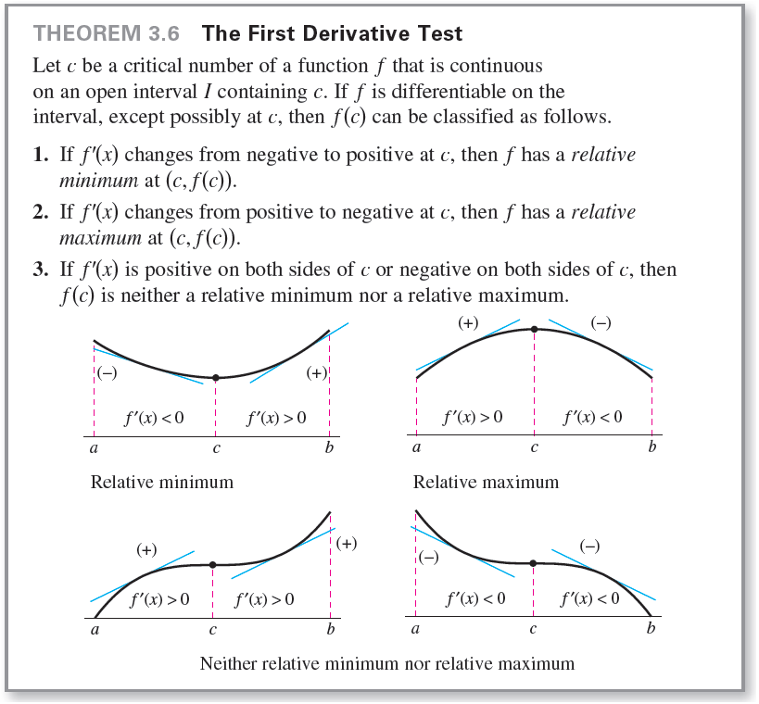
The First Derivative Test

Slide 19


Example 2 – Applying the First Derivative Test
Find the relative extrema of in the interval (0, 2π).
Solution:
Note that f is continuous on the interval (0, 2π). The derivative of f is
To determine the critical numbers of f in this interval, set
f'(x) equal to 0.

Slide 20



Example 2 – Solution
cont'd
Because there are no points for which f' does not exist, you can conclude that x = π/3 and x = 5π/3 are the only critical numbers.

Slide 21
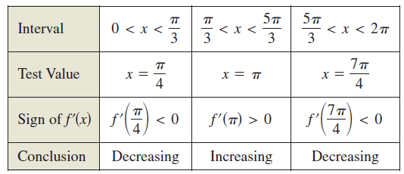
Example 2 – Solution
cont'd
The table summarizes the testing of the three intervals determined by these two critical numbers.

Slide 22
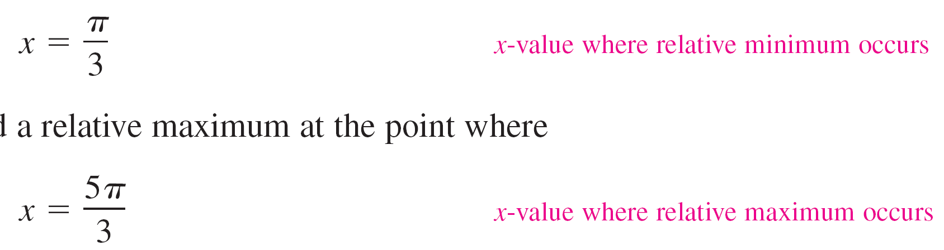
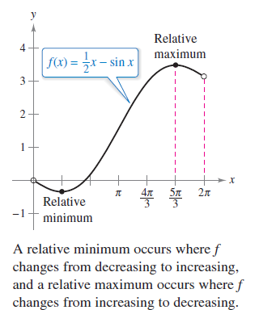
Example 2 – Solution
cont'd
By applying the First Derivative Test, you can conclude that f has a relative minimum at the point where
and a relative maximum at the point
where
,
as shown in Figure 3.19.
Figure 3.19

