Slide 1
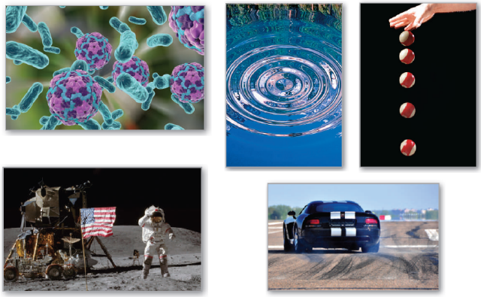
P
2
Differentiation
Copyright © Cengage Learning. All rights reserved.

Slide 2

2.5
Implicit Differentiation
Copyright © Cengage Learning. All rights reserved.

Slide 3
Objectives
Distinguish between functions written in implicit form and explicit form.
Use implicit differentiation to find the derivative of a function.

Slide 4
Implicit and Explicit Functions

Slide 5

Implicit and Explicit Functions
Most functions have been expressed in explicit form.
For example, in the equation , the variable y is explicitly written as a function of x.
Some functions, however, are only implied by an equation. For instance, the function y = 1/x is defined implicitly by the equation
xy = 1. Implicit form

Slide 6
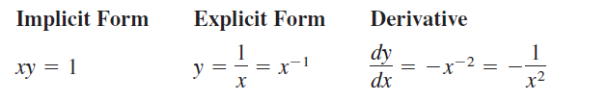
Implicit and Explicit Functions
To find dy/dx for this equation, you can write y explicitly as a function of x and then differentiate.
This strategy works whenever you can solve for the function explicitly.
You cannot, however, use this procedure when you are unable to solve for y as a function of x.

Slide 7

Implicit and Explicit Functions
For instance, how would you find dy/dx for the equation
For this equation, it is difficult to express y as a function of x explicitly. To find dy/dx, you can use implicit differentiation.

Slide 8
Implicit and Explicit Functions
To understand how to find dy/dx implicitly, you must realize that the differentiation is taking place with respect to x.
This means that when you differentiate terms involving x alone, you can differentiate as usual.
However, when you differentiate terms involving y, you must apply the Chain Rule, because you are assuming that y is defined implicitly as a differentiable function of x.

Slide 9
Example 1 – Differentiating with Respect to x

Slide 10


Example 1 – Differentiating with Respect to x
cont’d

Slide 11
Implicit Differentiation

Slide 12
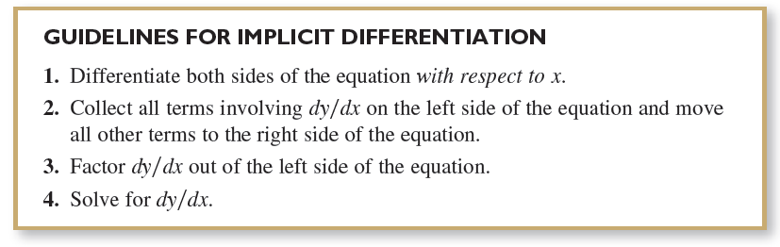
Implicit Differentiation

Slide 13

Example 2 – Implicit Differentiation
Find dy/dx given that y³ + y² – 5y – x² = –4.
Solution:
1. Differentiate both sides of the equation with respect to x.

Slide 14

Example 2 – Solution
cont’d
2. Collect the dy/dx terms on the left side of the equation and move all other terms to the right side of the equation.
3. Factor dy/dx out of the left side of the equation.
4. Solve for dy/dx by dividing by (3y² + 2y – 5).

Slide 15
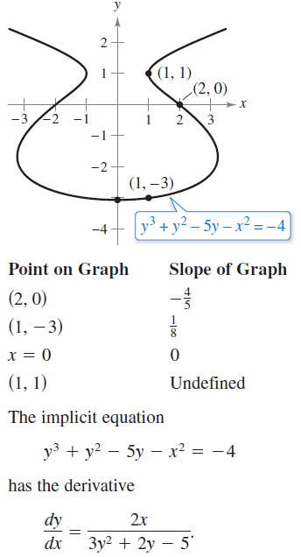
Implicit Differentiation
To see how you can use an implicit derivative, consider the graph shown in Figure 2.27.
From the graph, you can see that
y is not a function of x. Even so,
the derivative found in Example 2
gives a formula for the slope of the
tangent line at a point on this graph.
The slopes at several points on the
graph are shown below the graph.
Figure 2.27

Slide 16
Implicit Differentiation
It is meaningless to solve for dy/dx in an equation that has no solution points. (For example, x² + y² = –4 has no solution points.)
If, however, a segment of a graph can be represented by a differentiable function, then dy/dx will have meaning as the slope at each point on the segment.
Recall that a function is not differentiable at (a) points with vertical tangents and (b) points at which the function is not continuous.

Slide 17



Example 5 – Finding the Slope of a Graph Implicitly
Determine the slope of the graph of 3(x² + y²)² = 100xy
at the point (3, 1).
Solution:

Slide 18

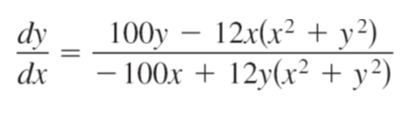
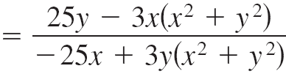
Example 5 – Solution
cont’d

Slide 19
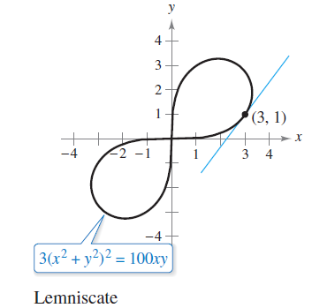
Example 5 – Solution
cont’d
At the point (3, 1), the slope of the graph is as shown in Figure 2.30. This graph is called a lemniscate.
Figure 2.30

