Slide 1
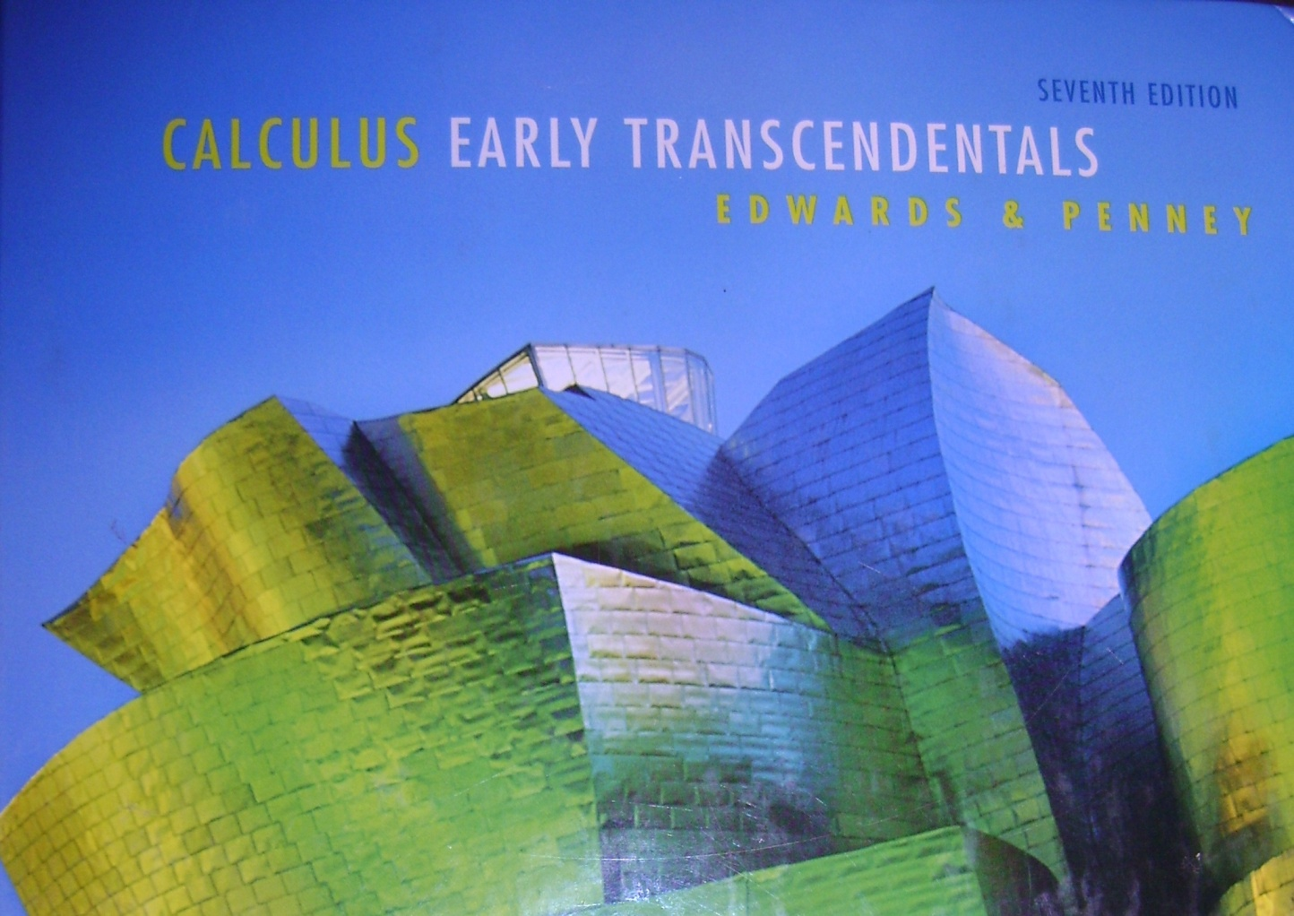
Section 9.5
Alternating Series

Slide 2
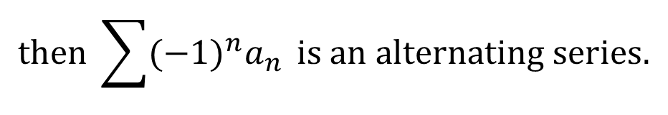
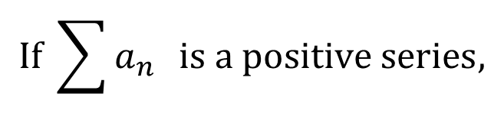
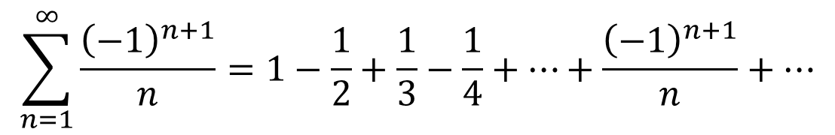
Alternating Series
$$If \sum{a_{n} } is a positive series,$$
$$then \sum{(−1)^{n}a_{n}} is an alternating series.$$
Example:
$$\sum_{n=1}^{∞}{\frac{{\left(−1\right)}^{n+1}}{n}}=1−\frac{1}{2}+\frac{1}{3}−\frac{1}{4}+…+\frac{{\left(−1\right)}^{n+1}}{n}+…$$
This series is the alternating harmonic series – quite famous!

Slide 3
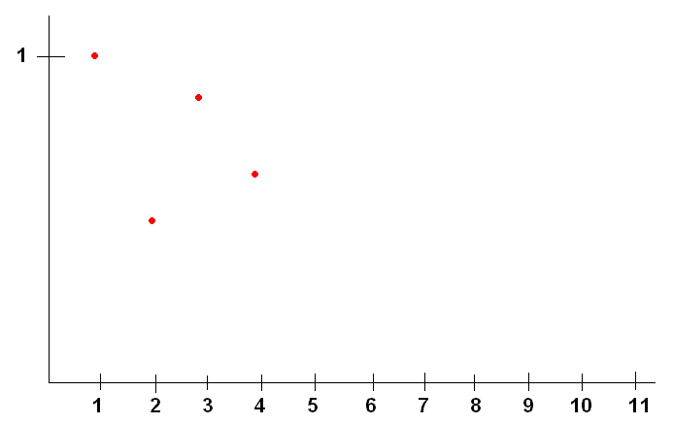
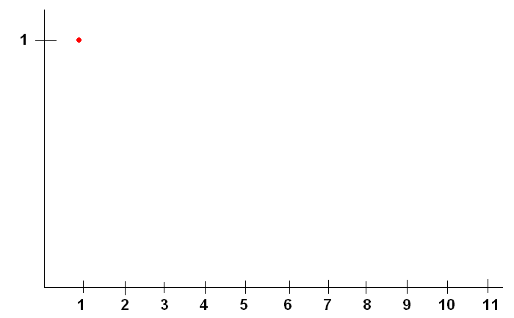
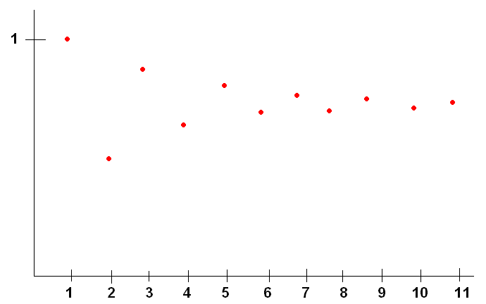
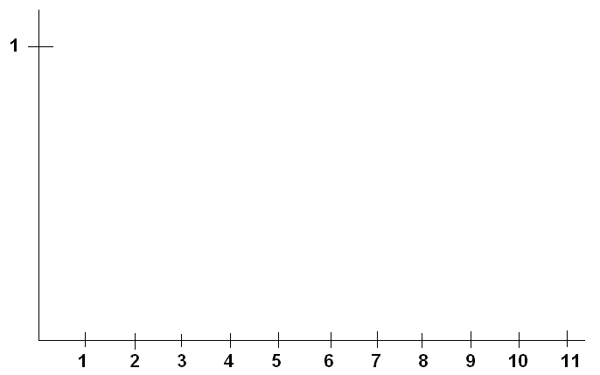
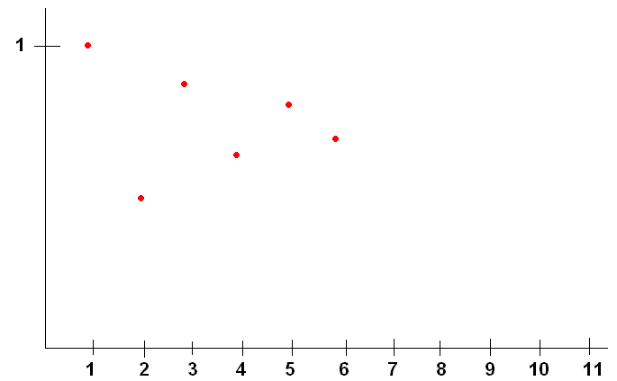
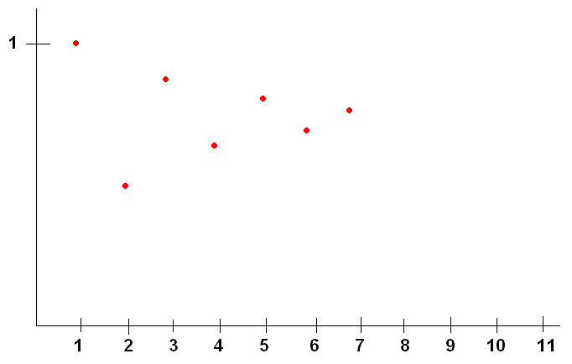
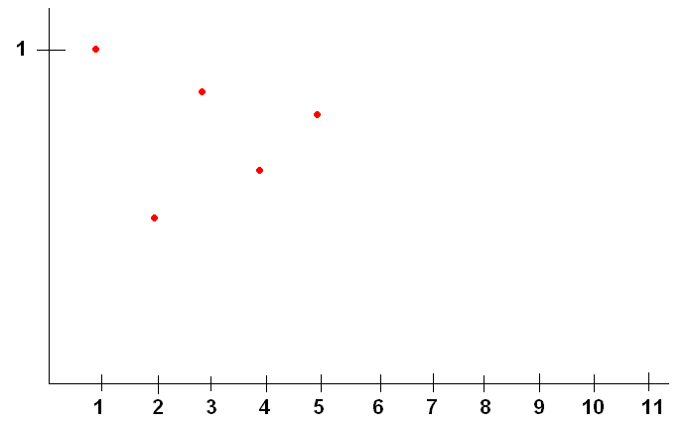
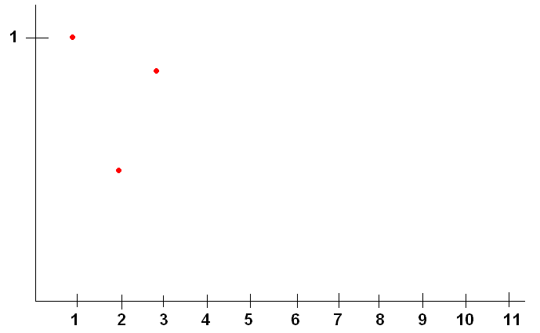
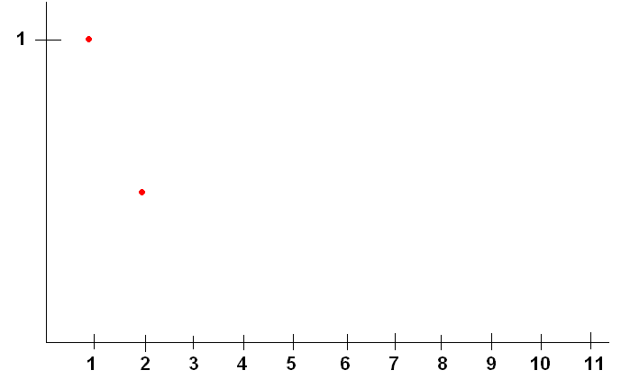
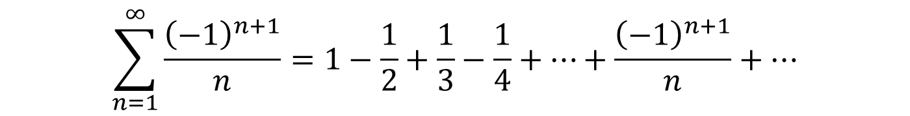
$$\sum_{n=1}^{∞}{\frac{{\left(−1\right)}^{n+1}}{n}}=1−\frac{1}{2}+\frac{1}{3}−\frac{1}{4}+…+\frac{{\left(−1\right)}^{n+1}}{n}+…$$
Let’s look at some partial sums graphically.
Clearly, the Partial Sums are headed for some limit in the middle of these points.
Each “jump” is smaller than the previous one.

Slide 4
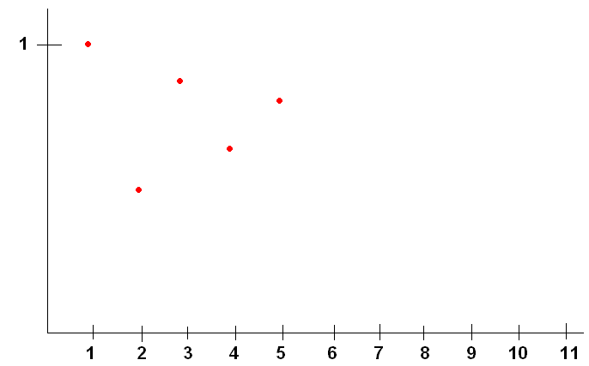
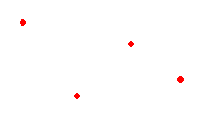
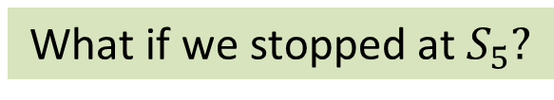

What if we stopped at $S_{5}?$
We know that the infinite sum $S$ is between
$$S_{5}=1−\frac{1}{2}+\frac{1}{3}−\frac{1}{4}+\frac{1}{5}=\frac{47}{60}$$
and the next partial sum
$$S_{6}=S_{5}−\frac{1}{6}=\frac{37}{60}$$
So if I use $S_{5}=\frac{47}{60}$ as an estimate for $S,$my error is less than |$a_{6}|=\frac{1}{6}.$
How far off can my estimate be if I use $S_{11 }for my estimate? S_{100}?$
$\left|a_{12}\right|=\frac{1}{12}, and {|a}_{101}|=\frac{1}{101} respectively.$

Slide 5
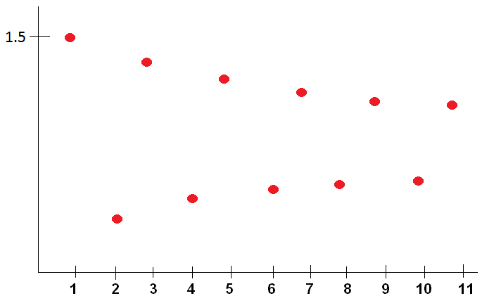
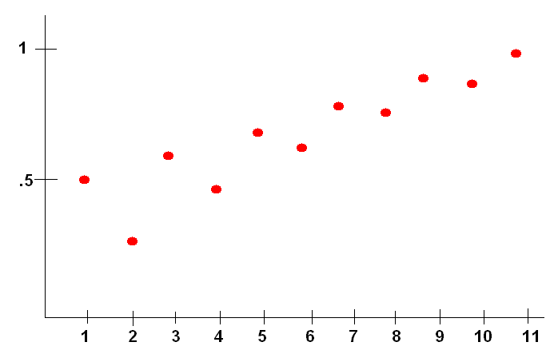
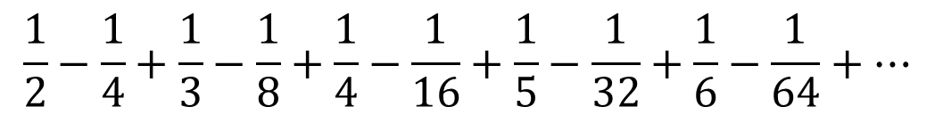

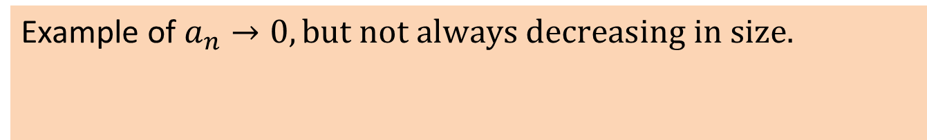

However, all this is only true if each step (term) is smaller than the last step and if the steps (terms) are approaching zero.
Example of $a_{n}$ getting smaller but not $→0$
$$\sum{\frac{{\left(−1\right)}^{n+1}(n+2)}{2n}}$$
Each jump gets smaller,
but never become less than ½ a unit.
Example of $a_{n}→0, but not always decreasing in size.$
$$\frac{1}{2}−\frac{1}{4}+\frac{1}{3}−\frac{1}{8}+\frac{1}{4}−\frac{1}{16}+\frac{1}{5}−\frac{1}{32}+\frac{1}{6}−\frac{1}{64}+…$$
The jump up is always larger than the jump down, even though the sizes of the jumps in each direction are going towards zero.

Slide 6
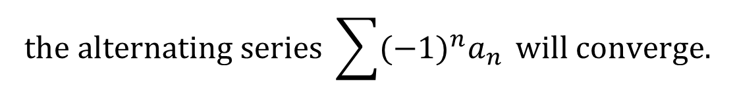
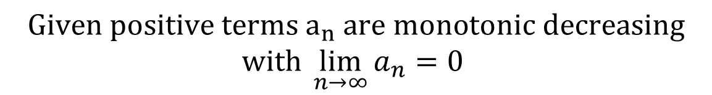

Alternating Series Test
$$Given {positive terms a}_{n} are monotonic decreasing$$
$$with \lim_{n→∞}{a_{n}=0}$$
$$the alternating series \sum{{(−1)}^{n}a_{n}} will converge.$$
$$Furthermore, \left|S−S_{n}\right|<a_{n+1}$$
if a series alternates,
In other words…
checking to see if the terms are
decreasing towards zero is sufficient.

Slide 7

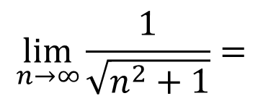
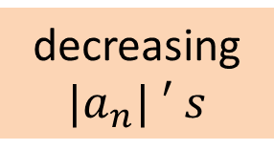

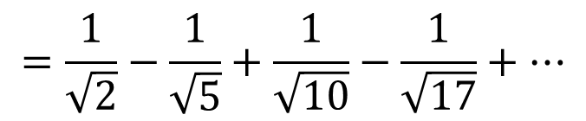
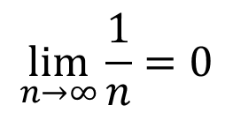
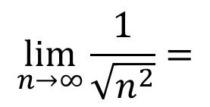
$$\sum_{n=1}^{∞}{\frac{{(−1)}^{n+1}}{\sqrt{n^{2}+1}}}$$
$$=\frac{1}{\sqrt{2}}−\frac{1}{\sqrt{5}}+\frac{1}{\sqrt{10}}−\frac{1}{\sqrt{17}}+…$$
decreasing
$${|a}_{n}| ′ s$$
Ex: #2
$$\lim_{n→∞}{\frac{1}{\sqrt{n^{2}+1}}}=$$
$$\lim_{n→∞}{\frac{1}{\sqrt{n^{2}}}}=$$
$$\lim_{n→∞}{\frac{1}{n}}=0$$
$$a_{n}→0$$
This series converges by the Alternating Series Test.

Slide 8
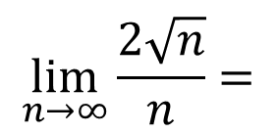
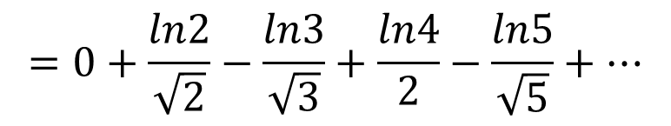
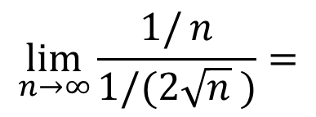
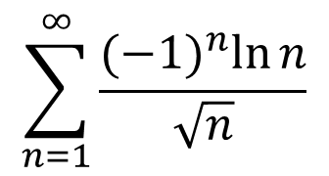
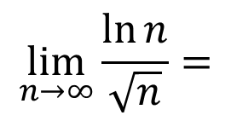

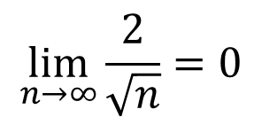
$$\sum_{n=1}^{∞}{\frac{{(−1)}^{n}\ln{n}}{\sqrt{n}}}$$
$$=0+\frac{ln2}{\sqrt{2}}−\frac{ln3}{\sqrt{3}}+\frac{ln4}{2}−\frac{ln5}{\sqrt{5}}+…$$
Ex: #8
$$≈0+.4901−.6343+.6931−.7198+…$$
The terms don’t appear to be decreasing in magnitude or going to 0
$$\lim_{n→∞}{\frac{\ln{n}}{\sqrt{n}}}=$$
$$\lim_{n→∞}{\frac{1/{n}}{1/(2\sqrt{n} )}}=$$
$$\lim_{n→∞}{\frac{2\sqrt{n}}{n}}=$$
$$\lim_{n→∞}{\frac{2}{\sqrt{n}}}=0$$
We need to look at some terms when n is large.
Let’s start with $a_{100}$.
$$\frac{ln100}{10}−\frac{ln101}{\sqrt{101}}+\frac{ln102}{\sqrt{102}}−\frac{ln103}{\sqrt{103}}+…≈.4605−.4592+.4579−.4567+…$$
The terms do eventually decrease in magnitude.
This series converges by the A.S.T.

Slide 9


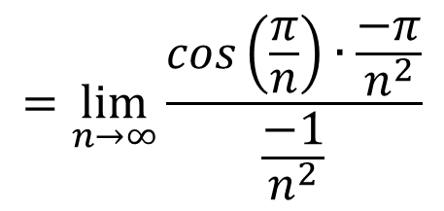

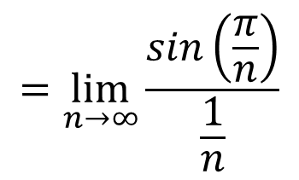



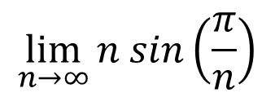
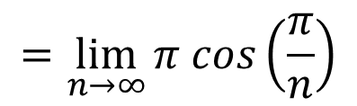
$$\sum_{n=1}^{∞}{{(−1)}^{n}n\sin\left(\frac{π}{n}\right)}$$
Ex: #16
$$=\lim_{n→∞}{\frac{\sin\left(\frac{π}{n}\right)}{\frac{1}{n}}}$$
$$=\lim_{n→∞}{\frac{\cos\left(\frac{π}{n}\right)∙\frac{−π}{n^{2}}}{\frac{−1}{n^{2}}}}$$
$$\lim_{n→∞}{n sin\left(\frac{π}{n}\right)}$$
$$∞∙0$$
$$=\lim_{n→∞}{π cos\left(\frac{π}{n}\right)}$$
$$={π cos\left(0\right)}=π$$
$$≠0$$
This series diverges by the n-term Test.

Slide 10




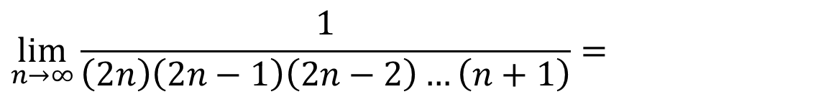
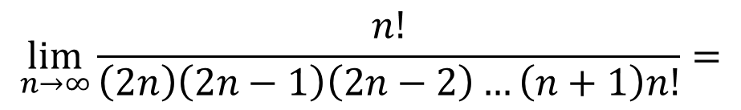
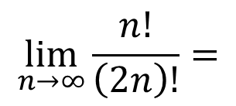
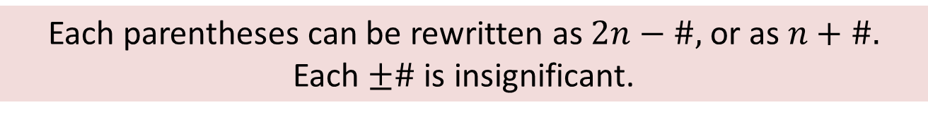
$$\sum_{n=1}^{∞}{\frac{{(−1)}^{n+1}n!}{\left(2n\right)!}}$$
Ex: #20
$$\lim_{n→∞}{\frac{n!}{\left(2n\right)!}}=$$
$$\lim_{n→∞}{\frac{n!}{\left(2n\right)\left(2n−1\right)\left(2n−2\right)…\left(n+1\right)n!}}=$$
$$\lim_{n→∞}{\frac{1}{\left(2n\right)\left(2n−1\right)\left(2n−2\right)…\left(n+1\right)}}=$$
$$\lim_{n→∞}{\frac{1}{2^{k}n^{n}}}$$
$$=0$$
Each parentheses can be rewritten as $2n−\#,$or as $n+\#.$
Each $±\#$ is insignificant.
You may want to quickly verify that the terms are decreasing.
This series converges by the A.S.T.

Slide 11
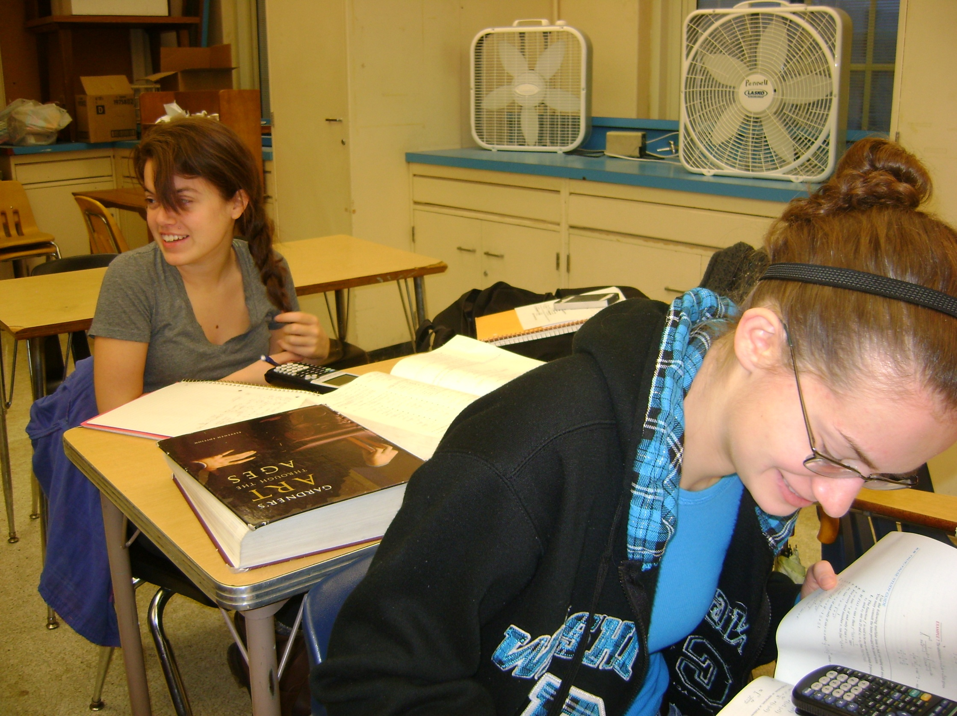
Easy Homework!

