Slide 1
Chapter R
Review

Slide 2
Section R.3
Geometry Essentials

Slide 3
Objectives
Use the Pythagorean Theorem and Its Converse
Know Geometry Formulas
Understand Congruent Triangles and Similar Triangles

Slide 4
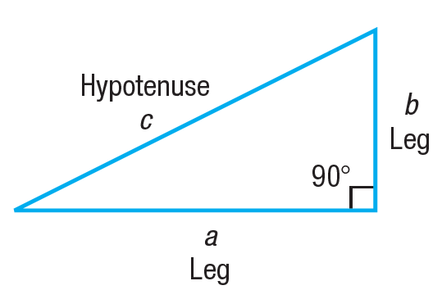
Pythagorean Theorem
THEOREM Pythagorean Theorem
In a right triangle, the square of the length of the hypotenuse is equal to the sum of the squares of the lengths of the legs. That is, in the right triangle shown below,
c² = a² + b²

Slide 5
Example 1: Finding the Hypotenuse of a Right Triangle
In a right triangle, one leg has length 12 and the other has length 5. What is the length of the hypotenuse?
Since the triangle is a right triangle, we use the Pythagorean Theorem with a = 12 and b = 5 to find the length c of the hypotenuse.
From the equation,
c² = a² + b²
c² = 12² + 5² = 144 + 25 = 169

Slide 6
Converse of the Pythagorean Theorem
Converse of the Pythagorean Theorem
In a triangle, if the square of the length of one side equals the sum of the squares of the lengths of the other two sides, the triangle is a right triangle. The 90° angle is opposite the longest side.

Slide 7
Example 2: Verifying That a Triangle Is a Right Triangle (1 of 2)
Show that a triangle whose sides are of lengths 8, 15, and 17 is a right triangle. Identify the hypotenuse.
Square the lengths of the sides.
8² = 64 15² = 225 17² = 289
Notice that the sum of the first two squares (64 and 225) equals the third square (289).
That is, because 64 + 225 = 289, the triangle is a right triangle.
The longest side, 17, is the hypotenuse.
17
8
15

Slide 8
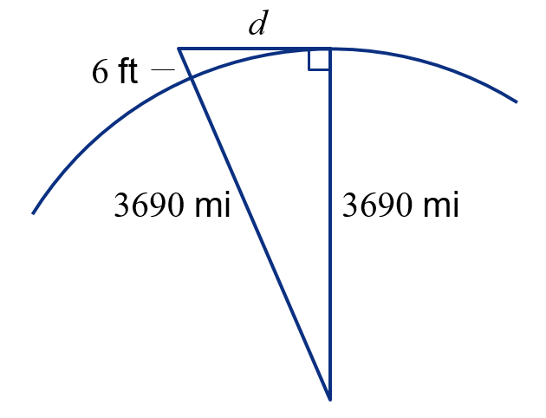
Example 3: Applying the Pythagorean Theorem (1 of 2)
A person who is 6 feet tall is standing on the beach in Fort Lauderdale, Florida, and looks out onto the Atlantic Ocean. Suddenly, a ship appears on the horizon. How far is the ship from shore?
Use the facts that the radius of Earth is 3960 miles and 1 mile = 5280 feet.

Slide 9
Example 3: Applying the Pythagorean Theorem (2 of 2)
Apply the Pythagorean Theorem to the right triangle.
The ship is approximately 3 miles from the shore.

Slide 10
Geometry Formulas (1 of 3)
For a rectangle of length l and width w,
Area = lw Perimeter = 2l + 2w
For a triangle with base b and altitude h,
w
l
h
b

Slide 11
Geometry Formulas (2 of 3)
For a circle of radius r (diameter d = 2r),
Area = πr²
Circumference = 2πr = πd
For a closed rectangular box of length l, width w, and height h,
Volume = lwh
Surface area = 2lh + 2wh + 2lw
r
d
h
w
l

Slide 12
Geometry Formulas (3 of 3)
For a sphere of radius r,
Volume = πr³
Surface area = 4πr²
For a closed right circular cylinder of height h and radius r,
Volume = πr²h
Surface area = 2πr² + 2πrh
r
r
r
h

Slide 13
Example 4: Using Geometry Formulas (1 of 2)
A Christmas tree ornament is in the shape of a triangle on top of a rectangle. How many square inches (in²) of construction paper is required to make the ornament if the height of the triangle is 4 in, the base is 3 in, and the length of the rectangle is 6 in?
4
3
6

Slide 14
Example 4: Using Geometry Formulas (2 of 2)
The amount of construction paper required equals the shaded area. The area is the sum of the areas of the triangle and rectangle.
The triangle has height h = 4 and base b = 3.
The rectangle has l = 6 and w = 3.
Total area = Area of triangle + Area of rectangle
24 in² of construction paper is required.
4
3
6

Slide 15
Congruent Triangles
DEFINITION Congruent Triangles
Two triangles are congruent if each pair of corresponding angles have the same measure and each pair of corresponding sides are the same length.

Slide 16
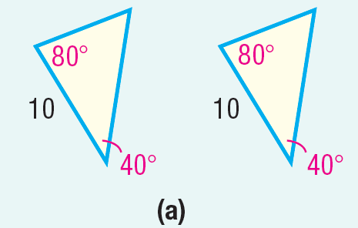
Determining Congruent Triangles (1 of 3)
Angle–Side–Angle Case Two triangles are congruent if two of the angles are equal and the lengths of the corresponding sides between the
two angles are equal.
For example, in Figure (a), the two triangles are congruent because two angles and the included side are equal.

Slide 17
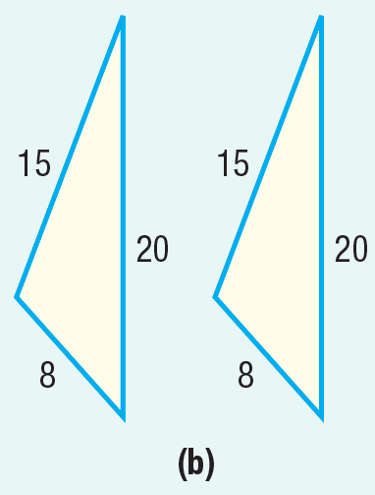
Determining Congruent Triangles (2 of 3)
Side–Side–Side Case Two triangles are congruent if the lengths of the corresponding sides of the triangles are equal.
For example, in Figure (b), the two triangles are congruent because the three corresponding sides are all equal.

Slide 18
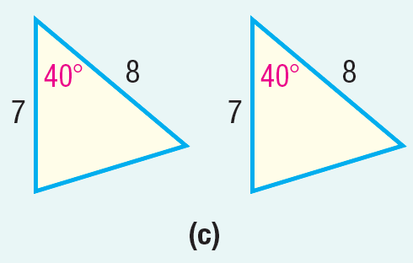
Determining Congruent Triangles (3 of 3)
Side–Angle–Side Case Two triangles are congruent if the lengths of two corresponding sides are equal and the angles between the two sides are the same.
For example, in Figure (c), the two triangles are congruent because two sides and the included angle are equal.

Slide 19
Similar Triangles
DEFINITION Similar Triangles
Two triangles are similar if the corresponding angles are equal and the lengths of the corresponding sides are proportional.

Slide 20
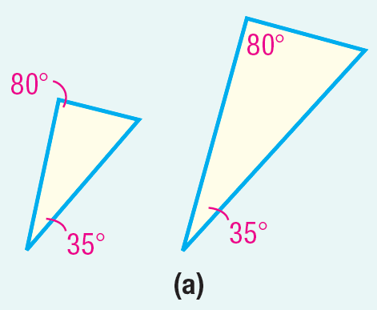
Determining Similar Triangles (1 of 3)
Angle-Angle Case Two triangles are similar if two of the corresponding angles are equal.
For example, in Figure (a), the two triangles are similar because two angles are equal.

Slide 21
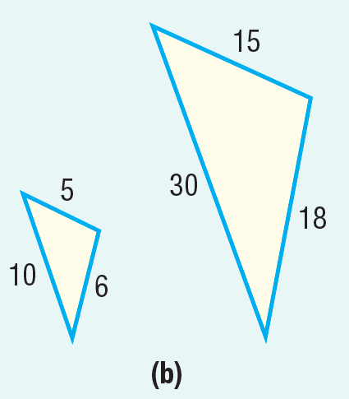
Determining Similar Triangles (2 of 3)
Side–Side–Side Case Two triangles are similar if the lengths of all three sides of each triangle are proportional.
For example, in Figure (b), the two triangles are similar because

Slide 22
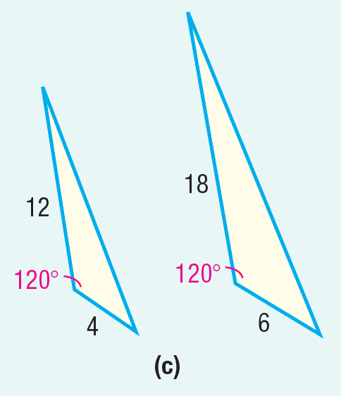
Determining Similar Triangles (3 of 3)
Side–Angle–Side Case Two triangles are similar if two corresponding sides are proportional and the angles between the two sides are equal.
For example, in Figure (c), the two triangles are similar because
and the angles between the sides are equal.

Slide 23
Example 5: Using Similar Triangles (1 of 2)
16
Given that the triangles are similar, find the missing length x and the angles A, B, and C.
Because the triangles are similar, corresponding angels are equal. So A = 30°, B = 75°, and C = 75°.
75°
30°
x
12
B
A
75°
6
C

Slide 24
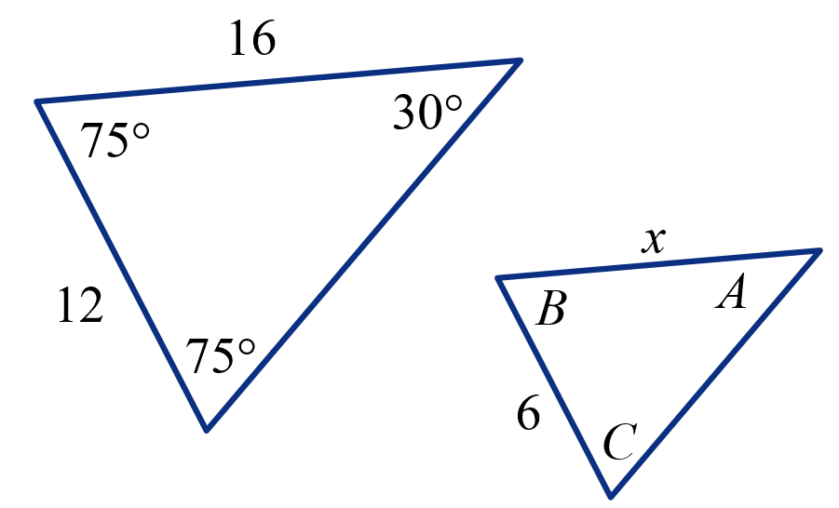
Example 5: Using Similar Triangles (2 of 2)
Also, the corresponding sides are proportional.
That is,
We solve this equation for x.
The missing length is 8 units.

