Slide 1

Chapter 2
Graphs

Slide 2
Section 2.5
Variation

Slide 3
Objectives
Construct a Model Using Direct Variation
Construct a Model Using Inverse Variation
Construct a Model Using Joint Variation

Slide 4
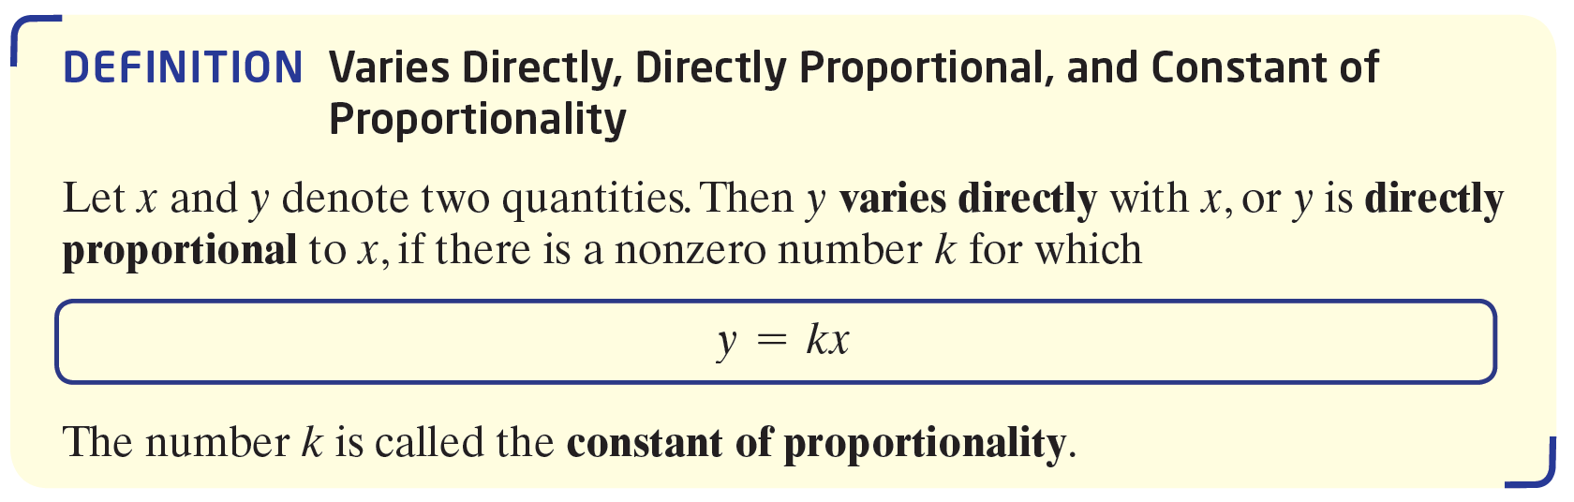
Varies Directly, Directly Proportional, and Constant of Proportionality (1 of 2)

Slide 5
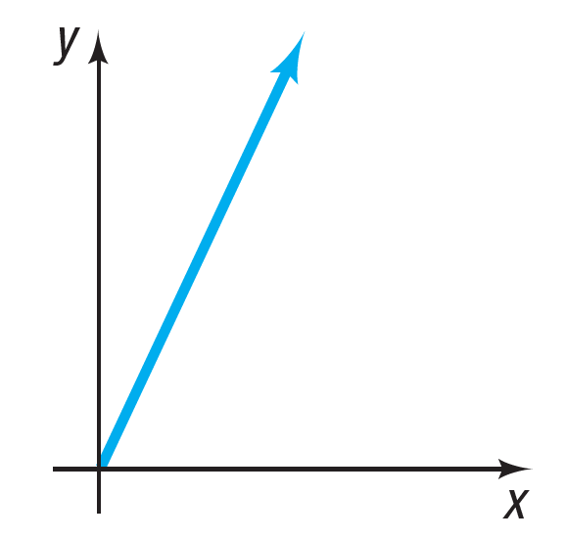
Varies Directly, Directly Proportional, and Constant of Proportionality (2 of 2)
If y varies directly with x,
x > 0, and k, k > 0, is the constant of proportionality, then the graph illustrates the relationship between
y and x.
Note that the constant of proportionality is, in fact, the slope of the line.

Slide 6
Example 1: Mortgage Payments (1 of 3)
The monthly payment p on a mortgage varies directly with the amount borrowed B. If the monthly payment on a 30-year mortgage is $6.25 for every $1000 borrowed, find a formula that relates the monthly payment p to the amount borrowed B for a mortgage with these terms. Then find the monthly payment p when the amount borrowed B is $200,000.

Slide 7
Example 1: Mortgage Payments (2 of 3)
Because p varies directly with B, we know that
p = kB for some constant k.
Because p = 6.25 when B = 1000, it follows that
Since p = kB,
p = 0.00625B
In particular, when B = $200,000,
p = 0.00625($200,000) = $1250

Slide 8
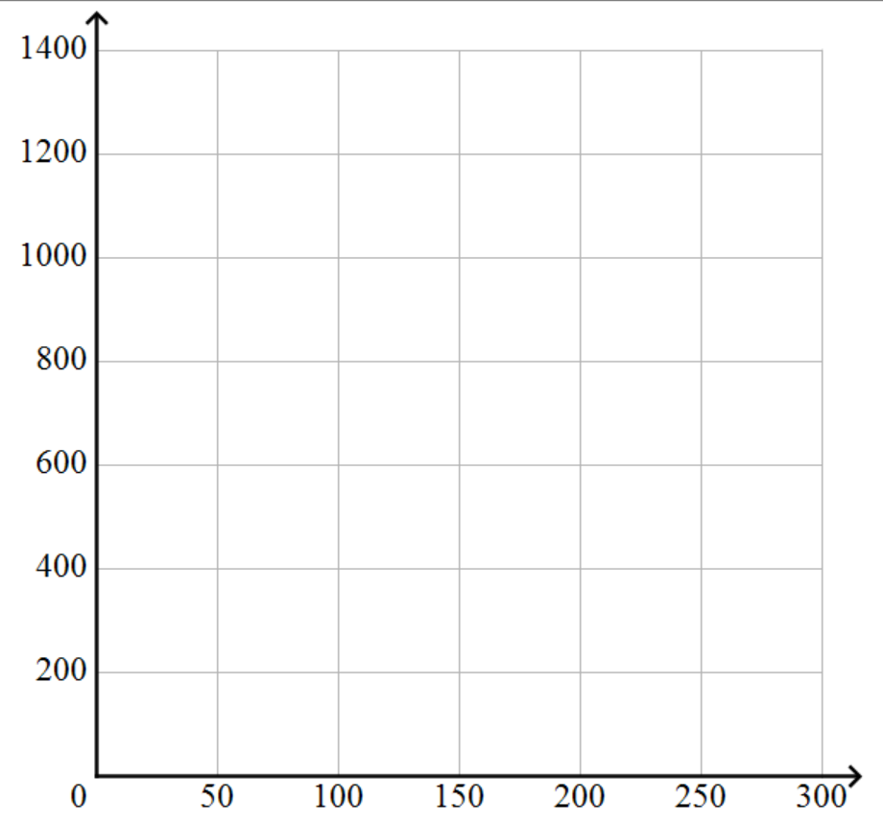
Example 1: Mortgage Payments (3 of 3)
The graph illustrates the relationship between the monthly payment
p and the amount borrowed B.
(200 000, 1250)
Monthly Payment
Amount Borrowed (000’s)

Slide 9
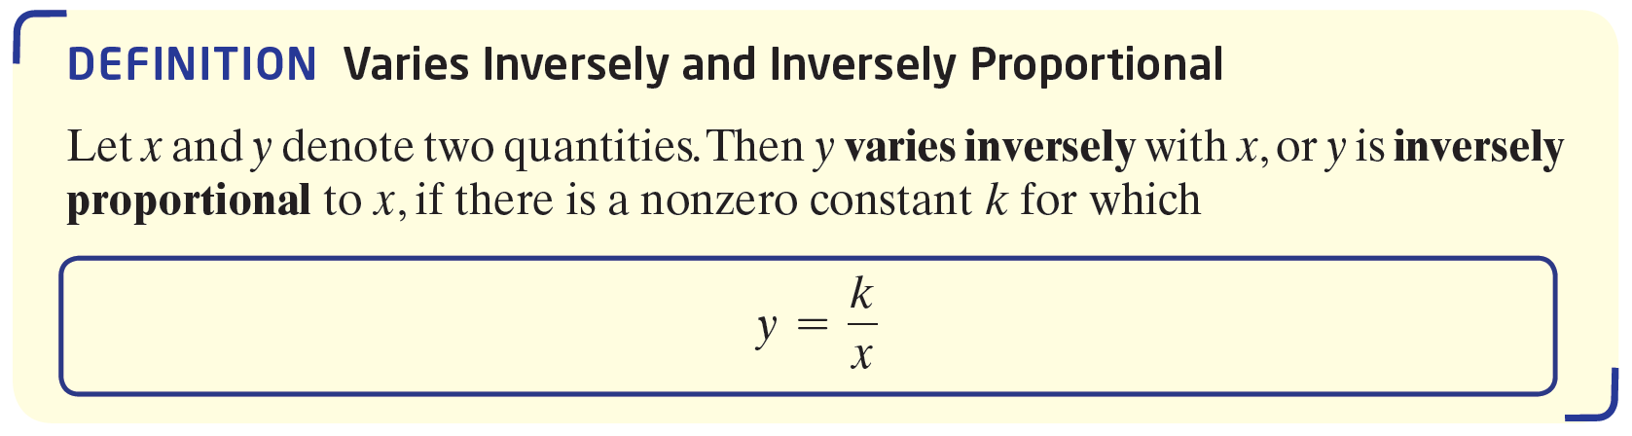
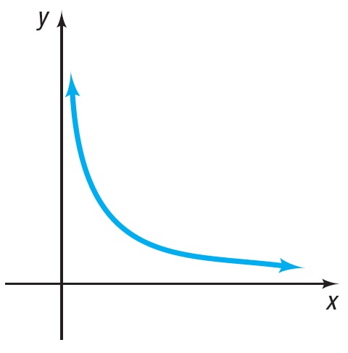
Varies Inversely and Inversely Proportional
The graph illustrates the
relationship between
y and x if y varies inversely
with x and k > 0, x > 0.

Slide 10
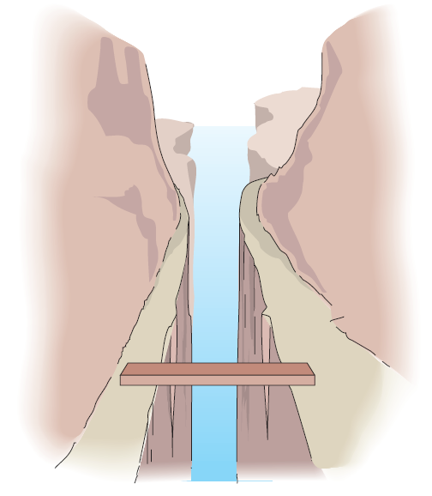
Example 2: Maximum Weight That Can Be Supported by a Piece of Pine (1 of 3)
The maximum weight W that can be safely supported by a 2-inch by 4-inch piece of pine varies inversely with its length l. Experiments indicate that the maximum weight that a 8-foot-long 2-by-4 piece of pine can support is 400 pounds.
Write a general formula relating the
maximum weight W (in pounds) to
length l (in feet). Find the maximum
weight W that can be safely
supported by a length of 20 feet.

Slide 11
Example 2: Maximum Weight That Can Be Supported by a Piece of Pine (2 of 3)
Because W varies inversely with l, we know that
for some constant k. Because W = 400 when l = 8, we have

Slide 12
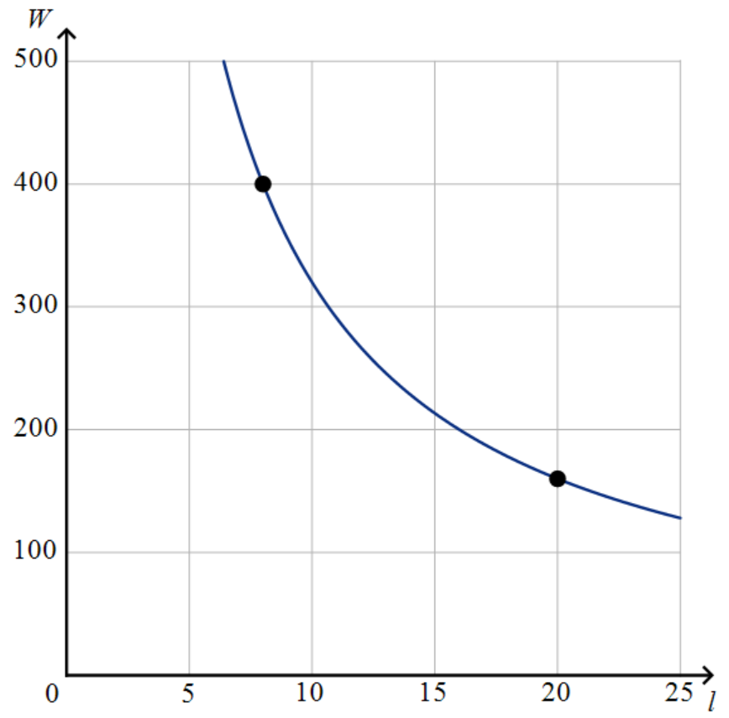
Example 2: Maximum Weight That Can Be Supported by a Piece of Pine (3 of 3)
In particular, the maximum weight W that can safely support the piece of pine 20 feet in length is
The figure illustrates the relationship between the weight W and the length l.
(8, 400)
(20, 160)

Slide 13
Example 3: Modeling a Joint Variation: A Student’s GPA (1 of 2)
A student’s GPA varies jointly with the average amount of time he or she studies each week and the average amount of time spent sleeping each week, and varies inversely with the average amount of time spent on social media each week. Write an equation that relates these quantities.

Slide 14
Example 3: Modeling a Joint Variation: A Student’s GPA (2 of 2)
Begin by assigning symbols to represent the quantities:
G = A Student’s GPA
S = Average amount of time studying weekly
R = Average amount of time sleeping weekly
F = Average amount of time using social media weekly
Then
where k is the constant of proportionality.

Slide 15
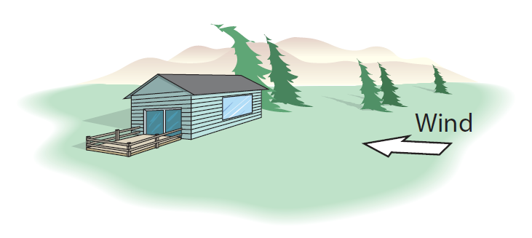
Example 4: Force of the Wind on a Window (1 of 3)
The force F of the wind on a flat surface positioned at a right angle to the direction of the wind varies jointly with the area A of the surface and the square of the speed v of the wind. A wind of 20 miles per hour blowing on a window measuring 3 feet by
4 feet has a force of 120 pounds. What force does a wind of 40 miles per hour exert on a window measuring 4 feet by 5 feet?

Slide 16
Example 4: Force of the Wind on a Window (2 of 3)
Since F varies jointly with A and v², we have
F = kAv²
where k is the constant of proportionality. We are told that F = 120 when A = 3(4) = 12 and v = 20.
Then

Slide 17
Example 4: Force of the Wind on a Window (3 of 3)
Since F = kAv²,
For a wind of 40 miles per hour blowing on a window whose area is A = 4(5) = 20 square feet, the force F is

