Slide 1
Chapter 2
Graphs

Slide 2
Section 2.4
Circles

Slide 3
Objectives
Write the Standard Form of the Equation of a Circle
Graph a Circle
Work with the General Form of the Equation of a Circle

Slide 4
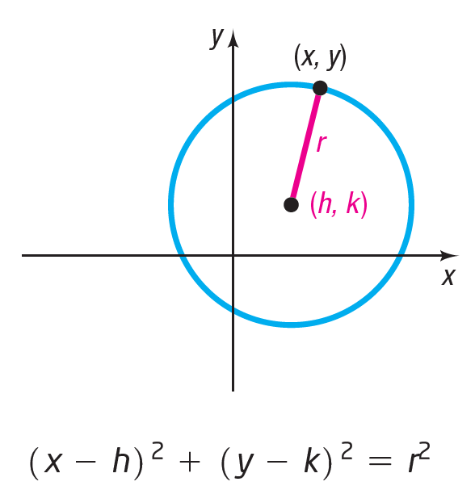
Circle

Slide 5
Standard Form of the Equation of a Circle (1 of 2)

Slide 6
Standard Form of the Equation of a Circle (2 of 2)

Slide 7
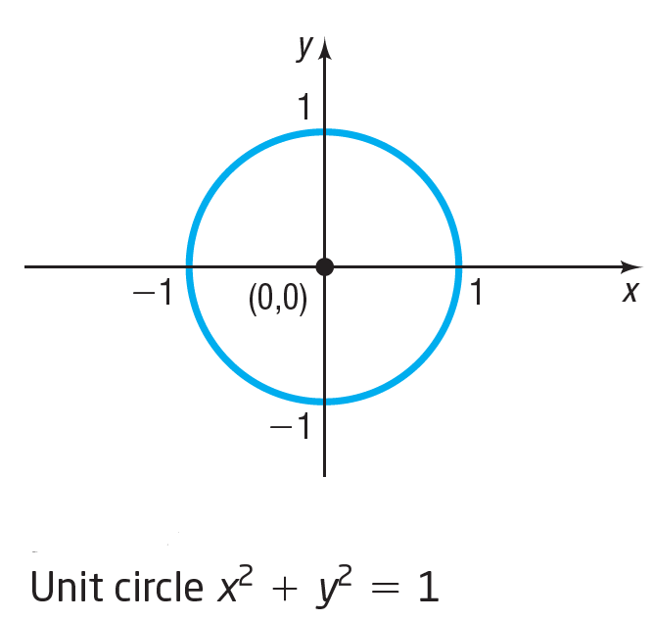
Unit Circle

Slide 8
Example 1: Writing the Standard Form of the Equation of a Circle
Write the standard form of the equation of the circle with radius 6 and center (–2, 5).
Substitute the values r = 6, h = –2, and k = 5, into equation (1).

Slide 9
Example 2: Graphing a Circle (1 of 2)
Graph the equation
The given equation is in the standard form of an equation of a circle. To graph the circle, compare the equation to equation (1). The comparison gives information about the circle.

Slide 10
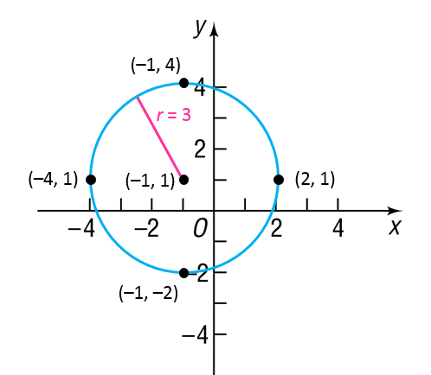
Example 2: Graphing a Circle (2 of 2)
We see that h = –1, k = 1, and r = 3. The circle has center (–1, 1) and a radius of 3 units. To graph this circle, first plot the center (–1, 1). Since the radius is 3, locate four points on the circle by plotting points 3 units to the left, to the right, and up and down from the center. Then use these four points as guides to obtain the graph.

Slide 11
Example 3: Finding the Intercepts of a Circle (1 of 2)
Find the intercepts, if any, of the graph of a circle
To find the x-intercepts, if any, let y = 0 and solve for x. Then
The x-intercepts are

Slide 12
Example 3: Finding the Intercepts of a Circle (2 of 2)
To find the y-intercepts, if any, let x = 0. Then
The y-intercepts are

Slide 13
General Form of the Equation of a Circle

Slide 14
Example 4: Graphing a Circle Whose Equation Is in General Form (1 of 3)
Graph the equation
Group the terms involving x, group the terms involving y, and put the constant on the right side of the equation. The result is

Slide 15
Example 4: Graphing a Circle Whose Equation Is in General Form (2 of 3)
Next, complete the square of each expression in parentheses. Remember that any number added on the left side of the equation must be added on the right.
This equation is the standard form of the equation of a circle with radius 3 and center (3, –2).

Slide 16
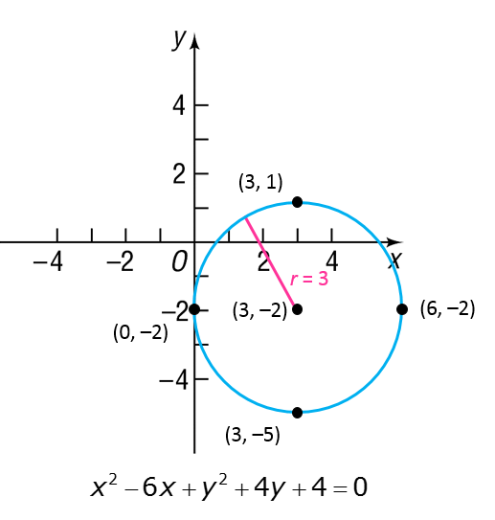
Example 4: Graphing a Circle Whose Equation Is in General Form (3 of 3)
To graph the equation, use the center (3, –2) and the radius 3.

Slide 17
Example 5: Using a Graphing Utility to Graph a Circle (1 of 2)
Graph the equation
This is the equation of a circle with center at the origin and a radius 3. To graph this equation using a graphing utility, begin by solving for y.

Slide 18
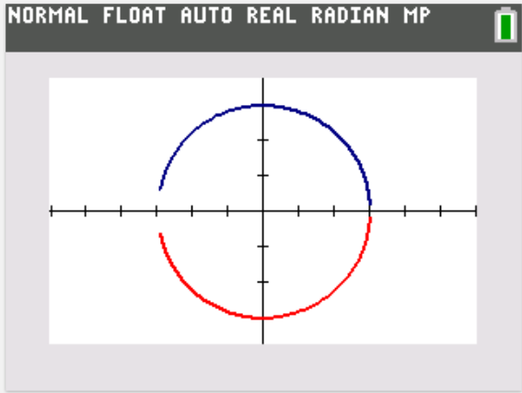
Example 5: Using a Graphing Utility to Graph a Circle (2 of 2)
There are two equations to graph: first graph
and then graph on the same square screen.
(Your circle will appear oval if you do not use a square screen.)
The figure displays the graph using a TI-84 Plus C.
4
–6
6
–4

