Slide 1
Chapter 2
Graphs

Slide 2
Section 2.3
Lines

Slide 3
Objectives
Calculate and Interpret the Slope of a Line
Graph Lines Given a Point and the Slope
Find the Equation of a Vertical Line
Use the Point-Slope Form of a Line; Identify Horizontal Lines
Use the Slope-Intercept Form of a Line
Find an Equation of a Line Given Two Points
Graph Lines Written in General Form Using Intercepts
Find Equations of Parallel Lines
Find Equations of Perpendicular Lines

Slide 4
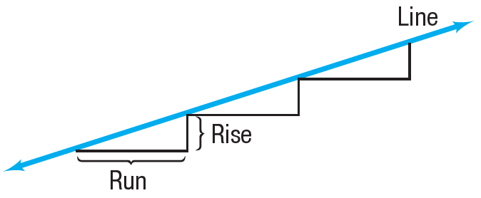
Calculate and Interpret the Slope of a Line
Consider the staircase illustrated. Each step contains exactly the same horizontal run and the same vertical rise.
The ratio of the rise to the run, called the slope, is a numerical measure of the steepness of the staircase.

Slide 5
Slope

Slide 6
Slope of a Line (1 of 4)

Slide 7
Slope of a Line (2 of 4)
The slope m of a nonvertical line may be viewed as
That is, the slope m of a nonvertical line measures the amount y changes when x changes from x₁ to x₂.
The expression is called the average rate of change of y with respect to x.

Slide 8
Slope of a Line (3 of 4)
Two comments about computing the slope of a nonvertical line may prove helpful:
Any two distinct points on the line can be used to compute the slope of the line. Since any two distinct points can be used to compute the slope of a line, the average rate of change of a line is always the same number.

Slide 9
Slope of a Line (4 of 4)
The slope of a line may be computed from P = (x₁, y₁) to Q = (x₂, y₂) or from Q to P because

Slide 10
Example 1: Finding and Interpreting the Slope of a Line Given Two Points
The slope m of the line containing the points (2, 8) and (6, –3) may be computed as
For every 4-unit change in x, y will change by –11 units. That is, if x increases by 4 units, then y will decrease by 11 units.
The average rate of change of y with respect to x is
or as

Slide 11
Example 2: Finding the Slopes of Various Lines Containing the Same Point (1, 2) (1 of 3)
Compute the slopes of the lines L₁, L₂, L₃, and L₄ containing the following pairs of points. Graph all four lines on the same set of coordinate axes.
L₁ : P = (1, 2) Q₁ = (0, 3)
L₂ : P = (1, 2) Q₂ = (0, 0)
L₃ : P = (1, 2) Q₃ = ($−$2, 2)
L₄ : P = (1, 2) Q₄ = (1, $−$2)

Slide 12
Example 2: Finding the Slopes of Various Lines Containing the Same Point (1, 2) (2 of 3)
Let m₁, m₂, m₃, and m₄ denote the slopes of the lines L₁, L₂, L₃, and L₄, respectively.
Then
m₄ is undefined because x₁ = x₂ = 1

Slide 13
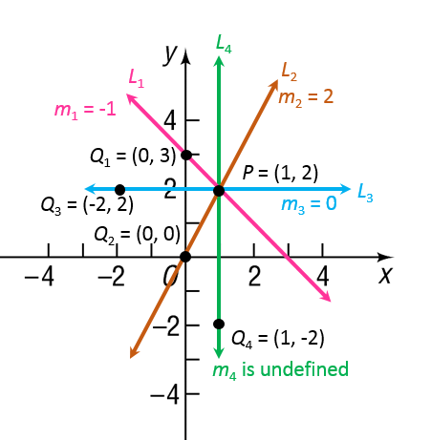
Example 2: Finding the Slopes of Various Lines Containing the Same Point (1, 2) (3 of 3)
The Figure illustrates the following facts:
When the slope of a line is positive, the line slants upward from left to right (L₂).
When the slope of a line is negative, the line slants downward from left to right (L₁).
When the slope is 0, the line is horizontal (L₃).
When the slope is undefined, the line is vertical (L₄).

Slide 14
Example 3: Graphing a Line Given a Point and a Slope (1 of 6)
Draw a graph of the line that contains the point (2, 1) and has a slope of:

Slide 15
Example 3: Graphing a Line Given a Point and a Slope (2 of 6)
means that for .
every horizontal change (run) of 2 units to the right, there will be a vertical change (rise) of 3 units.
Start at the given point, (2, 1) and move 2 units to the right and 3 units up arriving at the point (4, 4).

Slide 16
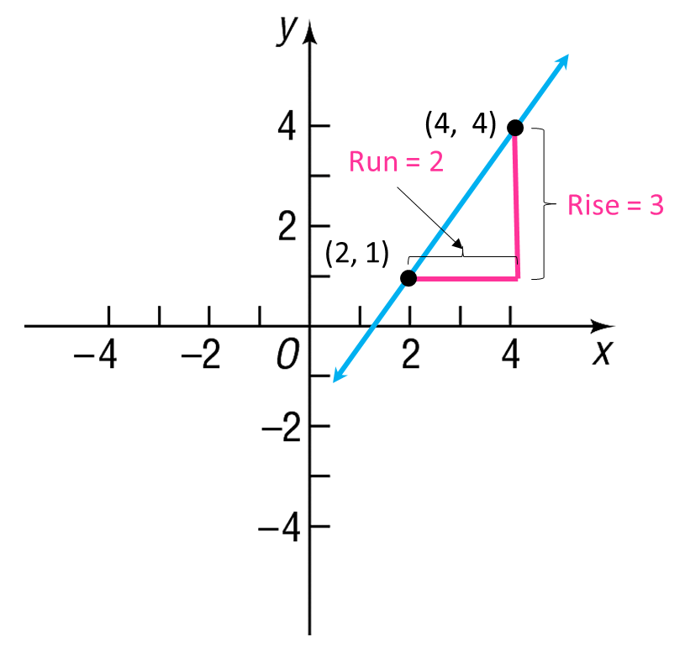
Example 3: Graphing a Line Given a Point and a Slope (3 of 6)
Drawing the line through (4, 4) and (2, 1) gives the graph.

Slide 17
Example 3: Graphing a Line Given a Point and a Slope (4 of 6)
means that for
every horizontal change of 2 units to the right, there will be a corresponding vertical change of –5 units (a downward movement).
Start at the given point (2, 1) and move 2 units to the right and then 5 units down, arriving at the point (4, –4).

Slide 18
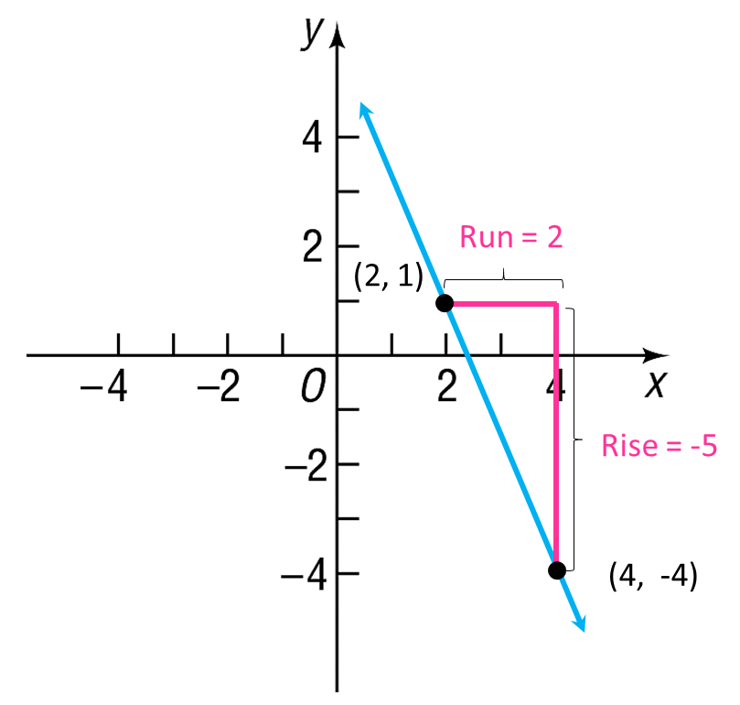
Example 3: Graphing a Line Given a Point and a Slope (5 of 6)
Drawing the line through these points gives the graph.

Slide 19
Example 3: Graphing a Line Given a Point and a Slope (6 of 6)
.
so for every horizontal change of –2 units (a movement to the left), there is corresponding vertical change of 5 units (upward). This approach leads to the point (0, 6).

Slide 20
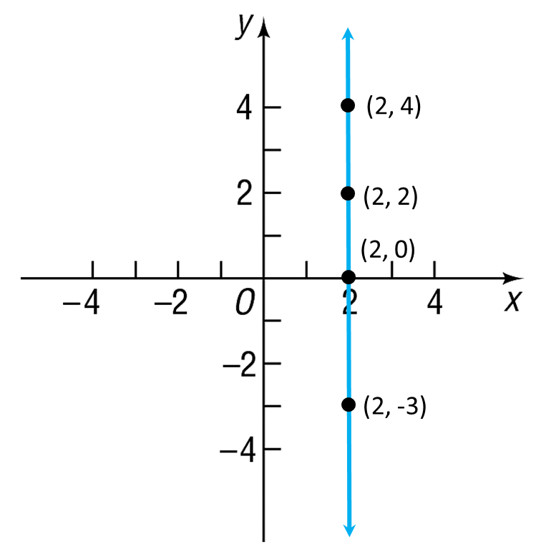
Example 4: Graphing a Line
Graph the equation x = 2
To graph x = 2, find all points (x, y) in the plane for which x = 2. No matter what y-coordinate is used, the corresponding x-coordinate always equals 2.
Consequently, the graph of the equation x = 2 is a vertical line with x-intercept 2 and undefined slope.
x = 2

Slide 21
Equation of a Vertical Line
Theorem Equation of a Vertical Line
A vertical line is given by an equation of the form x = a
where a is the x-intercept.

Slide 22
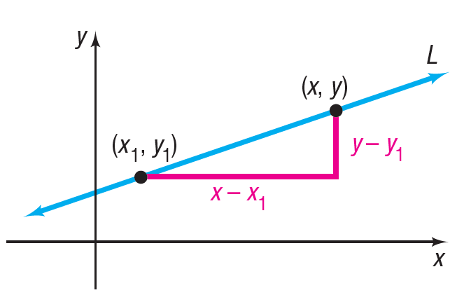
Point-Slope Form of an Equation of a Line

Slide 23
Example 5: Finding the Point–Slope Form of an Equation of a Line (1 of 2)
Find the point-slope form of an equation of the line with slope 3, containing the point (1, 0).
An equation of the line with slope 3 that contains the point (1, 0) can be found by using the point-slope form with m = 3, x₁ = 1, and y₁ = 0.
m = 3, x₁ = 1, y₁ = 0
Solve for y.

Slide 24
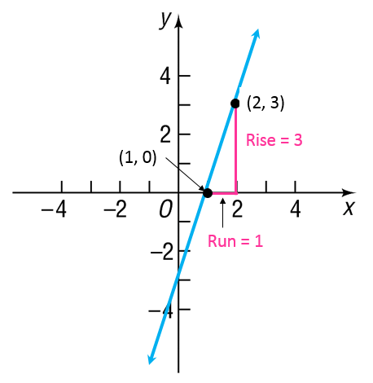
Example 5: Finding the Point–Slope Form of an Equation of a Line (2 of 2)
y = 3x $−$ 3

Slide 25
Example 6: Finding the Equation of a Horizontal Line (1 of 2)
Find an equation of the horizontal line containing the point (2, 3).
Because all the y-values are equal on a horizontal line, the slope of a horizontal line is 0.
To get an equation, use the point-slope form with m = 0, x₁ = 2, and y₁ = 3.
m = 0, x₁ = 2, and y₁ = 3
Solve for y.

Slide 26
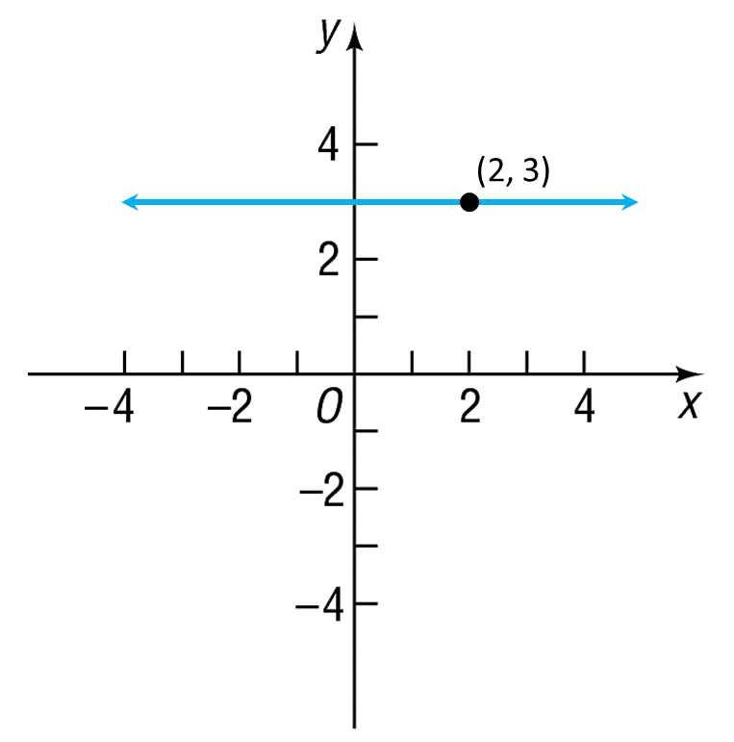
Example 6: Finding the Equation of a Horizontal Line (2 of 2)
y = 3

Slide 27
Equation of a Horizontal Line

Slide 28
Slope-Intercept Form of an Equation of a Line

Slide 29
Example 7: Finding the Slope and y-Intercept of a Line (1 of 2)
Find the slope m and y-intercept b of the equation 2x + 3y = 6. Graph the equation.
To find the slope and y-intercept, write the equation in slope-intercept form by solving for y.
y = mx + b

Slide 30
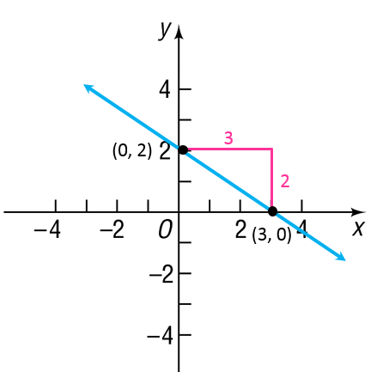
Example 7: Finding the Slope and y-Intercept of a Line (2 of 2)
The coefficient of x, is the slope, and the constant, 2, is the y-intercept. Graph the line with the y-intercept 2 and the slope
Starting at the point (0, 2), go to the right 3 units and then down 2 units to the point (3, 0). Draw the line through these points.

Slide 31
Example 8: Finding an Equation of a Line Given Two Points (1 of 2)
Find an equation of the line containing the points (3, 2) and (–3, 4). Graph the line.
First compute the slope of the line with (x₁, y₁) = (3, 2) and (x₂, y₂) = (–3, 4).

Slide 32
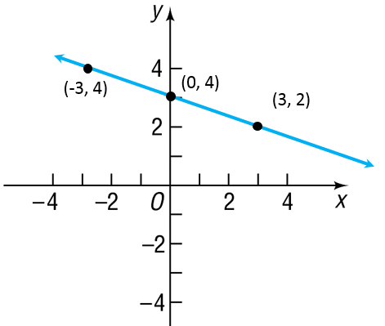
Example 8: Finding an Equation of a Line Given Two Points (2 of 2)
Use the point (x₁, y₁) = (3, 2) and the slope
to get the point–slope form of the equation of the line.
y – y₁ = m(x – x₁)
(0, 3)
y = mx + b
y = – $\frac{\text{1}}{\text{3}}$x + 3

Slide 33
General Form
*Some texts uses the term standard form.

Slide 34
Example 9: Graphing an Equation in General Form Using Its Intercepts (1 of 3)
Graph the equation 2x + 3y = 6 by finding its intercepts.
To obtain the x-intercept, let y = 0 in the equation and solve for x.
2x + 3y = 6
2x + 3(0) = 6 Let y = 0.
2x = 6
x = 3 Divide both sides by 2.
The x-intercept is 3 and the point (3, 0) is on the graph of the equation.

Slide 35
Example 9: Graphing an Equation in General Form Using Its Intercepts (2 of 3)
To obtain the y-intercept, let x = 0 in the equation and solve for y.
2x + 3y = 6
2(0) + 3y = 6 Let x = 0.
3y = 6
y = 2 Divide both sides by 3.
The y-intercept is 2 and the point (0, 2) is on the graph of the equation. Plot the points (3, 0) and (0, 2) and draw the line through the points.

Slide 36
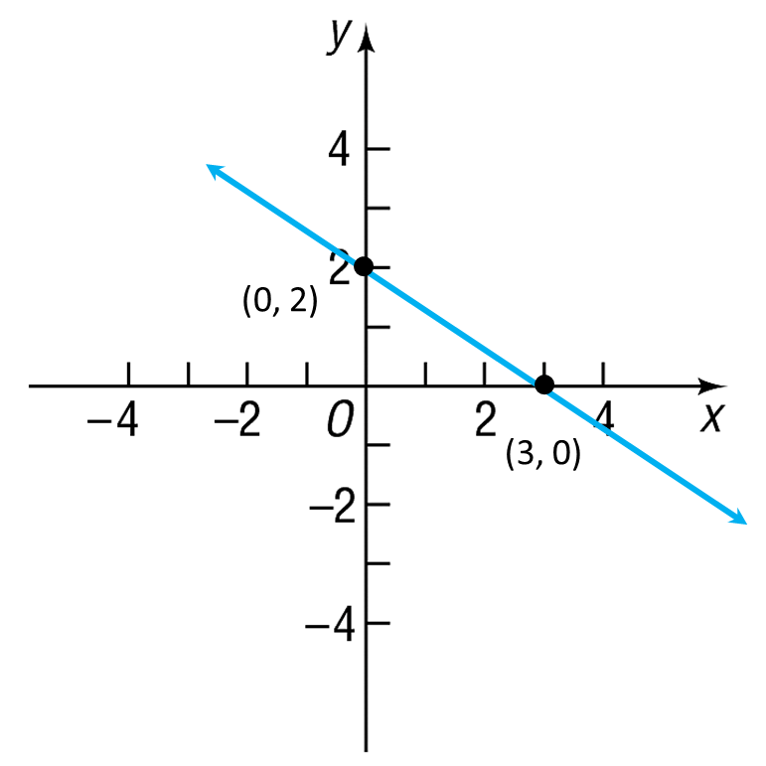
Example 9: Graphing an Equation in General Form Using Its Intercepts (3 of 3)

Slide 37
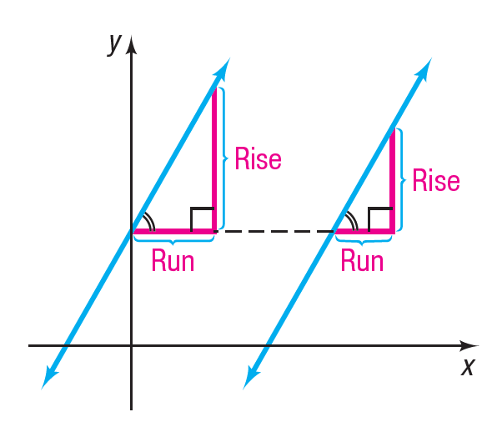
Parallel Lines (1 of 2)
When two lines (in the plane) do not intersect (that is, they have no points in common), they are parallel.

Slide 38
Parallel Lines (2 of 2)
If two nonvertical lines are parallel, then their slopes are equal and they have different y-intercepts.
If two nonvertical lines have equal slopes and they have different y-intercepts, then they are parallel.

Slide 39
Example 10: Showing That Two Lines Are Parallel (1 of 3)
Show that the lines given by the following equations are parallel.
L₁ : x + 2y = 6 L₂ : 2x + 4y = 0

Slide 40
Example 10: Showing That Two Lines Are Parallel (2 of 3)
To determine whether these lines have equal slopes and different y-intercepts, write each equation in slope–intercept form.
L₁:
L₂:

Slide 41
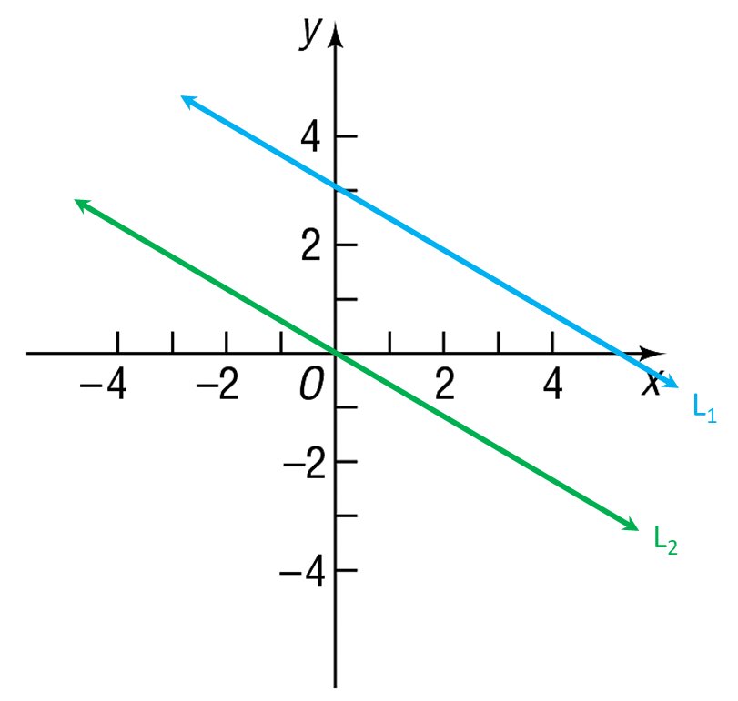
Example 10: Showing That Two Lines Are Parallel (3 of 3)
Because these lines have the same slope,
but different y-intercepts, the lines are parallel.

Slide 42
Example 11: Find a Line That Is Parallel to a Given Line (1 of 3)
Find an equation for the line that contains the point (1, 0) and is parallel to the line x + 2y = 6.
Since the two lines are to be parallel, the slope of the line being sought equals the slope of the line x + 2y = 6.
Begin by writing the equation of the line x + 2y = 6 in slope–intercept form.

Slide 43
Example 11: Find a Line That Is Parallel to a Given Line (2 of 3)
The slope is Since the line containing the point
(1, 0) , also has slope use the point–slope form
to obtain its equation.
m = x₁ = 1, y₁ = 0
Slope–intercept form
General form

Slide 44
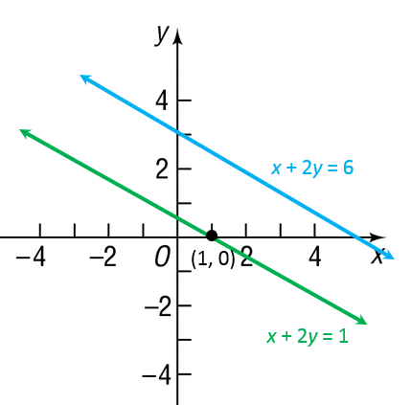
Example 11: Find a Line That Is Parallel to a Given Line (3 of 3)
The line x + 2y = 1 is parallel to the line x + 2y = 6 and contains the point (1, 0).

Slide 45
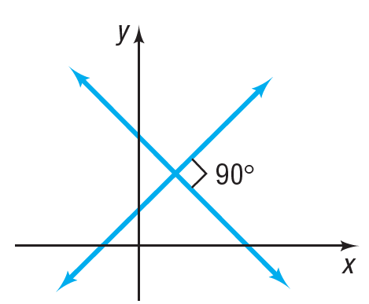
Perpendicular Lines
When two lines intersect at a right angle (90°), they are perpendicular.

Slide 46
Example 12: Finding the Slope of a Line Perpendicular to Another Line
If a line has slope any line having slope 2 is
perpendicular to it.

Slide 47
Example 13: Finding an Equation of a Line Perpendicular to a Given Line (1 of 3)
Find an equation of the line that contains the point (1, –2) and is perpendicular to the line x + 2y = 2. Graph the two lines.
First write the equation of the given line in slope–intercept form to find its slope.
Proceed to solve for y.
Place in the form y = mx + b.

Slide 48
Example 13: Finding an Equation of a Line Perpendicular to a Given Line (2 of 3)
The given line has slope Any line perpendicular to this line will have slope 2. Because the point (1, –2) is on this line with slope 2, use the point–slope form of the equation of a line.
Point–slope form
m = 2, x₁ = 1, y₁ = −2

Slide 49
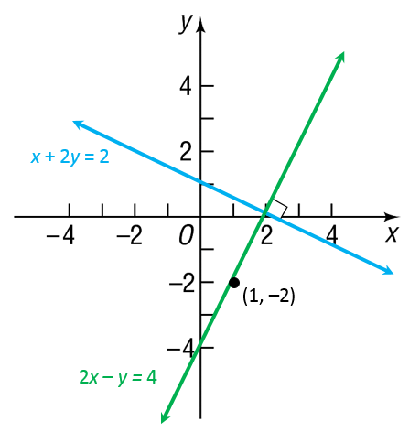
Example 13: Finding an Equation of a Line Perpendicular to a Given Line (3 of 3)
To obtain other forms of the equation, proceed as follows:
Simplify
Slope-intercept form
General form

