Slide 1

Chapter 2
Graphs

Slide 2
Section 2.1
The Distance and Midpoint Formulas

Slide 3
Objectives
Use the Distance Formula
Use the Midpoint Formula

Slide 4
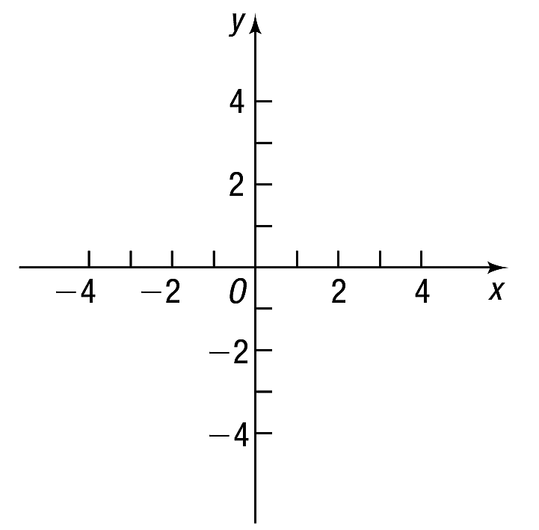
Rectangular Coordinates
Begin with two real number lines located in the same plane:
one horizontal and the other vertical.
The horizontal line is called the x-axis, the vertical line the y-axis, and the point of intersection the origin O.

Slide 5
Rectangular Coordinates
The coordinate system described here is called a rectangular or Cartesian coordinate system.
The plane formed by the x-axis and y-axis is sometimes called the xy-plane, and the
x-axis and y-axis are referred to as the coordinate axes.

Slide 6
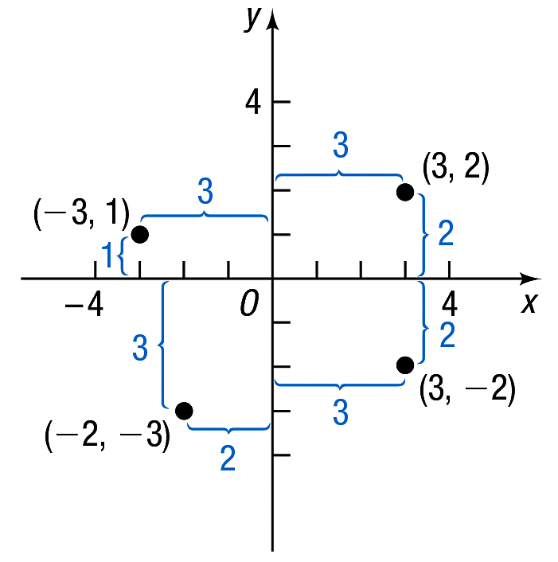
Rectangular Coordinates
Any point P in the xy-plane can be located by using an ordered pair (x, y) of real numbers.
The ordered pair (x, y), also called the coordinates of P, then gives us enough information to locate the point P in the plane.

Slide 7
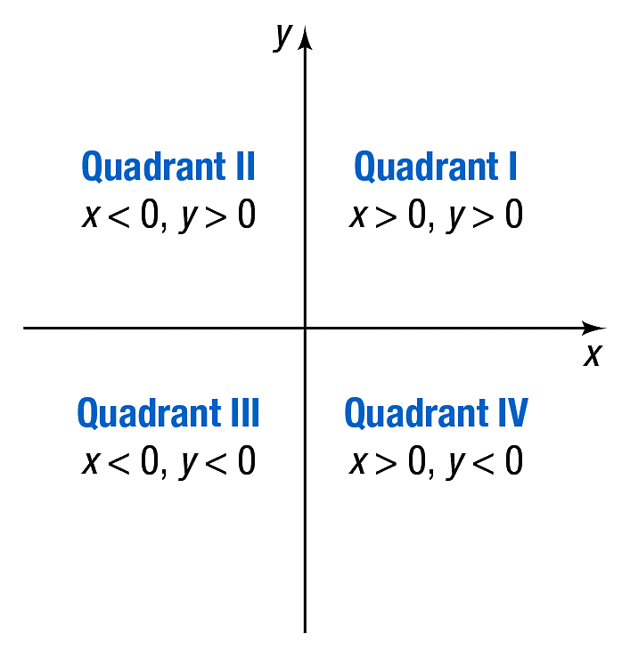
Rectangular Coordinates
If (x, y) are the coordinates of a point P, then x is called the x-coordinate, or abscissa, of P, and y is the y-coordinate, or ordinate, of P.
The coordinate axes divide the xy-plane into four sections called quadrants.

Slide 8
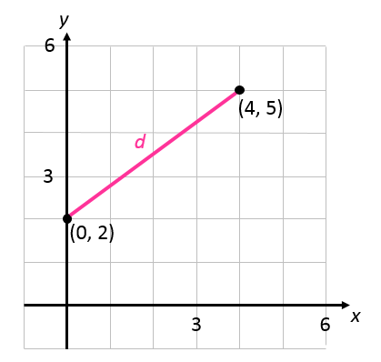
Example 1: Finding the Distance between Two Points (1 of 3)
Find the distance d between the points (0, 2) and (4, 5).
First plot the points (0, 2)
and (4, 5) and connect
them with a straight line.

Slide 9
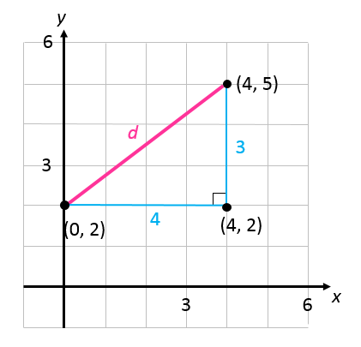
Example 1: Finding the Distance between Two Points (2 of 3)
To find the length d, begin by drawing a horizontal line from (0, 2) to (4, 2) and a vertical line from (4, 2) to (4, 5),
forming a right triangle,
as shown in the figure.

Slide 10

Example 1: Finding the Distance between Two Points (3 of 3)
One leg of the triangle is of length 4
(since |4 $−$ 0| = 4), and the other is of length 3 (since |5 – 2| = 3).
By the Pythagorean
Theorem, the square of
the distance d that we
seek is

Slide 11
Theorem
Distance Formula
The distance between to points
denoted by is

Slide 12
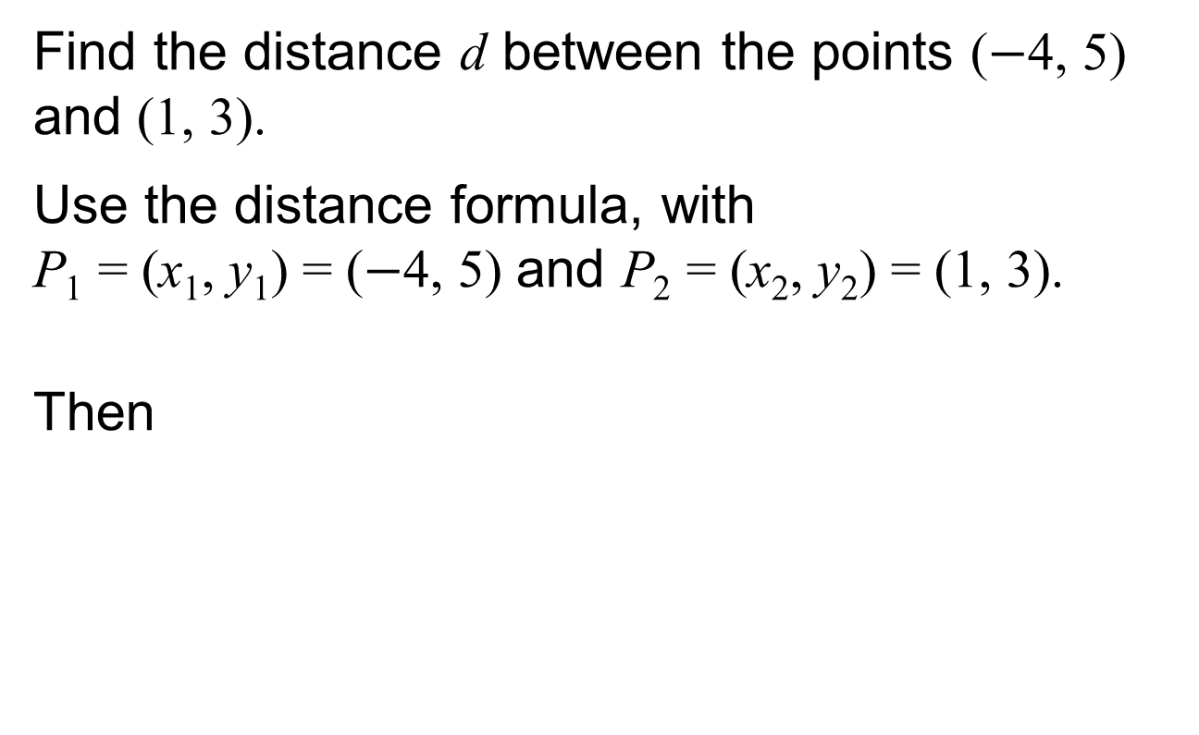
Example 2: Using the Distance Formula
Find the distance d between the points ($−$4, 5) and (1, 3).
Use the distance formula, with
P₁ = (x₁, y₁) = ($−$4, 5) and P₂ = (x₂, y₂) = (1, 3).
Then

Slide 13
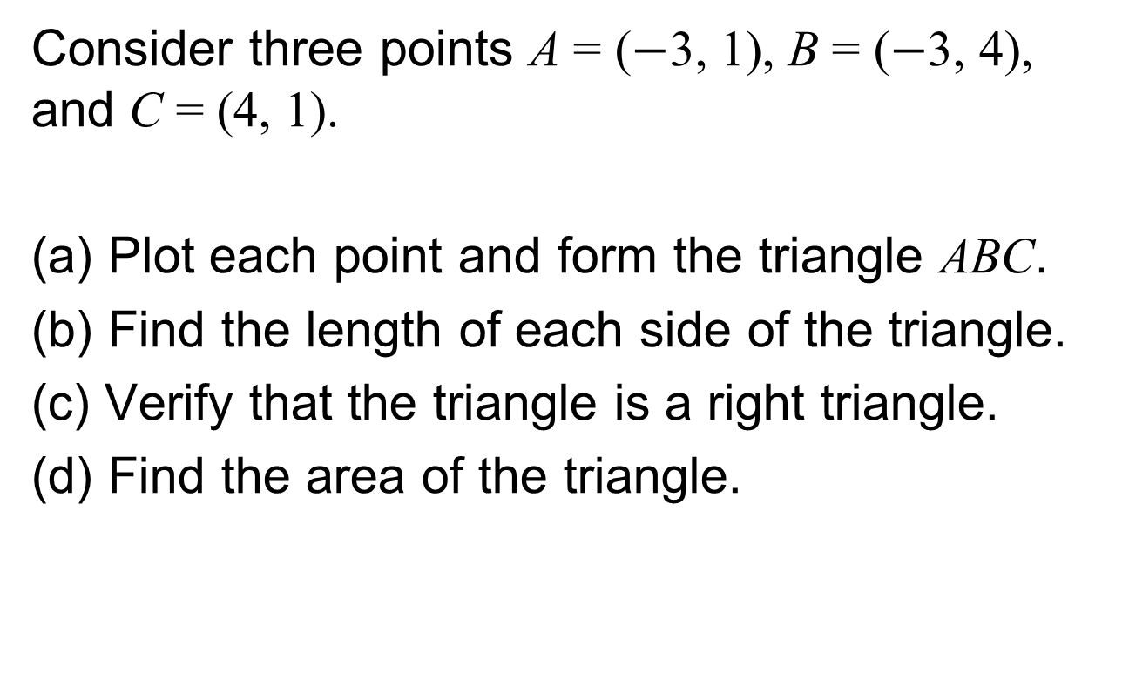
Example 3: Using Algebra to Solve a Geometry Problem (1 of 5)
Consider three points A = ($−\text{3}$, 1), B = ($−$3, 4), and C = (4, 1).
(a) Plot each point and form the triangle ABC.
(b) Find the length of each side of the triangle.
(c) Verify that the triangle is a right triangle.
(d) Find the area of the triangle.

Slide 14
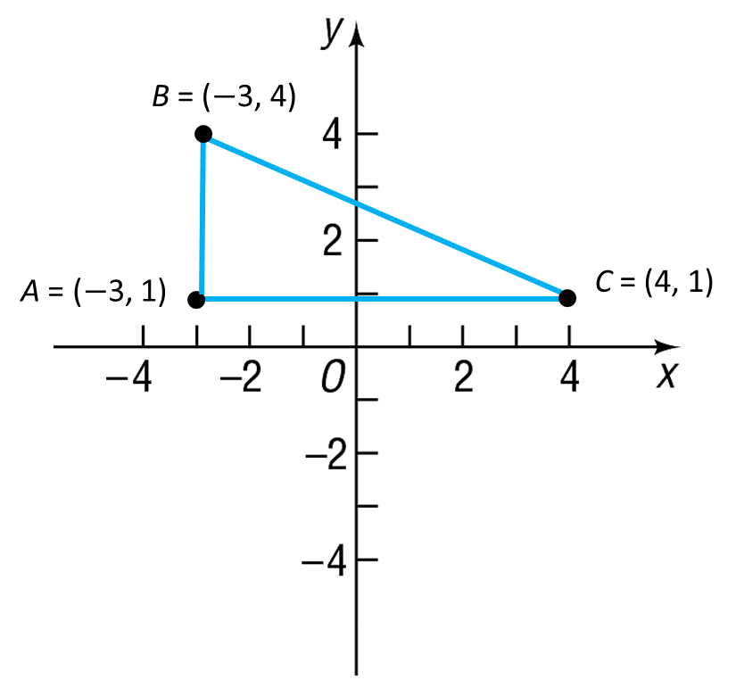
Example 3: Using Algebra to Solve a Geometry Problem (2 of 5)
(a) The figure shows the points A, B, C and the triangle ABC.

Slide 15
Example 3: Using Algebra to Solve a Geometry Problem (3 of 5)
(b) To find the length of each side of the triangle, use the distance formula.

Slide 16
Example 3: Using Algebra to Solve a Geometry Problem (4 of 5)
(c) If the sum of the squares of the lengths of two of the sides equals the square of the length of the third side, then the triangle is a right triangle. It seems reasonable to conjecture that the right angle is at vertex A. Check to see whether
Using the results from part (b) yields
It follows from the converse of the Pythagorean Theorem that triangle ABC is a right triangle.

Slide 17
Example 3: Using Algebra to Solve a Geometry Problem (5 of 5)
(d) Because the right angle is at vertex A, the sides AC and AB form the base and height of the triangle. Its area is

Slide 18
Theorem
Midpoint Formula
The midpoint M = (x, y) of a line segment from

Slide 19
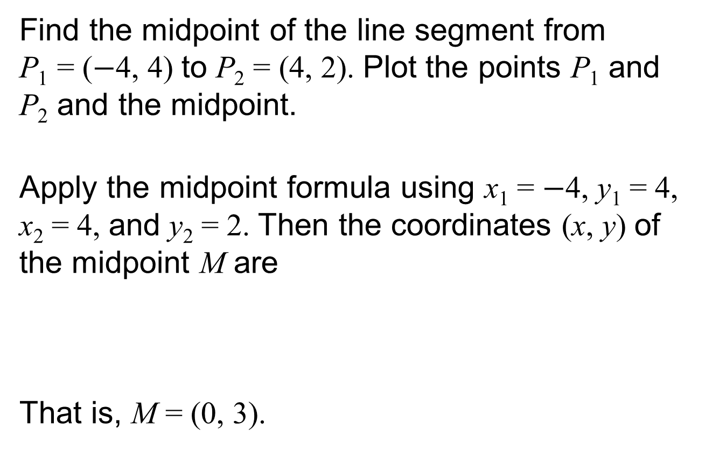
Example 4: Finding the Midpoint of a Line Segment (1 of 2)
Find the midpoint of the line segment from
P₁ = ($−$4, 4) to P₂ = (4, 2). Plot the points P₁ and P₂ and the midpoint.
Apply the midpoint formula using x₁ = $−$4, y₁ = 4, x₂ = 4, and y₂ = 2. Then the coordinates (x, y) of the midpoint M are
That is, M = (0, 3).

Slide 20
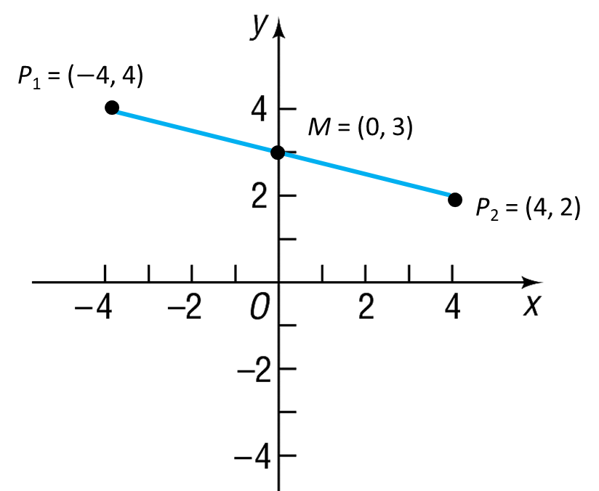

Example 4: Finding the Midpoint of a Line Segment (2 of 2)
The graph shows line segment P₁ = ($−$4, 4) to
P₂ = (4, 2) and the midpoint, M = (0, 3).

