Slide 1
Chapter 1
Equations and Inequalities

Slide 2
Section 1.7
Problem Solving: Interest, Mixture, Uniform Motion, Constant Rate Job Applications

Slide 3
Objectives
Translate Verbal Descriptions into Mathematical Expressions
Solve Interest Problems
Solve Mixture Problems
Solve Uniform Motion Problems
Solve Constant Rate Job Problems

Slide 4
Example 1: Translating Verbal Descriptions into Mathematical Expressions
Let C represent the circumference of a circle and r the radius. The circumference of a circle is the product of π times twice the radius.
Translation: C = 2πr
b) Let x denote a number.
The number 4 times as large as x is 4x.
The number 5 less than x is x – 5.
The number that exceeds x by 7 is x + 7.
The number that, when added to x, gives 6 is 6 – x.

Slide 5
Steps for Solving Applied Problems (1 of 2)
Step 1: Read the problem carefully, perhaps two or three times. Pay particular attention to the question being asked in order to identify what you are looking for. Identify any relevant formulas you may need (d = rt, A = πr², etc.). If you can, determine realistic possibilities for the answer.
Step 2: Assign a letter (variable) to represent what you are looking for, and if necessary, express any remaining unknown quantities in terms of this variable.

Slide 6
Steps for Solving Applied Problems (2 of 2)
Step 3: Make a list of all the known facts, and translate them into mathematical expressions. These may take the form of an equation or an inequality involving the variable. If possible, draw an appropriately labeled diagram to assist you. Sometimes, creating a table or chart helps.
Step 4: Solve for the variable, and then answer the question.
Step 5: Check the answer with the facts in the problem. If it agrees, congratulations! If it does not agree, review your work and try again.

Slide 7
Simple Interest Formula
If a principal of P dollars is borrowed for a period of t years at a per annum interest rate r, expressed as a decimal, the interest I charged is
I = Prt

Slide 8
Example 2: Finance: Computing Interest on a Loan (1 of 2)
Suppose that Julia borrows $1000 for 9 months at the simple interest rate of 6% per annum.
What is the interest that Julia will be charged on the loan? How much does Julia owe after 9 months?

Slide 9
Example 2: Finance: Computing Interest on a Loan (2 of 2)
The rate of interest is given per annum, so the actual time that the money is borrowed must be expressed in years.
The interest charged would be the principal, $1000, times the rate of interest (6% = 0.06), times the time
in years,
Interest charged = I = Prt
After 9 months, Julia will owe what she borrowed plus interest:
$1000 + $45 = $1045

Slide 10
Example 3: Financial Planning (1 of 5)
Samantha has $50,000 to invest and wants an annual return of $2500, which requires an overall rate of return of 5%.
She can invest in a safe, government-insured certificate of deposit, but it pays only 2%. To obtain 5%, she agrees to invest some of her money in noninsured corporate bonds paying 8%.
How much should be placed in each investment to achieve her goal?

Slide 11
Example 3: Financial Planning (2 of 5)
Step 1: The question is asking for two dollar amounts: the principal to invest in the corporate bonds and the principal to invest in the certificate of deposit.
Step 2: Let b represent the amount (in dollars) to be invested in the bonds. Then 50,000 – b is the amount that will be invested in the certificate.

Slide 12
Example 3: Financial Planning (3 of 5)
Step 3: We set up a table.
 | Principal ($) | Rate | Time (yr) | Interest ($)
Bonds | b | 8% = 0.08 | 1 | 0.08b
Certificate | 50,000 – b | 2% = 0.02 | 1 | 0.02(50,000 – b)
Total | 50,000 | 5% = 0.05 | 1 | 0.05(50,000) = 2500

Slide 13
Example 3: Financial Planning (4 of 5)
Since the combined interest from the investments is equal to the total interest, we have
Bond interest + Certificate interest = Total interest
0.08b + 0.02(50,000 – b) = 2500
(Note that the units are consistent: the unit is dollars on both sides.)

Slide 14
Example 3: Financial Planning (5 of 5)
Step 4: 0.08b + 1000 – 0.02b = 2500
0.06b = 1500 Simplify.
b = 25,000 Divide both sides by 0.06.
Samantha should place $25,000 in the bonds and $50,000 – 25,000 = $25,000 in the certificate.
Step 5: The interest on the bonds after 1 year is 0.08(25,000) = $2000; the interest on the certificate after 1 year is 0.02(25,000) = $500.
The total annual interest is $2500, the required amount.

Slide 15
Example 4: Blending Coffee (1 of 4)
A coffee manufacturer wants to market a new blend of coffee that sells for $4.10 per pound by mixing two coffees that sell for $2.75 and $5 per pound, respectively.
What amounts of each coffee should be blended to obtain the desired mixture?
[Hint: Assume that the total weight of the desired blend is 100 pounds.]

Slide 16
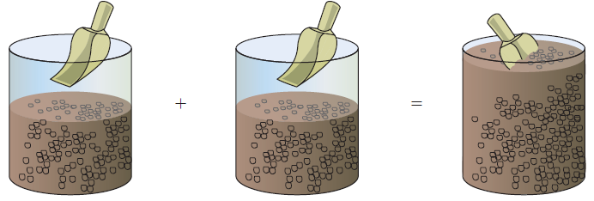
Example 4: Blending Coffee (2 of 4)
Let x represent the number of pounds of the first kind of coffee. Then 100 – x represents the number of pounds of the second kind of coffee.
$2.75 per pound
$5 per pound
$4.10 per pound
x pounds
100 – x pounds
100 pounds

Slide 17
Example 4: Blending Coffee (3 of 4)
Since there is to be no difference in revenue between selling the two coffees separately and selling the blend, we have
$2.75 ⋅ x + $5 ⋅ (100 – x) = $4.10 ⋅ 100
Now solve the equation:
2.75x + 5(100 – x) = 4.10(100)
2.75x + 500 – 5x = 410
–2.25x = –90
x = 40
{
}
{
}
{
}
{
}
{
}
{
}
Price per pound
Pounds of coffee
+
Price per pound
Pounds of coffee
=
Price per pound of blend
Pounds of blend

Slide 18
Example 4: Blending Coffee (4 of 4)
The manufacturer should blend 40 pounds of the first kind of coffee with 100 – 40 = 60 pounds of the second kind of coffee to get the desired blend.
Check: The 40 pounds of coffee would sell for $2.75(40) = $110, and the 60 pounds of coffee would sell for $5(60) = $300.
The total revenue, $410, equals the revenue obtained from selling the blend, as desired.

Slide 19
Uniform Motion Formula
If an object moves at an average speed (rate) r, the distance d covered in time t is given by the formula
d = rt
That is, Distance = Rate ⋅ Time

Slide 20
Example 5: Physics: Uniform Motion (1 of 4)
Tiffany, who is a long-distance runner, runs at an average speed of 7 miles per hour (mi/h). Three hours after Tiffany leaves your house, you leave in your car and follow the same route.
If your average speed is 35 mi/h, how long will it be before you catch up to Tiffany? How far will each of you be from your home?

Slide 21
Example 5: Physics: Uniform Motion (2 of 4)
3 h
We use t to represent the time (in hours) that it takes you to catch up to Tiffany. When this occurs, the total time elapsed for Tiffany is t + 3 hours because she left 3 hours earlier.
Set up the following table:
 | Rate (mi/h) | Time (h) | Distance (mi)
Tiffany | 7 | t + 3 | 7(t + 3)
Car | 35 | t | 35t

Slide 22
Example 5: Physics: Uniform Motion (3 of 4)
The distance traveled is the same for both, which leads to the equation
7(t + 3) = 35t
7t + 21 = 35t
28t = 21
It will take you hour to catch up to Tiffany. Each of you will have gone 26.25 miles.

Slide 23
Example 5: Physics: Uniform Motion (4 of 4)
Check: In 3.75 hours, Tiffany travels a distance of 3.75(7) = 26.25 miles.
In hour, you travel a distance of miles.

Slide 24
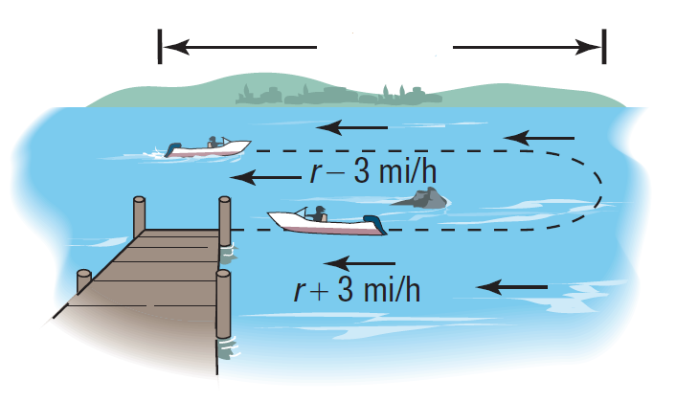
Example 6: Physics: Uniform Motion (1 of 5)
A boat heads upstream a distance of 16 miles on a river whose current is running at 3 miles per hour (mi/h). The trip up and back takes 8 hours. Assuming that the boat maintains a constant speed relative to the water, what is its speed?
16 miles

Slide 25
Example 6: Physics: Uniform Motion (2 of 5)
Use r to represent the constant speed of the boat relative to the water. Then the true speed going upstream is r – 3 mi/h, and the true speed going downstream is r + 3 mi/h.
Since Distance = Rate ⋅ Time, then
32 miles

Slide 26
Example 6: Physics: Uniform Motion (3 of 5)
Set up a table.
The total time up and back is 8 hours, which gives the equation
 | Rate (mi/h) | Distance (mi)
Upstream | r – 3 | 16
Downstream | r + 3 | 16

Slide 27
Example 6: Physics: Uniform Motion (4 of 5)
Add the quotients on the left.
Simplify.
32r = 8(r² – 9) Multiply both sides by r² – 9.
8r² – 32r – 72 = 0 Write in standard form.
r² – 4r – 9 = 0 Divide by 8.

Slide 28
Example 6: Physics: Uniform Motion (5 of 5)
Solve. r² – 4r – 9 = 0
Discard the solution r = –1.6 mi/h and conclude that the speed of the boat relative to the water is 5.6 mi/h.

Slide 29
Example 7: Working Together to Do a Job (1 of 4)
Patrick, by himself, can paint four rooms in 10 hours. His friend April says she can get the four rooms painted in 15 hours. If he and April work together, how long will it take them to paint four rooms?

Slide 30
Example 7: Working Together to Do a Job (2 of 4)
 | Hours to Do Job | Part of Job Done in 1 Hour
Patrick | 10
April | 15
Together | t
Set up a table.
In 1 hour Patrick does of the job, and in 1 hour,
April does of the job.
Let t be the time (in hours) that it takes them to do the job together.
In 1 hour, then, of the job is completed.

Slide 31
Example 7: Working Together to Do a Job (3 of 4)
Reason as follow:
From the table,
(
)
(
)
(
)
Part done by Patrick in 1 hour
+
Part done by April in 1 hour
=
Part done together in 1 hour
The Model
LCD = 30 on the left
Add on the left.
Simplify.

Slide 32
Example 7: Working Together to Do a Job (4 of 4)
Working together, Patrick and April can do the job in 6 hours.
Multiply both sides by 6t.

