Slide 1

Chapter 1
Equations and Inequalities

Slide 2
Section 1.5
Solving Inequalities

Slide 3
Objectives
Use Interval Notation
Use Properties of Inequalities
Solve Inequalities
Solve Combined Inequalities

Slide 4
Intervals (1 of 3)
DEFINITION Intervals
An open interval, denoted by (a, b), consists of all real numbers x for which a < x < b.
A closed interval, denoted by [a, b], consists of all real numbers x for which a ≤ x ≤ b.
The half-open, or half-closed, intervals are (a, b], consisting of all real numbers x for which a < x ≤ b, and [a, b), consisting of all real numbers x for which a ≤ x < b.

Slide 5
Intervals (2 of 3)
consists of all real numbers x for which x ≥ a.
consists of all real numbers x for which x > a.
consists of all real numbers x for which x ≤ a.
consists of all real numbers x for which x < a.
consists of all real numbers.

Slide 6
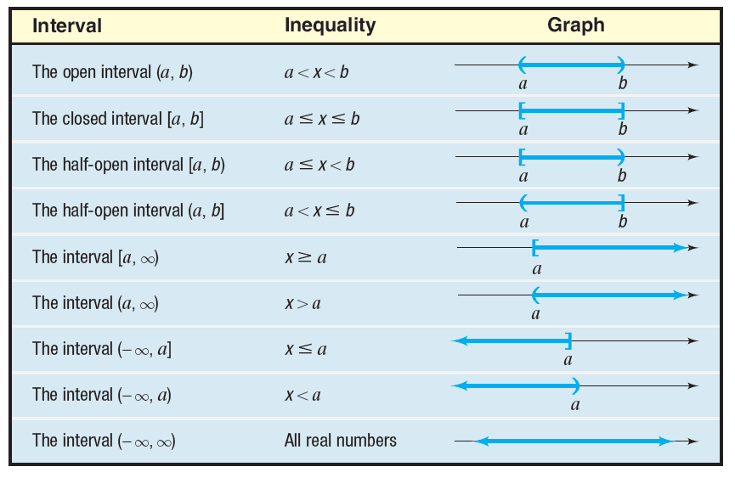
Intervals (3 of 3)

Slide 7
Example 1: Writing Inequalities Using Interval Notation (1 of 2)
Write each inequality using interval notation.
a) 4 ≤ x ≤ 7
  The inequality 4 ≤ x ≤ 7 describes all real numbers x between 4 and 7, inclusive. In interval notation, we write [4, 7].
b) –3 < x < 0
  In interval notation, –3 < x < 0 is written (–3, 0).

Slide 8
Example 1: Writing Inequalities Using Interval Notation (2 of 2)
c) x > 3
  In interval notation, x > 3 is written (3, ∞).
d) x ≤ 5
  In interval notation, x ≤ 5 is written (–∞, 5].

Slide 9
Example 2: Writing Intervals Using Inequality Notation (1 of 2)
Write each interval as an inequality involving x.
a) [0, 3)
  [0, 3) consists of all real numbers x for which
  0 ≤ x < 3.
b) (3, ∞)
  (3, ∞) consists of all real numbers x for which
  x > 3.

Slide 10
Example 2: Writing Intervals Using Inequality Notation (2 of 2)
c) [3, 4]
  [3, 4] consists of all real numbers x for which
  3 ≤ x ≤ 4.
d) (–∞, –5]
  (–∞, –5] consists of all real numbers x for which
  x ≤ –5.

Slide 11
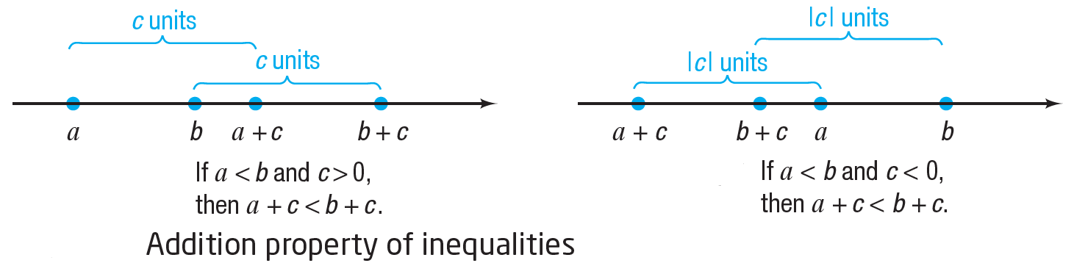
Properties of Inequalities
Nonnegative Property
For any real number a, a² ≥ 0
Addition Property of Inequalities
For real numbers a, b, and c,
If a < b, then a + c < b + c.
If a > b, then a + c > b + c.

Slide 12
Example 3: Addition Property of Inequalities
If x < –4, then x + 4 < –4 + 4 or x + 4 < 0.
If x > 4, then x + (–4) > 4 + (–4) or x – 4 > 0.

Slide 13
Example 4: Multiplying an Inequality by a Positive Number
Express as an inequality the result of multiplying both sides of the inequality 5 < 8 by 3.
Begin with
5 < 8
Multiplying both sides by 3 yields the numbers
15 and 24, so we have
15 < 24

Slide 14
Example 5: Multiplying an Inequality by a Negative Number
Express as an inequality the result of multiplying both sides of the inequality 8 > 3 by –2.
Begin with
8 > 3
Multiplying both sides by –2 yields the numbers
–16 and –6, so we have
–16 < –6
Note that the effect of multiplying both sides of 8 > 3 by the negative number –2 is that the direction of the inequality symbol is reversed.

Slide 15
More Properties of Inequalities
Multiplication Property of Inequalities
For real numbers a, b, and c,
If a < b, and if c > 0, then ac < bc.
If a < b, and if c < 0, then ac > bc.
If a > b, and if c > 0, then ac > bc.
If a > b, and if c < 0, then ac < bc.

Slide 16
Example 6: Multiplication Property of Inequalities
If 3x < 12, then
If then
If –5x < –10, then
If –x > 7, then

Slide 17
Additional Properties of Inequalities
Reciprocal Property for Inequalities
If a > 0, then
If a < 0, then
If b > a > 0, then
If a < b < 0, then

Slide 18
Procedures That Leave the Inequality Symbol Unchanged (1 of 2)
Simplify both sides of the inequality by combining like terms and eliminating parentheses:
    Replace x + 2 + 6 > 2x + 5(x + 1)
    by x + 8 > 7x + 5
Add or subtract the same expression on both sides of the inequality:
    Replace 3x – 5 < 4 by (3x – 5) + 5 < 4 + 5
Multiply or divide both sides of the inequality by the same positive expression:
    Replace 4x > 16 by

Slide 19
Procedures That Reverse the Sense or Direction of the Inequality Symbol
Interchange the two sides of the inequality:
      Replace 3 < x by x > 3
Multiply or divide both sides of the inequality by the same negative expression:
      Replace –2x > 6 by

Slide 20
Example 7: Solving an Inequality (1 of 2)
Solve the inequality 5 – 4x < 9, and graph the solution set.
5 – 4x < 9
5 – 4x – 5 < 9 – 5 Subtract 5 from both sides.
–4x < 4 Simplify.
        Divide both sides by –4.
        (The sense of the inequality symbol is reversed.)
x > –1 Simplify.

Slide 21
Example 7: Solving an Inequality (2 of 2)
The solution set is {x|x > –1} or, using interval notation, all numbers in the interval (–1, ∞).
The graph of the solution is
(

Slide 22
Example 8: Solving an Inequality (1 of 2)
Solve the inequality 2x – 2 ≥ 3 + x, and graph the solution set.
2x – 2 ≥ 3 + x
2x – 2 + 2 ≥ 3 + x + 2 Add 2 to both sides.
2x ≥ x + 5 Simplify.
2x – x ≥ x + 5 – x Subtract x from both sides.
x ≥ 5 Simplify.

Slide 23
Example 8: Solving an Inequality (2 of 2)
The solution set is {x|x ≥ 5} or, using interval notation, all numbers in the interval [5, ∞).
The graph of the solution is
[

Slide 24
Example 9: Solving a Combined Inequality (1 of 3)
Solve the inequality 4 < 2x + 2 < 10, and graph the solution set.
Recall that the inequality
4 < 2x + 2 < 10
is equivalent to the two inequalities
4 < 2x + 2 and 2x + 2 < 10

Slide 25
Example 9: Solving a Combined Inequality (2 of 3)
Solve each of these inequalities separately.
4 < 2x + 2 2x + 2 < 10
Subtract 2 from
both sides.
Simplify.
Divide both sides by 2.
Simplify.

Slide 26
Example 9: Solving a Combined Inequality (3 of 3)
The solution set of the original pair of inequalities consist of all x for which
1 < x and x < 4
This may be written more compactly as
{x| 1 < x < 4}.
In interval notation, the solution is (1, 4).
The graph of the solution is
( )

Slide 27
Example 10: Solving a Combined Inequality (1 of 2)
Solve the inequality , and graph the solution set.
        Multiply each part by 2 to remove the denominator.
        Simplify.
        Subtract 2 from each part to isolate the term containing x.
        Simplify.
        Divide each part by –1 (reverse the direction of each inequality symbol).

Slide 28
Example 10: Solving a Combined Inequality (2 of 2)
        Simplify.
        Reverse the order so that the numbers get larger as you read them from left to right.
The solution set is {x| –6 ≤ x ≤ 0}, that is, all real numbers in the interval [–6, 0].
The graph of the solution is
[
]

Slide 29
Example 11: Using a Reciprocal Property to Solve an Inequality (1 of 2)
Solve the inequality (2x – 4)^{–1} > 0, and graph the solution set.
Recall that A Reciprocal Property
states that if a > 0, then its reciprocal is greater than zero.
(2x – 4)^{–1} > 0
2x – 4 > 0 Reciprocal Property
2x > 4 Add 4 to both sides.
x > 2 Divide both sides by 2.

Slide 30
Example 11: Using a Reciprocal Property to Solve an Inequality (2 of 2)
The solution set is {x|x > 2}, that is, all real numbers in the interval (2, ∞).
The graph of the solution is
(

Slide 31
Example 12: Creating Equivalent Inequalities
If –4 < x < 0, find a and b so that a < < b.
The idea here is to change the middle part of the
combined inequality from x to , using properties of inequalities.
Divide each part by 2.
Simplify.
Now we see that a = –2 and b = 0.

Slide 32
Example 13: Physics: Ohm’s Law (1 of 2)
In electricity, Ohm’s law states that E = IR, where E is the voltage (in volts), I is the current (in amperes), and R is the resistance (in ohms). An
air-conditioning unit is rated at a resistance of 10 ohms. If the voltage varies from 90 to 110 volts, inclusive, what corresponding range of current will the air conditioner draw?

Slide 33
Example 13: Physics: Ohm’s Law (2 of 2)
The voltage lies between 90 and 110, inclusive, so
Ohm’s law, E = IR
R = 10
Divide each part by 10.
Simplify.
The air conditioner will draw between 9 and 11 amperes of current, inclusive.

