Slide 1
Chapter 1
Equations and Inequalities

Slide 2
Section 1.2
Quadratic Equations

Slide 3
Objectives
Solve a Quadratic Equation by Factoring
Solve a Quadratic Equation Using the Square Root Method
Solve a Quadratic Equation by Completing the Square
Solve a Quadratic Equation Using the Quadratic Formula
Solve Problems That Can Be Modeled by Quadratic Equations

Slide 4
Quadratic Equation
DEFINITION Quadratic Equation
A quadratic equation is an equation equivalent to one of the form
ax² + bx + c = 0 a ≠ 0
where a, b, and c are real numbers.

Slide 5
Example 1: Solving a Quadratic Equation by Factoring (1 of 3)
Solve the equations:
(a) x² – 5x = 0 (b) 2x² = 5x + 3

Slide 6
Example 1: Solving a Quadratic Equation by Factoring (2 of 3)
(a) The equation x² – 5x = 0 is in standard form. The left side may be factored as
x² – 5x = 0
x(x – 5) = 0 Factor.
Using the Zero-Product Property, set each factor equal to 0 and solve the first-degree equations
x = 0 or x – 5 = 0 Zero-Product Property
x = 0 or x = 5 Solve.
The solution set is {0, 5}.

Slide 7
Example 1: Solving a Quadratic Equation by Factoring (3 of 3)
(b) Place the equation 2x² = 5x + 3 in standard form by subtracting 5x and 3 from both sides.
2x² = 5x + 3
2x² – 5x – 3 = 0
The left side may now be factored as
(2x + 1)(x – 3) = 0 Factor.
so that 2x + 1 = 0 or x – 3 = 0
or x = 3
The solution set is
Subtract 5x and 3 from both sides.
Zero-Product Property

Slide 8
Solving a Quadratic Equation by Factoring
When the left side factors into two linear equations with the same solution, the quadratic equation is said to have a repeated solution.
This solution is also called a root of multiplicity 2, or a double root.

Slide 9
Example 2: Solving a Quadratic Equation by Factoring
Solve the equation: x² – 6x + 9 = 0
The equation is already in standard form, and the left side can be factored.
x² – 6x + 9 = 0
(x – 3)(x – 3) = 0
so
x = 3 or x = 3
This equation has only the repeated solution 3.
The solution set is {3}.

Slide 10
The Square Root Method
If x² = p and p > 0, then

Slide 11
Example 3: Solving a Quadratic Equation Using the Square Root Method (1 of 2)
Solve each equation.
(a) x² = 7 (b) (x – 3)² = 9
(a) Use the Square Root Method:
x² = 7
The solution set is
Use the Square Root Method.

Slide 12
Example 3: Solving a Quadratic Equation Using the Square Root Method (2 of 2)
(b) Use the Square Root Method:
(x – 3)² = 9
The solution set is {0, 6}.
Use the Square Root Method.

Slide 13
Example 4: Solving a Quadratic Equation by Completing the Square (1 of 2)
Solve by completing the square: x² + 6x + 5 = 0
Always begin by writing the equation with the constant on the right side.
x² + 6x + 5 = 0
x² + 6x = –5
Since the coefficient of x² is 1, complete the square
on the left side by adding Of course, in
an equation, whatever is added to the left side must be added to the right side. So add 9 to both sides.

Slide 14
Example 4: Solving a Quadratic Equation by Completing the Square (2 of 2)
x² + 6x + 9 = –5 + 9 Add 9 to both sides.
(x + 3)² = 4
The solution set is {–5, –1}.
Factor on the left; simplify on the right.
Use the Square Root Method.

Slide 15
Example 5: Solving a Quadratic Equation by Completing the Square (1 of 3)
Solve by completing the square: 2x² – 12x – 13 = 0
First, rewrite the equation so that the constant is on the right side.
2x² – 12x – 13 = 0
2x² – 12x = 13 Add 13 to both sides.
Next, divide both sides by 2 so that the coefficient of x² is 1. (This enables us to complete the square at the next step.)

Slide 16
Example 5: Solving a Quadratic Equation by Completing the Square (2 of 3)
Finally, complete the square by adding to both sides.
Add 9 to both sides.
Factor on the left; simplify on the right.
Use the Square Root Method.

Slide 17
Example 5: Solving a Quadratic Equation by Completing the Square (3 of 3)
The solution set is

Slide 18
Quadratic Formula
THEOREM Quadratic Formula
Consider the quadratic equation
ax² + bx + c = 0 a ≠ 0
If b² – 4ac < 0, this equation has no real solution.
If b² – 4ac ≥ 0, the real solution(s) of this equation is (are) given by the quadratic formula:

Slide 19
Example 6: Solving a Quadratic Equation Using the Quadratic Formula (1 of 2)
Use the quadratic formula to find the real solutions, if any, of the equation
6x² – 10x + 2 = 0
The equation is in standard form, so compare it to ax² + bx + c = 0 to find a, b, and c.
6x² – 10x + 2 = 0
ax² + bx + c = 0 a = 6, b = –10, c = 2

Slide 20
Example 6: Solving a Quadratic Equation Using the Quadratic Formula (2 of 2)
With a = 6, b = –10, and c = 2, evaluate the discriminant b² – 4ac.
b² – 4ac = (–10)² – 4(6)(2) = 100 – 48 = 52
Since b² – 4ac > 0, there are two real solutions, which can be found using the quadratic formula.
The solution set is

Slide 21
Example 7: Solving a Quadratic Equation Using the Quadratic Formula (1 of 2)
Use the quadratic formula to find the real solutions, if any, of the equation
The equation is given in standard form. However, to simplify the arithmetic, clear the fraction.
Multiply both sides by 2 to clear the fraction.

Slide 22
Example 7: Solving a Quadratic Equation Using the Quadratic Formula (2 of 2)
25x² – 40x + 16 = 0
ax² + bx + c = 0 Compare to standard form.
With a = 25, b = –40, and c = 16, evaluate the discriminant.
b² – 4ac = (–40)² – 4(25)(16) = 1600 – 1600 = 0
The equation has a repeated real solution, which is found by using the quadratic formula.
The solution set is

Slide 23
Example 8: Solving a Quadratic Equation Using the Quadratic Formula
Use the quadratic formula to find the real solutions, if any, of the equation
4x² + 3 = x
The equation, as given, is not in standard form.
4x² + 3 = x
4x² – x + 3 = 0 Put in standard form.
ax² + bx + c = 0 Compare to standard form.
With a = 4, b = –1, and c = 3, evaluate the discriminant. b² – 4ac = (–1)² – 4(4)(3) = 1 – 48 = –47
Since b² – 4ac < 0, the equation has no real solution.

Slide 24
Example 9: Solving an Equation Using the Quadratic Formula (1 of 2)
Find the real solutions, if any, of the equation:
In its present form, the equation is not a quadratic equation. However, it can be transformed into one by multiplying both sides by x². The result is
Although we multiplied both sides by x², we know that x² ≠ 0.

Slide 25
Example 9: Solving an Equation Using the Quadratic Formula (2 of 2)
Using a = 1, b = 8, and c = 7, the discriminant is
b² – 4ac = (8)² – 4(1)(7) = 64 – 28 = 36
Since b² – 4ac > 0, the new equation has two real solutions.
The solution set is {–7, –1}.

Slide 26
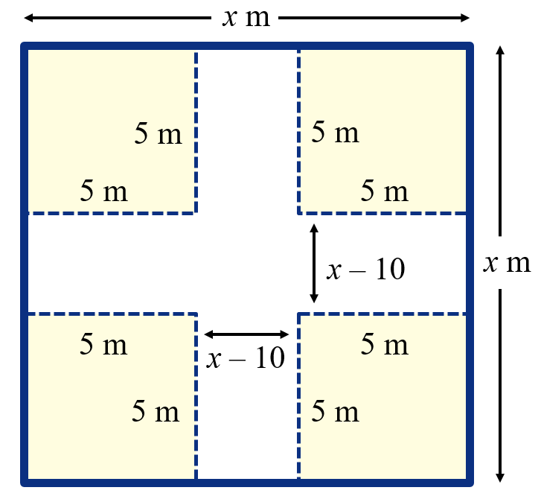
Example 10: Constructing a Box (1 of 4)
From each corner of a square piece of sheet metal, remove a square with sides of length 5 meters. Turn up the edges to form an open box.
If the box is to hold 1125 cubic meters (m³), what should be the dimensions of the piece of sheet metal?

Slide 27
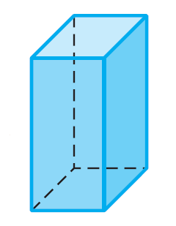
Example 10: Constructing a Box (2 of 4)
Use the figure as a guide. We have labeled by x the length of a side of the square piece of sheet metal.
The box will be of height 5 meters, and its square base will measure x – 10 on each side.
5 m
x – 10
x – 10

Slide 28
Example 10: Constructing a Box (3 of 4)
The volume V (Length × Width × Height) of the box is therefore
Since the volume of the box is to be 1125 m³, we have
5 m
x – 10
x – 10
V = 1125
Divide both sides by 5.
Use the Square Root Method.

Slide 29
Example 10: Constructing a Box (4 of 4)
Discard the solution x = –5 and conclude that the sheet metal should be 25 meters by 25 meters.
5 m
x – 10
x – 10

