Slide 1





8
Infinite Series
Copyright © Cengage Learning. All rights reserved.

Slide 2

8.10
Taylor and Maclaurin Series
Copyright © Cengage Learning. All rights reserved.

Slide 3
Objectives
Find a Taylor or Maclaurin series for a function.
Find a binomial series.
Use a basic list of Taylor series to find other Taylor series.

Slide 4
Taylor Series and Maclaurin Series

Slide 5
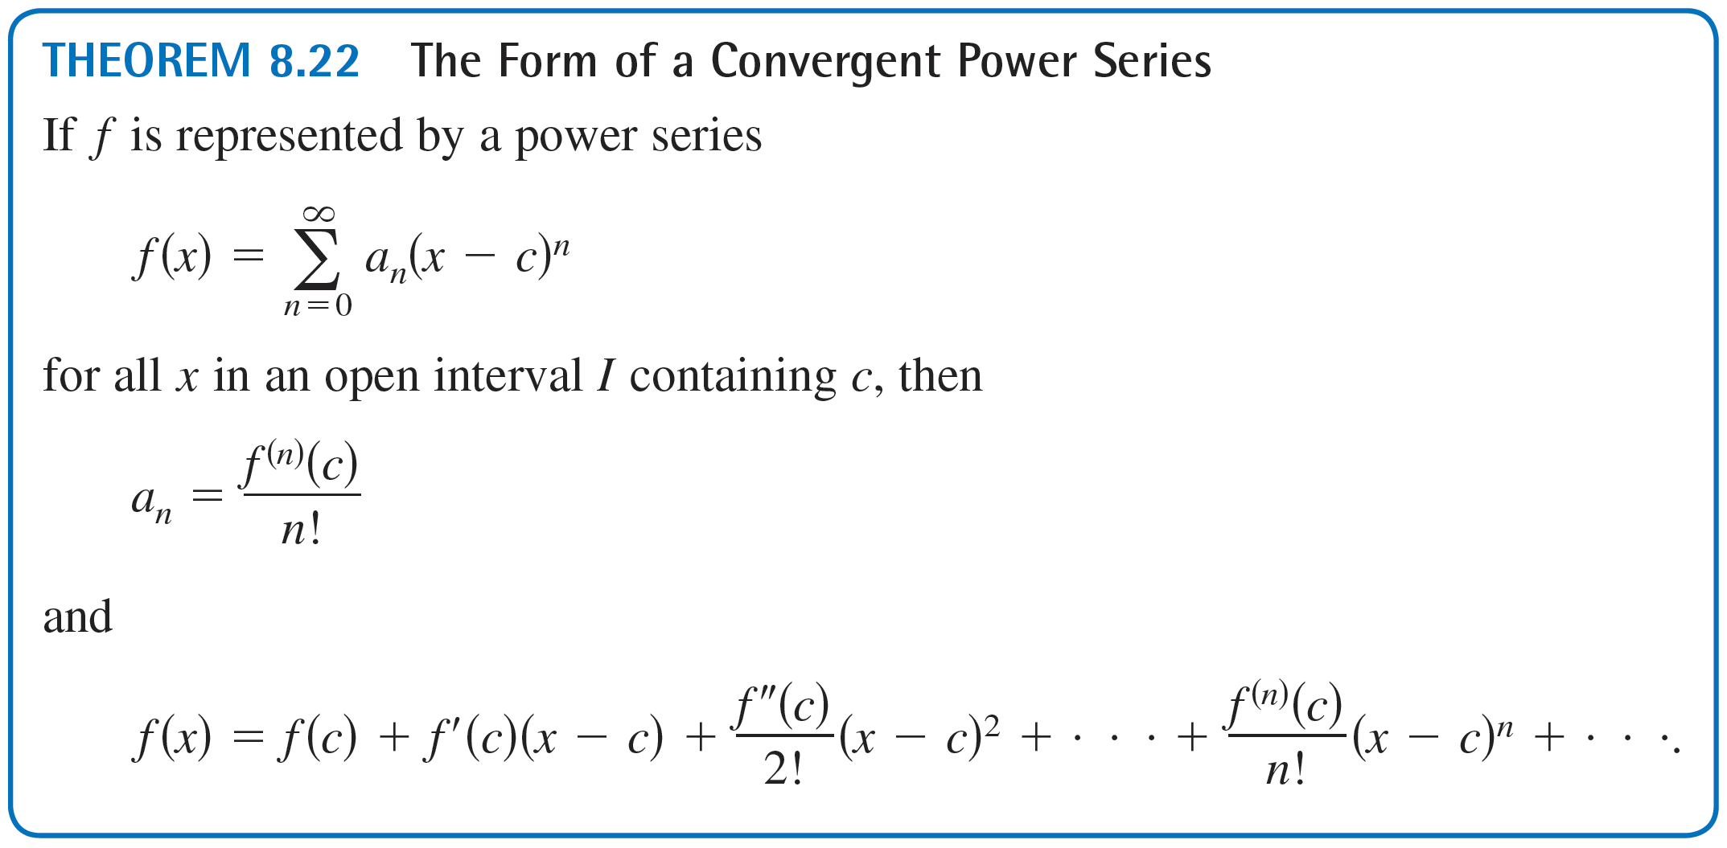
Taylor Series and Maclaurin Series
The following theorem gives the form that every convergent power series must take.

Slide 6
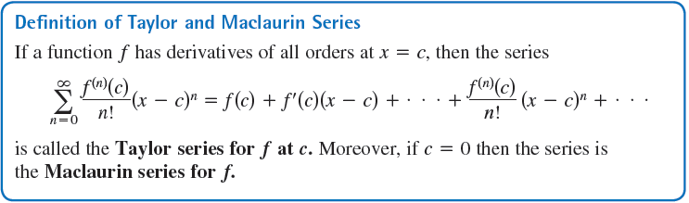
Taylor Series and Maclaurin Series
The coefficients of the power series in Theorem 8.22 are precisely the coefficients of the Taylor polynomials for f at c. For this reason, the series is called the Taylor series for f at c.

Slide 7

Example 1 – Forming a Power Series
Use the function f (x) = sin x to form the Maclaurin series
and determine the interval of convergence.
Solution:
Taking successive derivatives of f yields
f (x) = sin x f (0) = sin 0 = 0
f'(x) = cos x f'(0) = cos 0 = 1
f''(x) = –sin x f''(0) = –sin 0 = 0
f⁽³⁾(x) = – cos x f⁽³⁾(0) = – cos 0 = –1

Slide 8
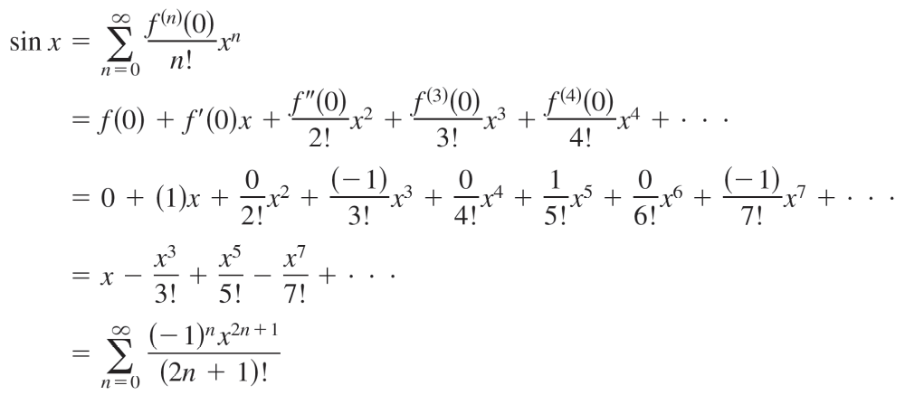
Example 1 – Solution
cont’d
f⁽⁴⁾(x) = sin x f⁽⁴⁾(0) = sin 0 = 0
f⁽⁵⁾(x) = cos x f⁽⁵⁾(0) = cos 0 = 1
and so on.
The pattern repeats after the third derivative.
So, the power series is as follows.

Slide 9
Example 1 – Solution
cont’d
By the Ratio Test, you can conclude that this series converges for all x.

Slide 10
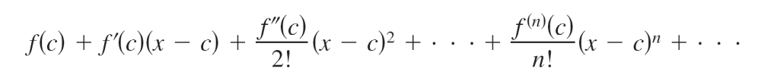
Taylor Series and Maclaurin Series
You cannot conclude that the power series converges to sin x for all x.
You can simply conclude that the power series converges to some function, but you are not sure what function it is.
This is a subtle, but important, point in dealing with Taylor or Maclaurin series.
To persuade yourself that the series
might converge to a function other than f, remember that the derivatives are being evaluated at a single point.

Slide 11
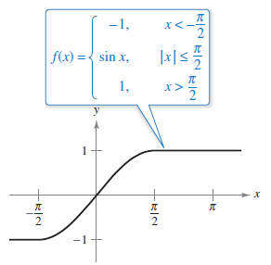
Taylor Series and Maclaurin Series
It can easily happen that another function will agree with the values of f ^{(n)}(x) when x = c and disagree at other x-values.
If you formed the power series for
the function shown in Figure 8.24,
you would obtain the same series
as in Example 1.
You know that the series converges
for all x, and yet it obviously cannot
converge to both f (x) and sin x
for all x.
Figure 8.24

Slide 12
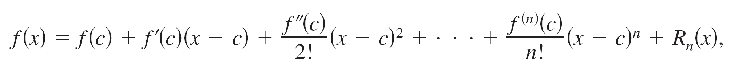
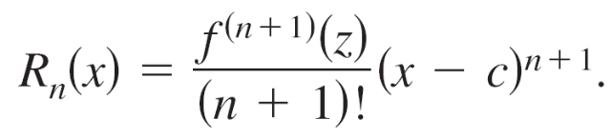
Taylor Series and Maclaurin Series
Let f have derivatives of all orders in an open interval I centered at c.
The Taylor series for f may fail to converge for some x in I. Or, even if it is convergent, it may fail to have f (x) as its sum.
Nevertheless, Theorem 8.19 tells us that for each n,
where

Slide 13
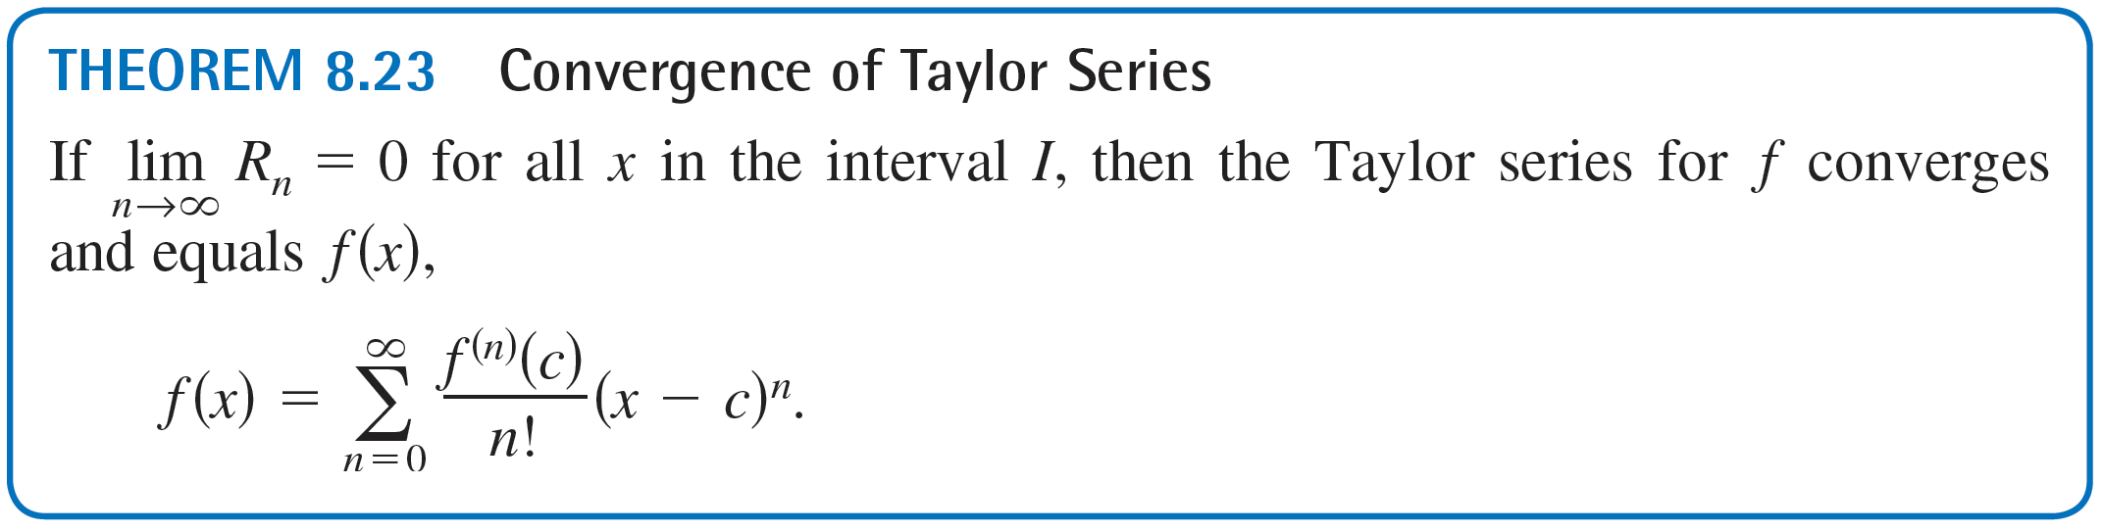
Taylor Series and Maclaurin Series
Note that in this remainder formula, the particular value of z that makes the remainder formula true depends on the values of x and n. If then the next theorem tells us that the Taylor series for f actually converges to f (x) for all x in I.

Slide 14
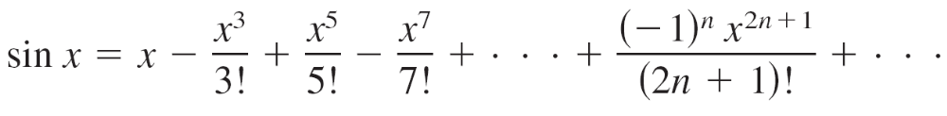
Example 2 – A Convergent Maclaurin Series
Show that the Maclaurin series for f (x) = sin x converges to sin x for all x.
Solution:
You need to show that
is true for all x.

Slide 15
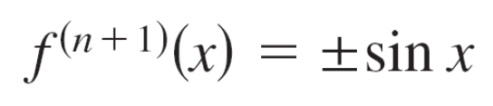
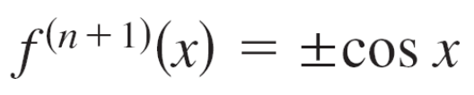

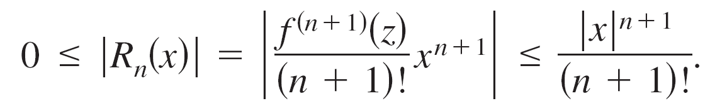
Example 2 – Solution
cont’d
Because
or
you know that for every real number z.
Therefore, for any fixed x, you can apply Taylor’s Theorem
(Theorem 8.19) to conclude that

Slide 16
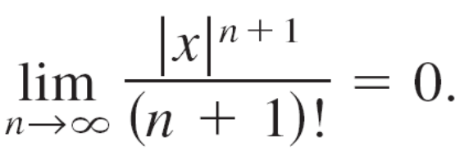

Example 2 – Solution
cont’d
From the discussion regarding the relative rates of convergence of exponential and factorial sequences, it follows that for a fixed x
Finally, by the Squeeze Theorem, it follows that for all x,
R_{n}(x)→0 as n→ .
So, by Theorem 8.23, the Maclaurin series for sin x converges to sin x for all x.

Slide 17
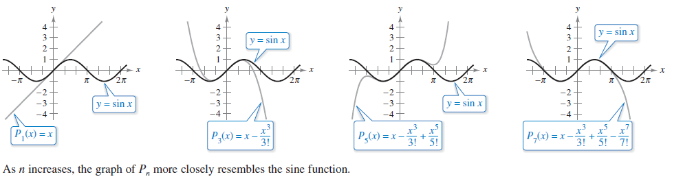
Taylor Series and Maclaurin Series
Figure 8.25 visually illustrates the convergence of the Maclaurin series for sin x by comparing the graphs of the Maclaurin polynomials P₁, P₃, P₅, and P₇ with the graph of the sine function. Notice that as the degree of the polynomial increases, its graph more closely resembles that of the sine function.
Figure 8.25

Slide 18
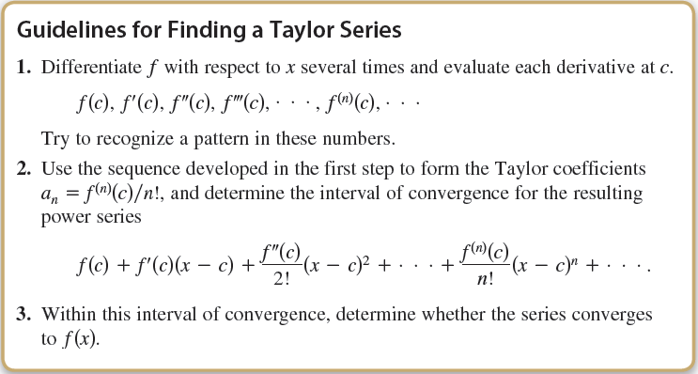
Taylor Series and Maclaurin Series

Slide 19
Binomial Series

Slide 20
Binomial Series
Before presenting the basic list for elementary functions, you will develop one more series—for a function of the form f (x) = (1 + x)^{k}. This produces the binomial series.

Slide 21
Example 4 – Binomial Series
Find the Maclaurin series for f (x) = (1 + x)^{k} and determine its radius of convergence.
Assume that k is not a positive integer and k ≠ 0.
Solution:
By successive differentiation, you have
f (x) = (1 + x)^{k} f (0) = 1
f'(x) = k(1 + x)^{k – 1} f'(0) = k
f''(x) = k(k – 1)(1 + x)^{k – 2} f''(0) = k(k – 1)

Slide 22
Example 4 – Solution
cont’d
f'''(x) = k(k – 1)(k – 2)(1 + x)^{k – 3} f'''(0) = k(k – 1)(k – 2)
. .
. .
. .
f ^{(n)}(x) = k…(k – n + 1)(1 + x)^{k – n} f ^{(n)}(0) = k(k – 1)…(k – n + 1)
Which produces the series
By the Ratio Test, you can conclude that the radius of
convergence is R = 1.
So, the series converges to some function in the interval (–1, 1).

Slide 23
Deriving Taylor Series from
a Basic List

Slide 24
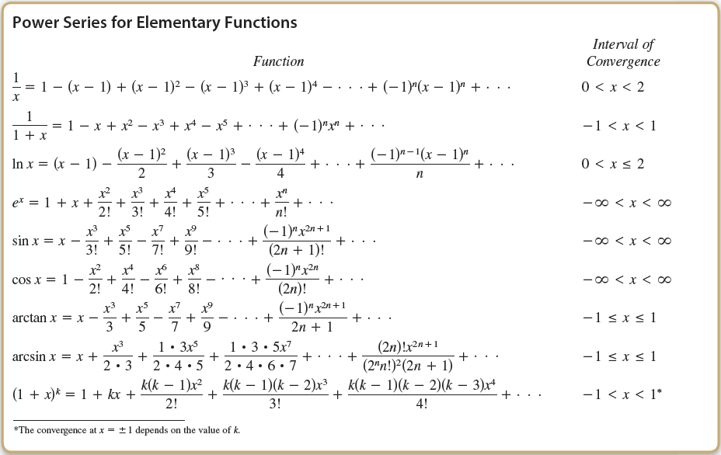
Deriving Taylor Series from a Basic

Slide 25
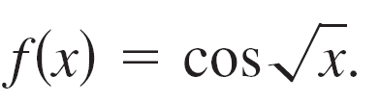
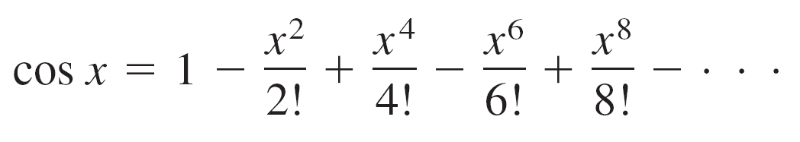

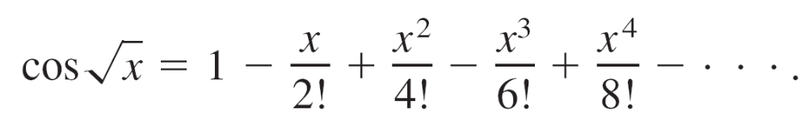

Example 6 – Deriving a Power Series from a Basic List
Find the power series for
Solution:
Using the power series
you can replace x by to obtain the series
This series converges for all x in the domain of —that is, for x ≥ 0.

