Slide 1


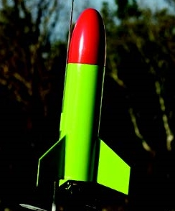


8
Infinite Series
Copyright © Cengage Learning. All rights reserved.

Slide 2

Representation of Functions
by Power Series
8.9
Copyright © Cengage Learning. All rights reserved.

Slide 3
Objectives
Find a geometric power series that represents a function.
Construct a power series using series operations.

Slide 4
Geometric Power Series

Slide 5
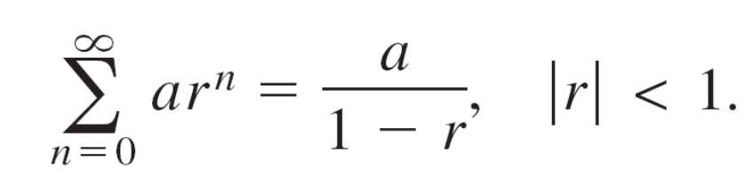
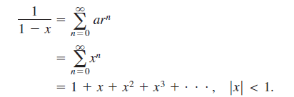
Geometric Power Series
Consider the function given by f (x) = 1/(1 – x). The form of f closely resembles the sum of a geometric series
In other words, when a = 1 and r = x, a power series representation for 1/(1 – x), centered at 0, is

Slide 6
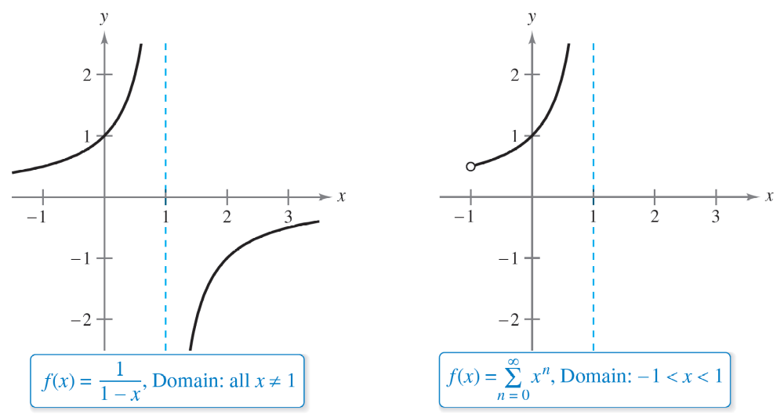
Geometric Power Series
Of course, this series represents f (x) = 1/(1 – x) only on the interval (–1, 1), whereas f is defined for all x ≠ 1, as shown in Figure 8.23. To represent f in another interval, you must develop a different series.
Figure 8.23

Slide 7
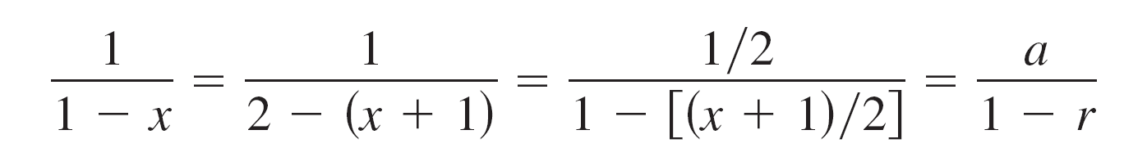
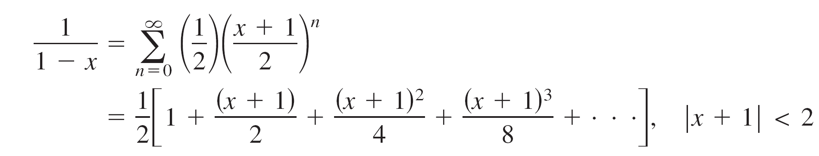
Geometric Power Series
For instance, to obtain the power series centered at –1, you could write
which implies that
So, for you have
which converges on the interval (–3, 1).

Slide 8
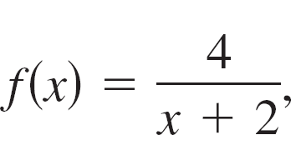
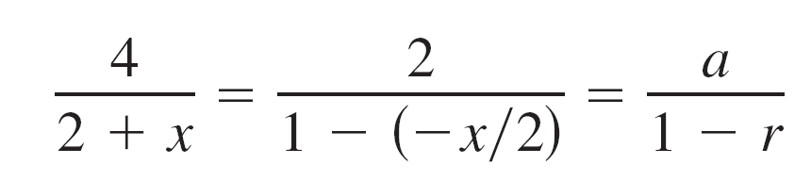
Example 1 – Finding a Geometric Power Series Centered at 0
Find a power series for centered at 0.
Solution:
Writing f (x) in the form a/(1 – r) produces
which implies that a = 2 and r = –x/2.

Slide 9
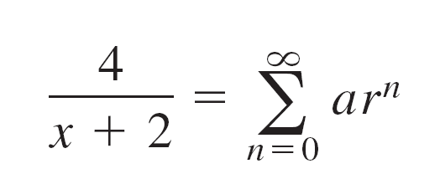
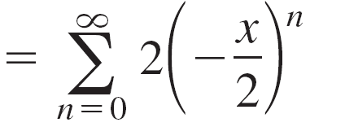
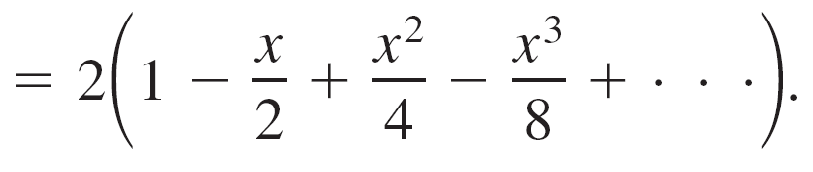
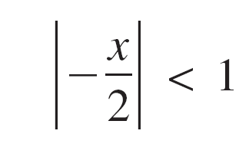
Example 1 – Solution
cont’d
So, the power series for f (x) is
This power series converges when
which implies that the interval of convergence is (–2, 2).

Slide 10
Operations with Power Series

Slide 11
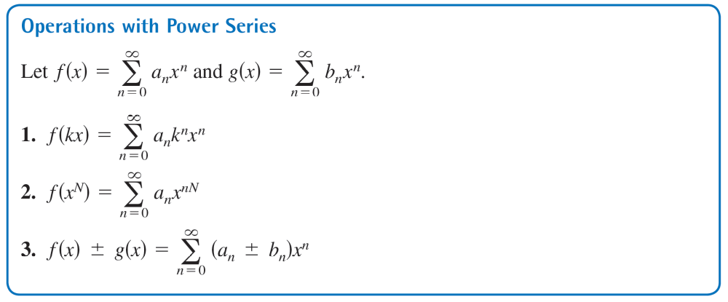
Operations with Power Series

Slide 12

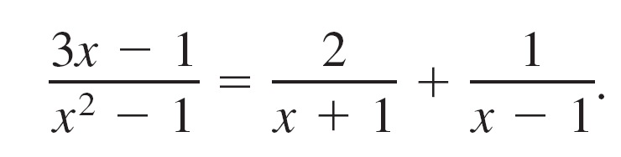
Example 3 – Adding Two Power Series
Find a power series for
centered at 0.
Solution:
Using partial fractions, you can write f (x) as

Slide 13
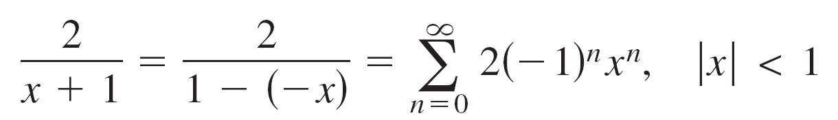
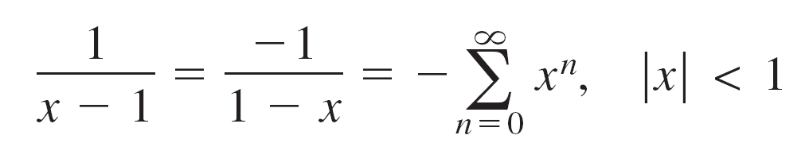
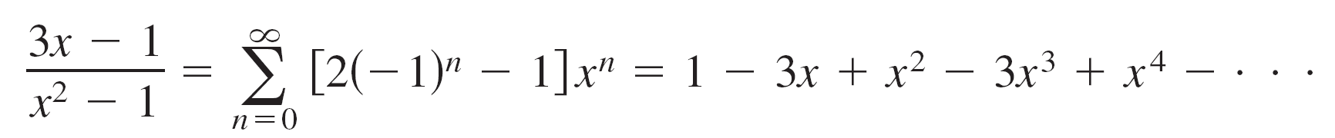
Example 3 – Solution
cont’d
By adding the two geometric power series
and
you obtain the power series shown below.
The interval of convergence for this power series is (–1, 1).

