Slide 1





8
Infinite Series
Copyright © Cengage Learning. All rights reserved.

Slide 2

Taylor Polynomials and
Approximations
8.7
Copyright © Cengage Learning. All rights reserved.

Slide 3
Objectives
Find polynomial approximations of elementary functions and compare them with the elementary functions.
Find Taylor and Maclaurin polynomial approximations of elementary functions.
Use the remainder of a Taylor polynomial.

Slide 4
Polynomial Approximations of Elementary Functions

Slide 5
Polynomial Approximations of Elementary Functions
To find a polynomial function P that approximates another function f, begin by choosing a number c in the domain of f at which f and P have the same value. That is,
The approximating polynomial is said to be expanded about c or centered at c.
Geometrically, the requirement that P(c) = f(c) means that the graph of P passes through the point (c, f(c)). Of course, there are many polynomials whose graphs pass through the point (c, f(c)).

Slide 6
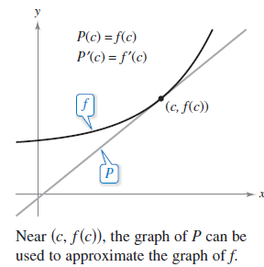
Polynomial Approximations of Elementary Functions
Your task is to find a polynomial whose graph resembles the graph of f near this point. One way to do this is to impose the additional requirement that the slope of the polynomial function be the same as the slope of the graph of f at the point (c, f(c)).
With these two requirements, you
can obtain a simple linear approximation
of f, as shown in Figure 8.11.
Figure 8.11

Slide 7


Example 1 – First-Degree Polynomial Approximation of f(x) = e^{x}
For the function f(x) = e^{x}, find a first-degree polynomial function
P₁(x) = a₀ + a₁x
whose value and slope agree with the value and slope of f at x = 0.
Solution:
Because f(x) = e^{x} and f'(x) = e^{x}, the value and the slope of f, at x = 0, are
f(0) = e⁰ = 1
and
f'(0) = e⁰ = 1.

Slide 8
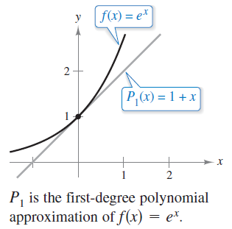
Example 1 – Solution
cont’d
Because P₁(x) = a₀ + a₁x, you can use the condition that P₁(0) = f(0) to conclude that a₀ = 1.
Moreover, because P₁'(x) = a₁, you can use the condition that P₁'(0) = f'(0) to conclude that a₁ = 1.
Therefore, P₁(x) = 1 + x.
The figure shows the graphs
of P₁(x) = 1 + x and f(x) = e^{x}.

Slide 9
Taylor and Maclaurin Polynomials

Slide 10
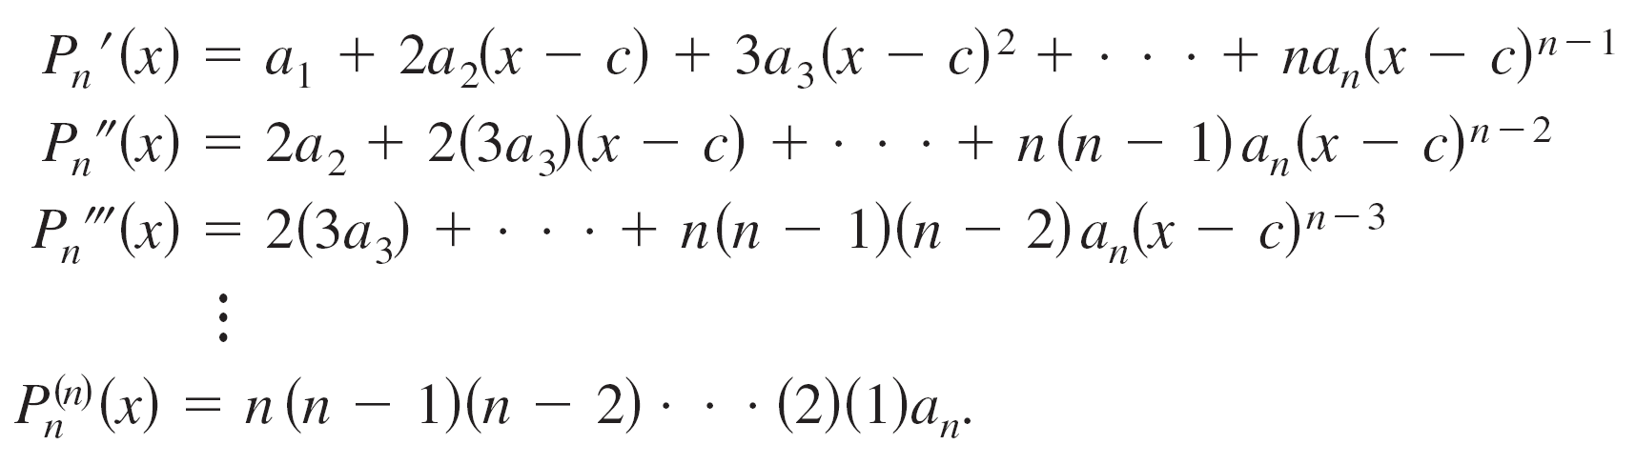
Taylor and Maclaurin Polynomials
For expansions about an arbitrary value of c, it is convenient to write the polynomial in the form
In this form, repeated differentiation produces

Slide 11
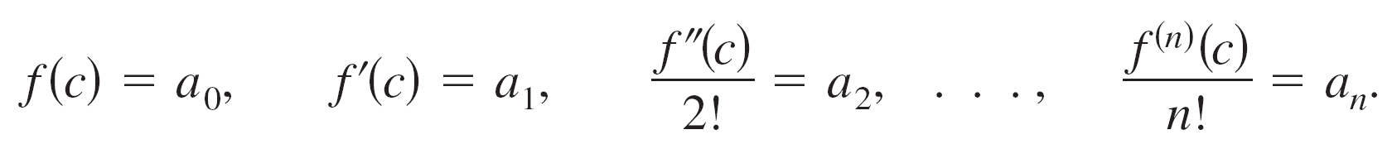
Taylor and Maclaurin Polynomials
Letting x = c, you then obtain
and because the values of f and its first n derivatives must agree with the values of P_{n} and its first n derivatives at
x = c, it follows that
With these coefficients, you can obtain the following definition of Taylor polynomials, named after the English mathematician Brook Taylor, and Maclaurin polynomials,
named after the English mathematician Colin Maclaurin (1698–1746).

Slide 12
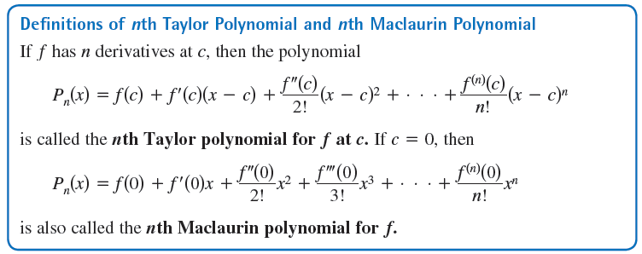
Taylor and Maclaurin Polynomials

Slide 13
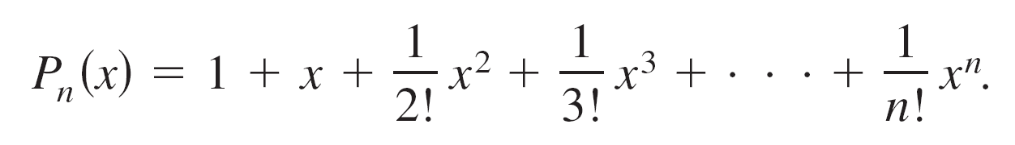
Example 3 – A Maclaurin Polynomial for f(x) = e^{x}
Find the nth Maclaurin polynomial for f(x) = e^{x}.
Solution:
The nth Maclaurin polynomial for
f(x) = e^{x}
is

Slide 14
Remainder of a Taylor Polynomial

Slide 15
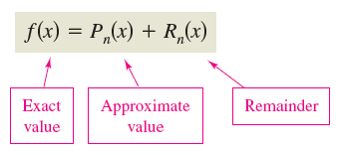
Remainder of a Taylor Polynomial
An approximation technique is of little value without some idea of its accuracy.
To measure the accuracy of approximating a function value f(x) by the Taylor polynomial P_{n}(x), you can use the concept of a remainder R_{n}(x), defined as follows.

Slide 16
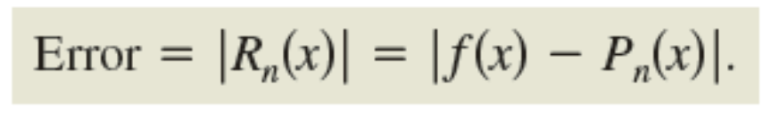
Remainder of a Taylor Polynomial
So, R_{n}(x) = f(x) – P_{n}(x). The absolute value of R_{n}(x) is called the error associated with the approximation. That is,
The next theorem gives a general procedure for estimating the remainder associated with a Taylor polynomial.
This important theorem is called Taylor’s Theorem, and the remainder given in the theorem is called the Lagrange form of the remainder.

Slide 17
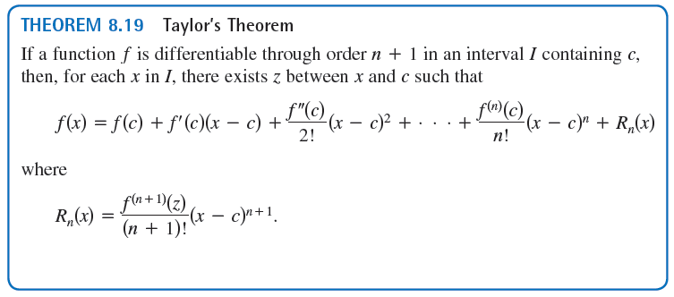
Remainder of a Taylor Polynomial

Slide 18
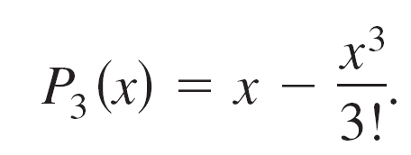
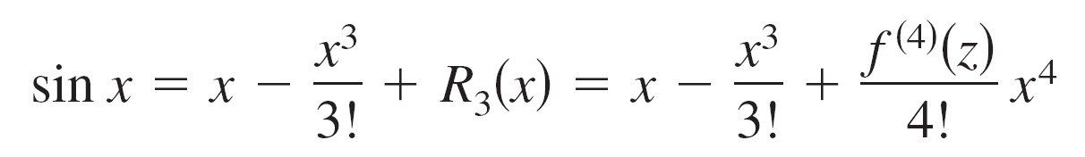
Example 8 – Determining the Accuracy of an Approximation
The third Maclaurin polynomial for sin x is given by
Use Taylor’s Theorem to approximate sin(0.1) by P₃(0.1) and determine the accuracy of the approximation.
Solution:
Using Taylor’s Theorem, you have
where 0 < z < 0.1.

Slide 19
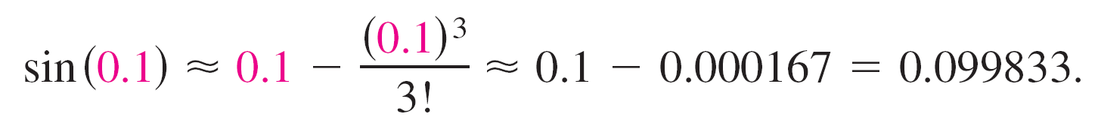
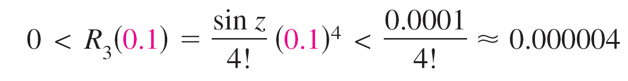

Example 8 – Solution
cont’d
Therefore,
Because f ⁽⁴⁾(z) = sin z, it follows that the error |R₃(0.1)| can be bounded as follows.
This implies that
or

