Slide 1





8
Infinite Series
Copyright © Cengage Learning. All rights reserved.

Slide 2

8.6
The Ratio and Root Tests
Copyright © Cengage Learning. All rights reserved.

Slide 3
Objectives
Use the Ratio Test to determine whether a series converges or diverges.
Use the Root Test to determine whether a series converges or diverges.
Review the tests for convergence and divergence of an infinite series.

Slide 4
The Ratio Test

Slide 5
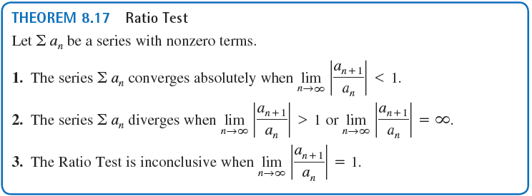
The Ratio Test
This section begins with a test for absolute convergence—the Ratio Test.

Slide 6
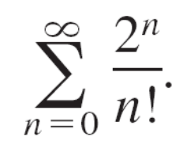
Example 1 – Using the Ratio Test
Determine the convergence or divergence of

Slide 7




Example 1 – Solution
Algebraic Solution
Because you can write the following.
This series converges because the limit of |a_{n + 1}/a_{n}| is less than 1.

Slide 8
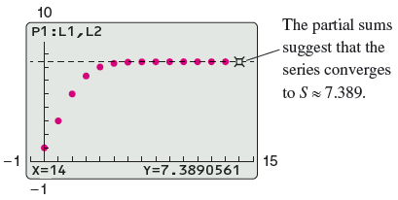
Example 1 – Solution
cont’d
Graphical Solution
We know that the factorial function grows faster than any exponential function.
So, you expect this series to converge.
The figure shows the first 15 partial sums of the series.

Slide 9
The Root Test

Slide 10
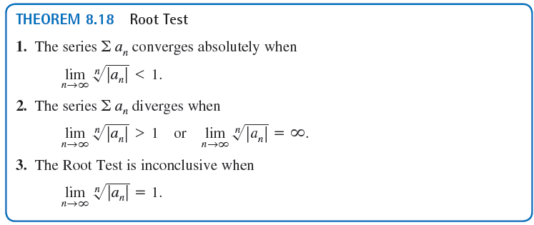
The Root Test
The next test for convergence or divergence of series works especially well for series involving nth powers.

Slide 11
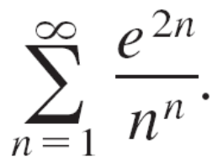
Example 4 – Using the Root Test
Determine the convergence or divergence of

Slide 12
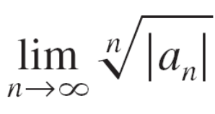
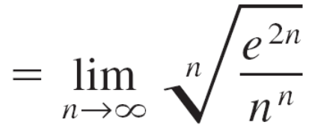
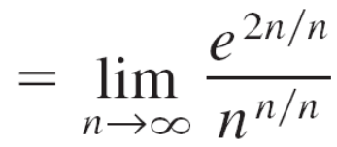
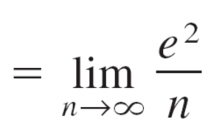

Example 4 – Solution
Algebraic Solution
You can apply the Root Test as follows.
Because this limit is less than 1, you can conclude that the series converges absolutely (and therefore converges).

Slide 13

Example 4 – Solution
cont’d
Numerical Solution
The partial sums in the table suggest that the series converges to S ≈ 60.386.

Slide 14
Strategies for Testing Series

Slide 15
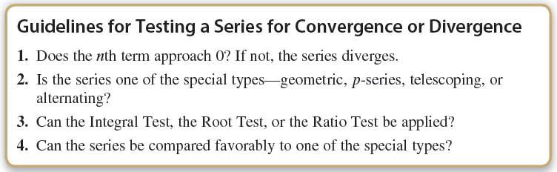
Strategies for Testing Series
You have studied various tests for determining the convergence or divergence of an infinite series. Below is a set of guidelines for choosing an appropriate test.

Slide 16
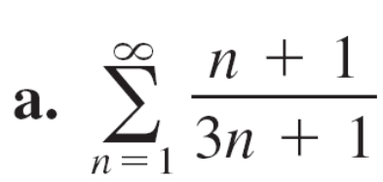
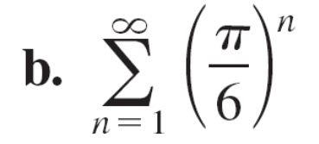
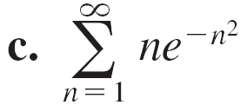
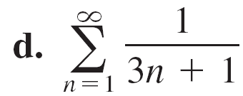
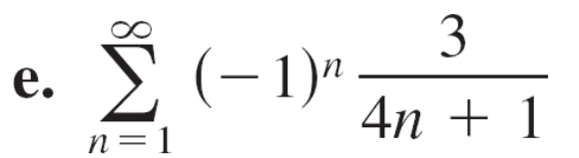
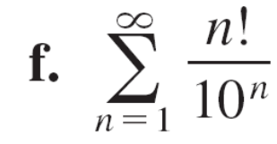
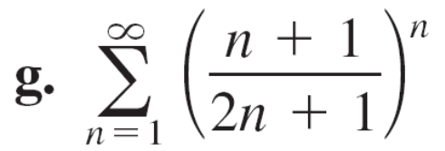
Example 5 – Applying the Strategies for Testing Series
Determine the convergence or divergence of each series.

Slide 17


Example 5 – Solution
a. For this series, the limit of the nth term is not . So, by the nth-Term Test, the series
diverges.
b. This series is geometric. Moreover, because the ratio of
the terms r = π/6 is less than 1 in absolute value, you
can conclude that the series converges.
c. Because the function is easily integrated,
you can use the Integral Test to conclude that the series
converges.

Slide 18
Example 5 – Solution
cont’d
d. The nth term of this series can be compared to the nth
term of the harmonic series. After using the Limit
Comparison Test, you can conclude that the series
diverges.
e. This is an alternating series whose nth term
approaches 0. Because you can use the
Alternating Series Test to conclude that the series
converges.
f. The nth term of this series involves a factorial, which
indicates that the Ratio Test may work well. After
applying the Ratio Test, you can conclude that the
series diverges.

Slide 19
Example 5 – Solution
cont’d
g. The nth term of this series involves a variable that is raised to the nth power, which indicates that the Root Test may work well. After applying the Root Test, you can conclude that the series converges.

Slide 20
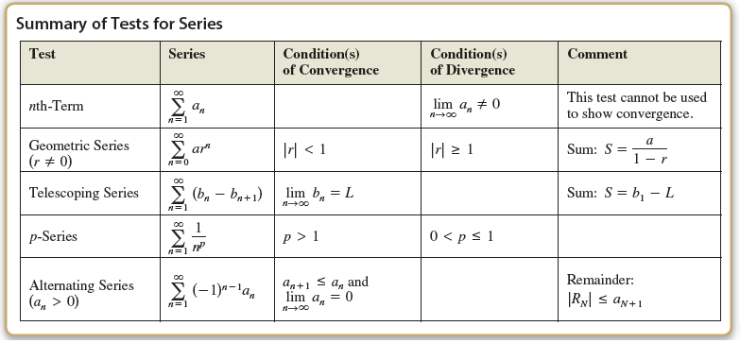
Strategies for Testing Series

Slide 21
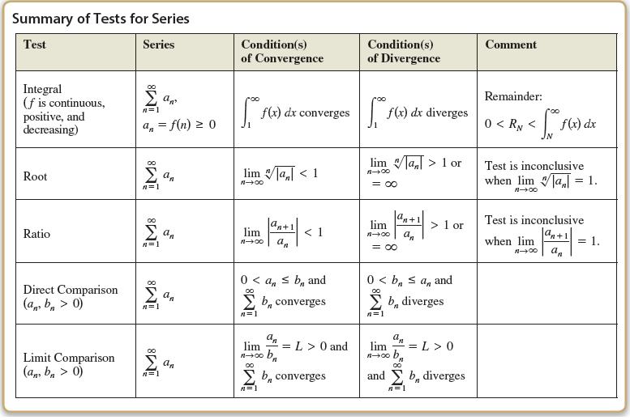
Strategies for Testing Series
cont’d

