Slide 1





8
Infinite Series
Copyright © Cengage Learning. All rights reserved.

Slide 2

8.2
Series and Convergence
Copyright © Cengage Learning. All rights reserved.

Slide 3
Objectives
Understand the definition of a convergent infinite series.
Use properties of infinite geometric series.
Use the nth-Term Test for Divergence of an infinite series.

Slide 4
Infinite Series

Slide 5


Infinite Series
One important application of infinite sequences is in representing “infinite summations.”
Informally, if {a_{n}} is an infinite sequence, then
is an infinite series (or simply a series).
The numbers a₁, a₂, a₃, and so on are the terms of the series. For some series, it is convenient to begin the index at n = 0 (or some other integer). As a typesetting convention, it is common to represent an infinite series as simply

Slide 6
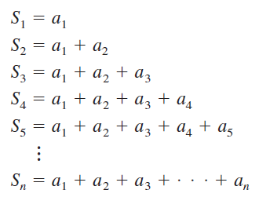
Infinite Series
In such cases, the starting value for the index must be taken from the context of the statement.
To find the sum of an infinite series, consider the following sequence of partial sums.
If this sequence of partial sums converges, then the series is said to converge and has the sum indicated in the next definition.

Slide 7
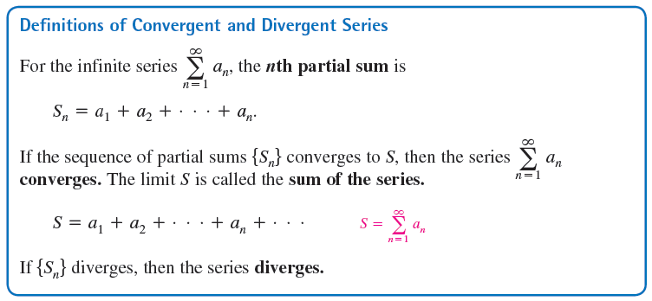
Infinite Series

Slide 8
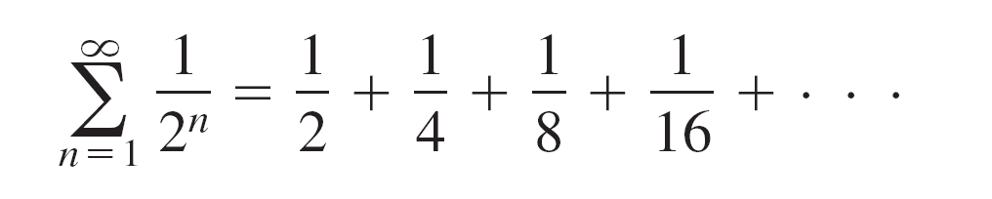

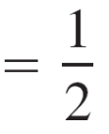

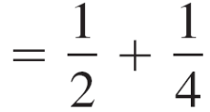
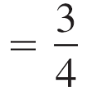

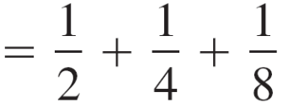
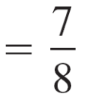


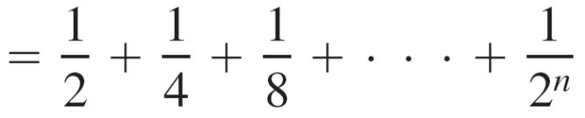
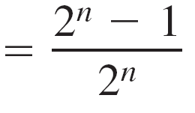
Example 1(a) – Convergent and Divergent Series
The series
has the partial sums listed below.

Slide 9
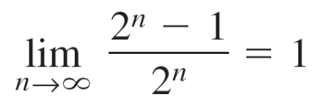
Example 1(a) – Convergent and Divergent Series
cont’d
Because
it follows that the series converges and its sum is 1.

Slide 10
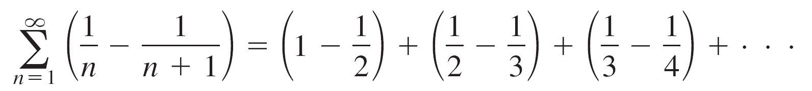
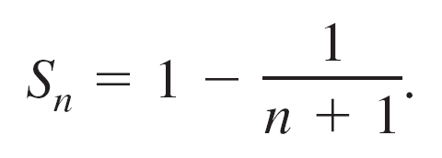
Example 1(b) – Convergent and Divergent Series
cont’d
The nth partial sum of the series
is
Because the limit of S_{n} is 1, the series converges and its sum is 1.

Slide 11
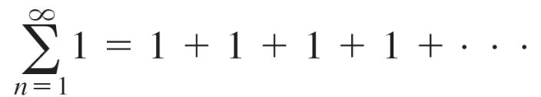
Example 1(c) – Convergent and Divergent Series
cont’d
The series
diverges because S_{n} = n and the sequence of partial sums diverges.

Slide 12
Infinite Series
The series
is a telescoping series of the form
Note that b₂ is canceled by the second term, b₃ is canceled by the third term, and so on.

Slide 13


Infinite Series
Because the nth partial sum of this series is
S_{n} = b₁ – b_{n + 1}
it follows that a telescoping series will converge if and only
if b_{n} approaches a finite number as
Moreover, if the series converges, its sum is

Slide 14
Geometric Series

Slide 15

Geometric Series
The series is a geometric series.
In general, the series given by
is a geometric series with ratio r, r ≠ 0.

Slide 16
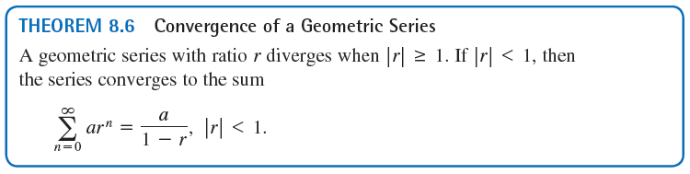
Geometric Series

Slide 17


Example 3 – Convergent and Divergent Geometric Series
Determine the convergence or divergence of each series.
a.
b.

Slide 18
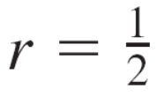


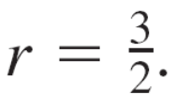
Example 3 – Solution
Algebraic Solution
a. The geometric series has a ratio of with a = 3.
Because |r| < 1, the series converges and its sum is
b. The geometric series has a ratio of
Because |r| ≥ 1, the series diverges.

Slide 19


Example 3 – Solution
cont’d
Numerical Solution
a. The partial sums in the table suggest that the series
converges to S = 6.
b. The partial sums in the table suggest that the series
diverges.

Slide 20
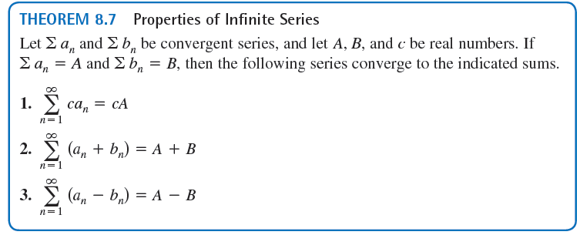
Geometric Series

Slide 21
nth-Term Test for Divergence

Slide 22
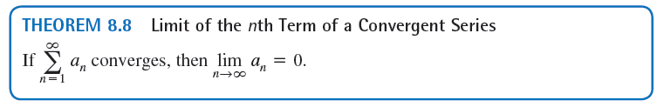
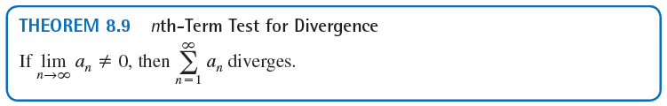
nth-Term Test for Divergence
The contrapositive of Theorem 8.8 provides a useful test for divergence. This nth-Term Test for Divergence states that if the limit of the nth term of a series does not converge to 0, the series must diverge.

Slide 23





Example 5 – Using the nth-Term Test for Divergence
a. For the series you have
So, the limit of the nth term is not 0, and the series
diverges.
b. For the series you have
So, the limit of the nth term is not 0, and the series
diverges.

Slide 24


Example 5 – Using the nth-Term Test for Divergence
cont’d
c. For the series you have
Because the limit of the nth term is 0, the nth-Term Test for Divergence does not apply and you can draw no conclusions about convergence or divergence.

