Slide 1





8
Infinite Series
Copyright © Cengage Learning. All rights reserved.

Slide 2

8.1
Sequences
Copyright © Cengage Learning. All rights reserved.

Slide 3
Objectives
Write the terms of a sequence.
Determine whether a sequence converges or diverges.
Write a formula for the nth term of a sequence.
Use properties of monotonic sequences and bounded sequences.

Slide 4
Sequences

Slide 5
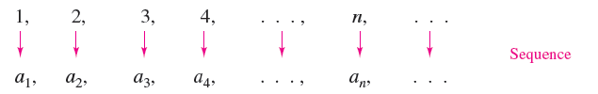
Sequences
A sequence is defined as a function whose domain is the set of positive integers. Although a sequence is a function, it is common to represent sequences by subscript notation rather than by the standard function notation. For instance, in the sequence
1 is mapped onto a₁, 2 is mapped onto a₂, and so on. The numbers a₁, a₂, a₃, . . ., a_{n}, . . . are the terms of the sequence. The number a_{n} is the nth term of the sequence, and the entire sequence is denoted by {a_{n}}.

Slide 6
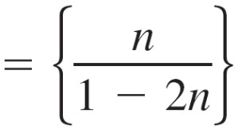
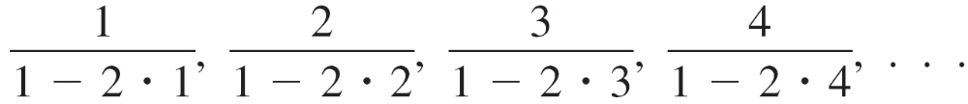
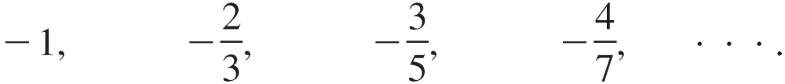
Example 1 – Writing Terms of a Sequence
a. The terms of the sequence {a_{n}} = {3 + (–1)^{n}} are
3 + (–1)¹, 3 + (–1)², 3 + (–1)³, 3 + (–1)⁴, . . .
2, 4, 2, 4, . . . .
b. The terms of the sequence {b_{n}} are

Slide 7
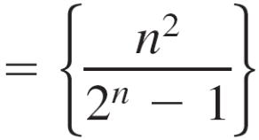
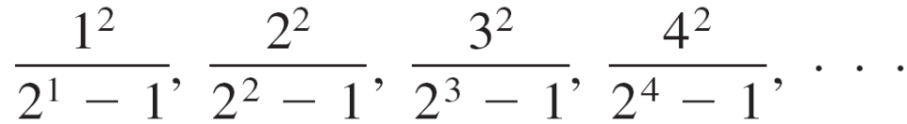
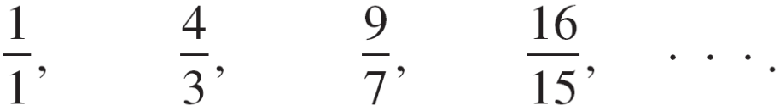
Example 1 – Writing Terms of a Sequence
cont’d
c. The terms of the sequence {c_{n}} are
d. The terms of the recursively defined sequence {d_{n}}, where d₁ = 25 and d_{n + 1} = d_{n} – 5, are
25, 25 – 5 = 20, 20 – 5 = 15, 15 – 5 = 10,. . . .

Slide 8
Limit of a Sequence

Slide 9
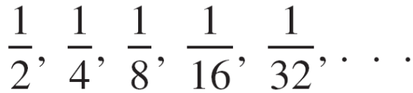
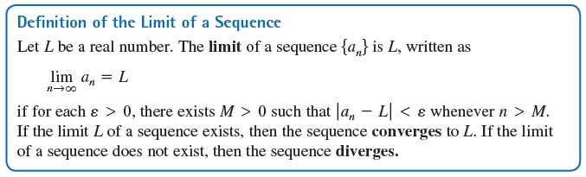
Limit of a Sequence
Sequences whose terms approach limiting values. Such sequences are said to converge. For instance, the sequence {1/2^{n}}
converges to 0, as indicated in the following definition.

Slide 10
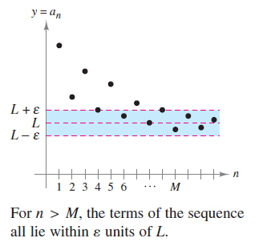

Limit of a Sequence
Graphically, this definition says that eventually
(for n > M and ε > 0), the terms of a sequence that
converges to L will lie within the band between the lines
y = L + ε and y = L – ε, as shown in Figure 8.1.
If a sequence {a_{n}} agrees with a
function f at every positive integer,
and if f(x) approaches a limit L as
then the sequence must
converge to the same limit L.
Figure 8.1

Slide 11
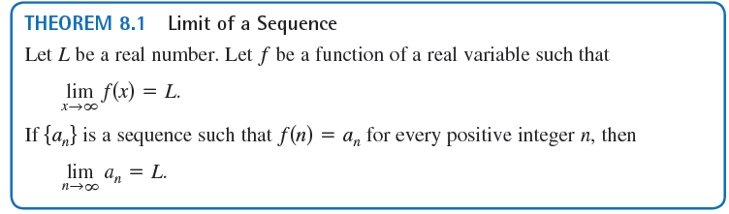
Limit of a Sequence

Slide 12



Example 2 – Finding the Limit of a Sequence
Find the limit of the sequence whose nth term is
Solution:
You learned that
So, you can apply Theorem 8.1 to conclude that

Slide 13

Limit of a Sequence
There are different ways in which a sequence can fail to have a limit.
One way is that the terms of the sequence increase without bound or decrease without bound.
These cases are written symbolically, as shown below.

Slide 14
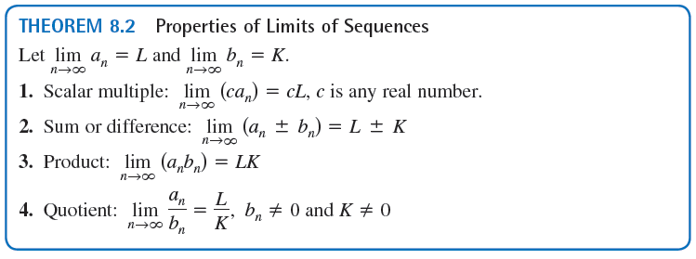
Limit of a Sequence

Slide 15
Limit of a Sequence
The symbol n! (read “n factorial”) is used to simplify some of these formulas. Let n be a positive integer; then n factorial is defined as
n! = 1 • 2 • 3 • 4 . . . (n – 1) • n.
As a special case, zero factorial is defined as 0! = 1.
From this definition, you can see that 1! = 1, 2! = 1 • 2 = 2, 3! = 1 • 2 • 3 = 6, and so on.

Slide 16
Limit of a Sequence
Factorials follow the same conventions for order of operations as exponents. That is, just as 2x³ and (2x)³ imply different order of operations, 2n! and (2n)! imply the orders
2n! = 2(n!) = 2(1 • 2 • 3 • 4 • • • n)
and
(2n)! = 1 • 2 • 3 • 4 • • • n • (n + 1) • • • 2n
respectively.

Slide 17
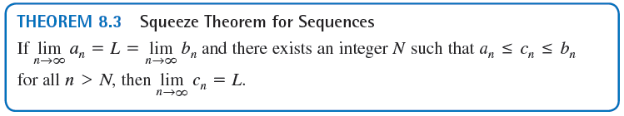
Limit of a Sequence
Another useful limit theorem that can be rewritten for sequence is the Squeeze Theorem.

Slide 18
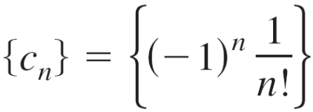
Example 5 – Using the Squeeze Theorem
Show that the sequence converges, and find its limit.
Solution:
To apply the Squeeze Theorem, you must find two convergent sequences that can be related to .
Two possibilities are a_{n} = –1/2^{n} and b_{n} = 1/2^{n}, both of which converge to 0.

Slide 19


Example 5 – Solution
cont’d
By comparing the term n! with 2^{n}, you can see that,
and

Slide 20
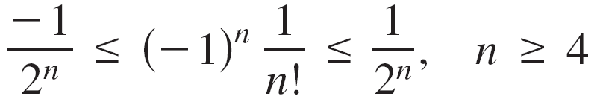
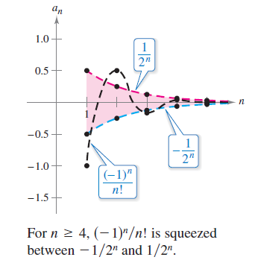
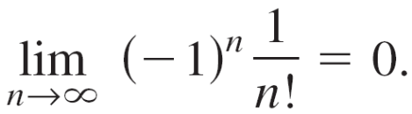
Example 5 – Solution
cont’d
This implies that for n ≥ 4, 2^{n} < n!, and you have
as shown in Figure 8.2.
So, by the Squeeze Theorem
it follows that
Figure 8.2

Slide 21
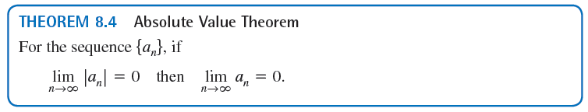
Limit of a Sequence

Slide 22
Pattern Recognition for Sequences

Slide 23
Pattern Recognition for Sequences
Sometimes the terms of a sequence are generated by some rule that does not explicitly identify the nth term of the sequence.
In such cases, you may be required to discover a pattern in the sequence and to describe the nth term.
Once the nth term has been specified, you can investigate the convergence or divergence of the sequence.

Slide 24
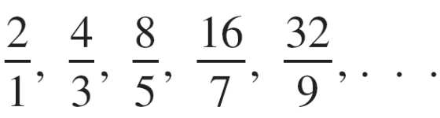
Example 6 – Finding the nth Term of a Sequence
Find a sequence {a_{n}} whose first five terms are
and then determine whether the particular sequence you have chosen converges or diverges.

Slide 25

Example 6 – Solution
First, note that the numerators are successive powers of 2, and the denominators form the sequence of positive odd integers.
By comparing a_{n} with n, you have the following pattern.

Slide 26


Example 6 – Solution
cont’d
Consider the function of a real variable f(x) = 2^{x}/(2x – 1). Applying L'Hôpital's Rule produces
Next, apply Theorem 8.1 to conclude that
So, the sequence diverges.

Slide 27
Pattern Recognition for Sequences
Without a specific rule for generating the terms of a sequence or some knowledge of the context in which the terms of the sequence are obtained, it is not possible to determine the convergence or divergence of the sequence merely from its first several terms.
For instance, although the first three terms of the following four sequences are identical, the first two sequences converge to 0, the third sequence converges to 19, and the fourth sequence diverges.

Slide 28
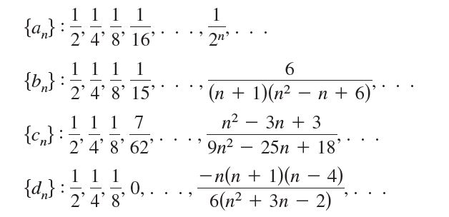
Pattern Recognition for Sequences
The process of determining an nth term from the pattern observed in the first several terms of a sequence is an example of inductive reasoning.

Slide 29
Monotonic Sequences and Bounded Sequences

Slide 30
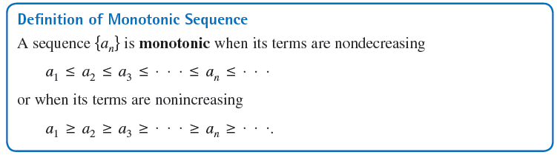
Monotonic Sequences and Bounded Sequences

Slide 31
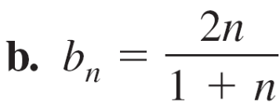
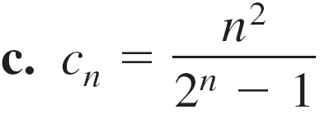

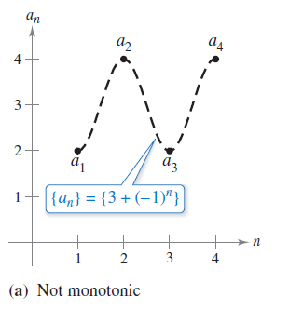
Example 8 – Determining Whether a Sequence Is Monotonic
Determine whether each sequence having the given nth term is monotonic.
Solution:
a. This sequence alternates between
2 and 4.
So, it is not monotonic.
Figure 8.3(a)

Slide 32
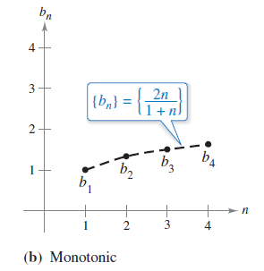
Example 8 – Solution
cont’d
b. This sequence is monotonic because each successive
term is larger than its predecessor.
To see this, compare the terms b_{n} and b_{n + 1}.
[Note that, because n is positive,
you can multiply each side of the
inequality by (1 + n) and (2 + n)
without reversing the inequality sign.]
Figure 8.3(b)

Slide 33
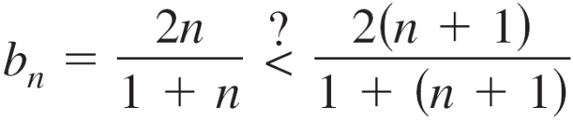




Example 8 – Solution
cont’d
Starting with the final inequality, which is valid, you can reverse the steps to conclude that the original inequality is also valid.

Slide 34
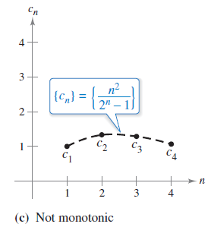
Example 8 – Solution
cont’d
c. This sequence is not monotonic, because the second
term is greater than the first term, and greater than the
third.
(Note that if you drop the first term,
the remaining sequence c₂, c₃, c₄, . . .
is monotonic.)
Figure 8.3(c)

Slide 35
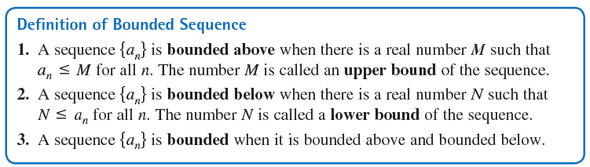
Monotonic Sequences and Bounded Sequences

Slide 36
Monotonic Sequences and Bounded Sequences
One important property of the real numbers is that they are complete. Informally this means that there are no holes or gaps on the real number line. (The set of rational numbers does not have the completeness property.)
The completeness axiom for real numbers can be used to conclude that if a sequence has an upper bound, then it must have a least upper bound (an upper bound that is less than all other upper bounds for the sequence).

Slide 37
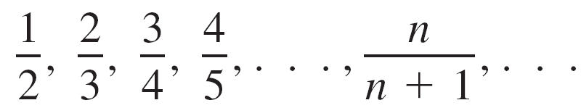
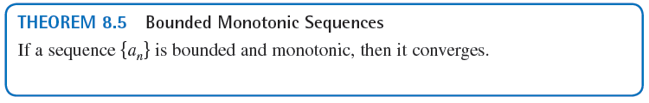
Monotonic Sequences and Bounded Sequences
For example, the least upper bound of the sequence
{a_{n}} = {n/(n + 1)},
is 1.

Slide 38
Example 9 – Bounded and Monotonic Sequences
a. The sequence {a_{n}} = {1/n} is both bounded and
monotonic and so, by Theorem 8.5, must converge.
b. The divergent sequence {b_{n}} = {n²/(n + 1)} is monotonic,
but not bounded. (It is bounded below.)
c. The divergent sequence {c_{n}} = {(–1)^{n}} is bounded, but
not monotonic.

