Slide 1
Chapter 9.1
Infinite Series

Slide 2
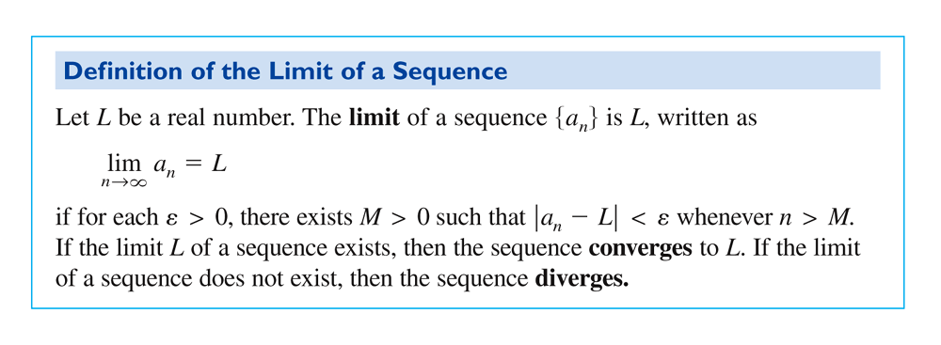
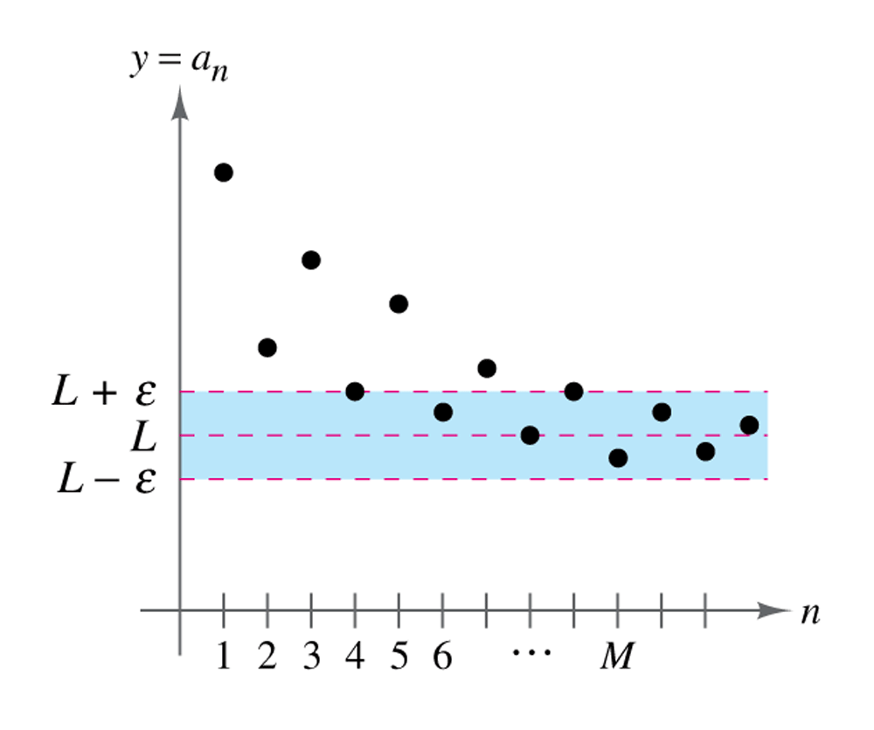
Definition of the Limit of a Sequence and Figure 9.1

Slide 3
Theorem 9.1 Limit of a Sequence

Slide 4
Theorem 9.2 Properties of Limits of Sequences

Slide 5
Theorem 9.3 Squeeze Theorem for Sequences

Slide 6
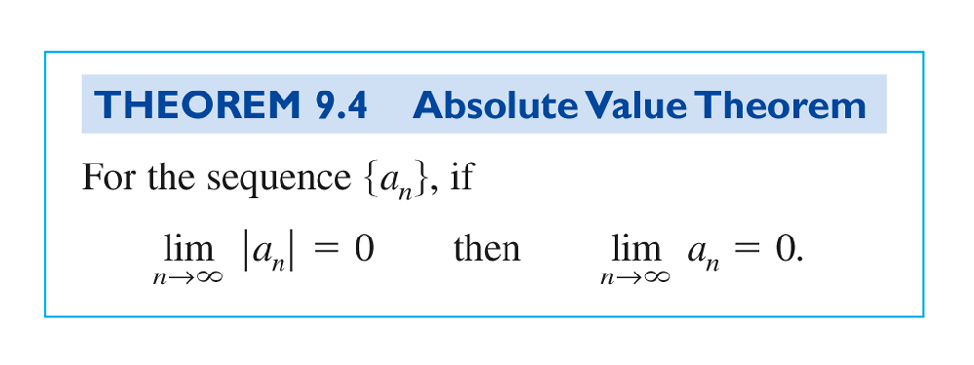
Theorem 9.4 Absolute Value Theorem

Slide 7
Definition of a Monotonic Sequence

Slide 8
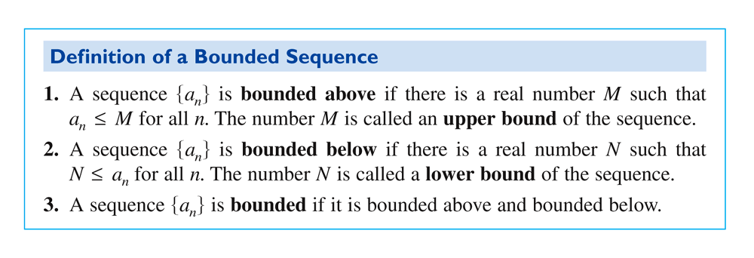
Definition of a Bounded Sequence

Slide 9
Theorem 9.5 Bounded Monotonic Sequences

